Slide 1
ODE Update on Educator Effectiveness
Oregon Department of Education
COSA Law Conference 2015
Notes:
Presenter 1

Slide 2
Warm Up
The median is the middle number in a sequence of numbers
On your table is a list of Student Growth Percentiles from Mr. Hendrick’s class
Identify the median score from his class list and circle it
Notes:
Presenter 1
What was the median score of the class? 51
The process you just engaged in is, in a nutshell, what is required to find a median SGP. The intention behind this activity is to illustrate that determining the median SGP is not a complex process.

Slide 3
Norms
Share your expertise
Equity of voice
Active listening
Respect for all perspectives
Self-monitor use of technology
Safety and confidentiality
Notes:
Presenter 1
Before we get started today, let’s spend a few minutes talking about how we’ll function and interact with each other today. This slide has a list of norms. Can we all accept these agreements? Are there any not listed here that need to be added?

Slide 4
Connector
On an index card please complete the following sentence stem
“One of the most important learnings that I hope to take away today is…”
Notes:
Presenter 1
Before we dive into SGPs, please take a moment individually to write a response to the prompt on this slide. This will help ensure that by the end of this session we’ve met the needs of everyone who is attending.

Slide 5

Give One, Get One!
Turn to a neighbor
Introduce yourself to a colleague
(name, position & district)
Share the information on your card
Share out
Notes:
Presenter 1
Please take the index card that you completed and introduce yourself to someone nearby. Take turns sharing the thoughts on your card, and then turn the other direction, find a new partner and repeat the process.
BEFORE TRANSITIONING TO NEXT SLIDE TAKE A FEW MOMENTS TO ASK FOR VOLUNTEERS TO SHARE OUT WHAT SOME OF THE DESIRED LEARNING ARE
Chart important learnings

Slide 6
Outcomes for Today
ESEA Waiver Update
Review SLG Goal process and requirements
Clarify the connection between SGPs and SLGs for the 2015-16 SY
Notes:
Presenter 1
During our time together today our goal is twofold:
First to increase everyone’s knowledge about Student Growth percentiles – what they are and how they are determined, as well as how SGPs are incorporated into educator evaluations through Median SGPs. As part of our session today we are going to engage in a simulation with a fictitious teacher, Mr. Hendricks, and the students in his class and you’ll get the opportunity to work with some data.
Our second goal is to clarify the role of SGPs in the goal setting and evaluation process for this school year.

Slide 7
ESEA Waiver Requirement
Teachers in tested grades and subjects (Grades 4-8 ELA/Math) and principals must use state assessments as one measure of student learning and growth (SLG) in their evaluation
Oregon educators set two SLG goals annually; Category 1 goals are measured by state assessment; Category 2 goals are measured by other assessments
Teachers in tested grades and subjects & Principals
Category 1 SLG goal
Category 2 SLG goal
Teachers in non-tested grades and subjects
Category 2 SLG goal
Category 2 SLG goal
ELA/Math
Grades 4-8
Notes:
Presenter 1
As you know, the waiver requires the use of statewide assessments as a measure of SLG goal attainment for teachers and principals in tested grades and subjects for one of the two goals set.
In October of 2014, Oregon’s waiver was conditionally approved with the question remaining of how statewide assessments would be used consistently in evaluations across the state.

Slide 8
ESEA Waiver Update
Oregon’s waiver approved for 3 years with conditions removed
For evaluation purposes statewide assessments will only be used as a measure of SLG goal attainment for those grades that have baseline data
Tested grades and subjects are now ELA and Math 4-8
Notes:
Presenter 1
Oregon’s waiver was approved on July 23rd with all conditions removed. In that waiver Oregon indicated that it will only be using the statewide assessment for those grades in which baseline data is available. This means that tested grades and subjects are now grades 4-8. Grades 3 and 11 no longer required.

Slide 9
Request to USED for 2015-16
ODE has requested a modification to the waiver
Districts will determine MSGPs, but not incorporate them in educator summative evaluations for SY 2015-2016
Districts required to provide SGP training to staff
ODE recommends that all educators set two goals that use Category 2 measures
Notes:
Presenter 1
As you are no doubt aware, HB 2680 in the last session generated some question as to whether SGPs would be used this year since they will rely on using Smarter data from 2015 as the baseline for determining growth. A letter went out to superintendent’s on September 17th from Paula Radich our interim associate superintendent explaining a request that we have made to the USED in regard to our waiver.
The request is that for the 2015-16 SY all districts would put practices and procedures in place for SGPs and determine MSGPs for educators to whom they apply, but not use them for the purposes of evaluation. We have not yet received a response to our request from USED and will update the field as soon as we have an answer
In the meantime ODE is recommending that all educators set 2 Category 2 goals. This will ensure that regardless of whether SGPs are in play this year everyone will have two goals.

Slide 10
What is a Student Growth Percentile?
Student Growth Percentiles (SGPs) measure growth for individual students by comparing the improvement in his or her achievement on Smarter Balanced to that of his or her “academic peers” (i.e. those who have similar historical assessment results).
Notes:
Presenter 1
So what are Student Growth Percentiles? They are a measure of growth for individual students by comparing their improvement in achievement on the statewide assessment with his or her academic peers. This comparison group is defined solely on their state assessment scores, not on any other characteristics.
It is not unlike taking your child to the doctor. When a child goes to the doctor’s office, his weight and height are measured. The doctor can tell us if the child’s growth in the last year is “typical”, that is: is he growing the same, less, or more than other children his age?

Slide 11
What is a Median Student Growth Percentile?
Median Student Growth Percentile
represents the exact middle of the Student Growth Percentile scores for the educator’s students. In other words, half of the educator’s students performed above or below the median score.
Notes:
Presenter 1
In the context of evaluation, individual Student Growth Percentiles are compiled into a list that represents a teacher’s roster. Once lined up in order from smallest growth to highest growth the exact middle score, or median, is identified. This represents the educator’s Median SPG.
Why was the MEDIAN selected? For the purposes of growth, using the median rather than the average, is more appropriate because an average can be influenced greatly by a few very high or very low scores.

Slide 12
Impact of Class Size on SGPs
Districts are required to use Median Student Growth Percentiles for educators who have at least 20 students
Teachers and principals in grades 4-8 (ELA and math only) who fall below 20 students must use other measures that are valid, reliable, and comparable across the school or district (Category 2 measures)
Notes:
Presenter 1
An “N” size of 20 required before SGPs can be used. This means there have to be at least 20 students with individual growth scores before a median would be calculated. For those educators who do not reach this number, SGPs would not be used and instead 2 goals would be written using Category 2 measures.
Any teacher or principal whose roster is less than 20 students would set both goals using Category 2 measures. In the future, districts are encouraged to pool data across three years to strengthen the results and allow for the inclusion of more educators who do not meet the minimum n size of 20 students in a single summative evaluation year.

Slide 13
Two Options; Districts Choose
Option A:
State Assigned SGPs
Option B:
Verify SLG Goal
This option does not require educators to set a Category 1 SLG goal
Student Growth Percentiles (SGPs) are used exclusively to determine the Category 1 SLG rating
This option requires educators to set Category 1 SLG goals using Smarter Balanced and rate their goals using the SLG scoring rubric
The SLG goal rating is compared with the educator’s median SGP rating to determine the Category 1 SLG rating
Notes:
Presenter 1
Oregon’s approved waiver involves the use of median Student Growth Percentiles (SPGs) to fulfill the requirement of using state assessments in tested grades and subjects. SGPs measure growth for an individual student by comparing the change in his or her achievement on state assessments (Smarter Balanced) to that of his or her “academic peers” (those having similar historical assessment results). Districts have two options to choose from, but both include the use of SGPs.
In Option A educators are provided with a median SGP which is used as a the SLG score for that goal. In Option B, educators set and score a goal using Smarter Balanced and the state scoring rubric and then compare that score to their median SGP to determine the final score for the SLG.

Slide 14
Timeline and Responsibilities
2015-16 SY | ODE RESPONSIBILITIES | DISTRICT RESPONSIBILITIES
Fall 2015 | Provide districts state criteria for determining Median Student Growth Percentiles (see Table 3 on page 5 in this guidance). Provide districts with communications and guidance. | Select Option A or Option B to be used district-wide. Establish a process for determining the teacher of record. Create class rosters and establish a roster verification process.
2015-16 School Year | Provide districts with professional development and technical support. | Provide training in the district to educators, evaluators, and coordinating staff.
February - June 2016 | Administer Smarter Balanced Assessment | Administer Smarter Balanced Assessment Educators verify class rosters.
Summer 2016 | Calculate Student Growth Percentiles for all students. Send districts Student Growth Percentiles and Smarter Balanced achievement data in August. | Receive Student Growth Percentiles and Smarter Balanced results from ODE.
Fall 2016 | Provide guidance and support to districts. | Determine the Median Student Growth Percentile ratings using the state criteria. Incorporate median Student Growth Percentile ratings into educator summative evaluations.
Notes:
Presenter 1
Both ODE and districts have responsibilities related to SGPs. This slide outlines the timeline for the 2015-16 SY and the various roles and responsibilities related to SGPs.

Slide 15
Student Growth Percentiles
(SGPs)
Normative growth measure
One year of growth
Growth is relative to students with a similar score history
Notes:
Presenter 2
SGPs are a normative measure of student growth. SGPs quantify the growth an individual student made in one year relative to all other students in Oregon with similar score history in state assessments.
The slides we are going share in this next section are from a presentation created by OSPI in Washington

Slide 16

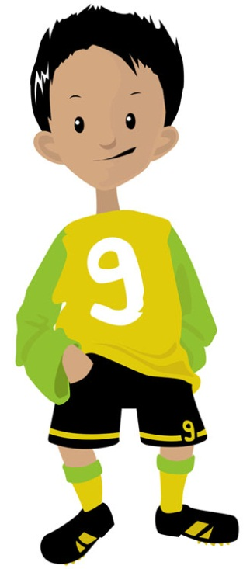
What do we mean by normative growth?
Notes:
Presenter 2
What do we mean by normative growth? We are referring to the amount of growth a child makes in comparison to his or her peers. For instance, when a child goes to the doctor’s office, his weight and height are measured. The doctor can tell us if the child’s growth in the last year is “typical”, that is: is he growing the same, less, or more than other children his age?

Slide 17
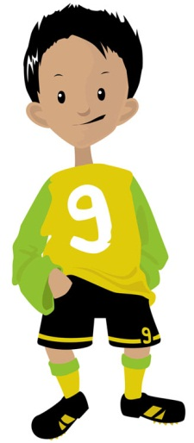
Percentiles
35%
65%
35th
Notes:
Presenter 2
Often this is expressed in percentile terms. The child’s height may be at the 35th percentile which means that the child is taller than 35 percent of other children his age and shorter than 65 percent of children his age. Normative growth is the basis for student growth percentiles.

Slide 18

Anthony
3rd Grade
2262
4th Grade
2398
Level 1
Level 2
Notes:
Presenter 2
Let’s look at an example. Anthony was a 4th grade student last year. On his Smarter Balanced assessment in the spring, he scored a 2398. In the previous year, his 3rd grade score was 2262. There appears to be “growth” in that his score improved…but relative to what? How do we place Anthony’s growth in context?

Slide 19
2398
- 2262
136 points
Notes:
Presenter 2
We want to understand how Anthony has improved. To do this we cannot simply subtract his 3rd grade score from his 4th grade score because Oregon state assessments is not vertically scaled, that is they do not combine to form one long yard stick from year to year so we cannot say he grew by XX points.

Slide 20
Anthony’s Comparison Group
Notes:
Presenter 2
Instead we attempt to define “above” and “below” average growth by placing Anthony’s growth in the context of a comparison group.

Slide 21

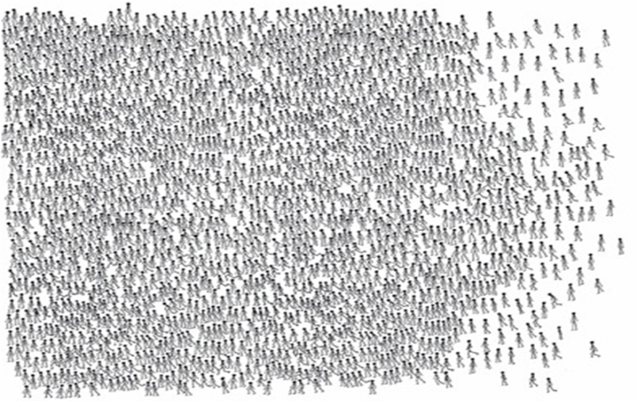

Level 2
Level 3
Level 1
Level 4
All 3rd grade test takers in
Oregon
…with Anthony’s Prior Score ~2262
Anthony
Notes:
Presenter 2
When Anthony was in 3rd grade, he scored a 2262. Many other 3rd graders in Oregon took the same state test in reading. Anthony was just one student among them. Of all these 3rd graders in the state many others scored a 2262….

Slide 22

4th Grade Score Distribution
Level 2
Level 3
Level 1
Level 4
Middle score
High score
Anthony’s Comparison Group
Anthony’s prior
score ~2262
Notes:
Presenter 2
Here we can see the distribution of 4th grade test scores for Anthony’s comparison group. You can see that this is an overall lower performing subgroup of students relative to the statewide distribution
***
The highest scoring student met standard but
***
the middle score of Anthony’s Comparison Group is on the border of “Level 1” and “Level 2”.

Slide 23

4th Grade Score Distribution
80% of students in Anthony’s comparison group scored below him
Level 2
Level 3
Level 1
Level 4
2398
Anthony’s Comparison Group
Notes:
Presenter 2
Recall that this year Anthony scored 2398. Although Anthony is “Below Standard” in the state distribution, he is definitely above the middle score within his comparison group. Analyzing the data more closely, we can see that Anthony scored higher than 80 percent of students in his comparison group.

Slide 24
4th Grade Score Distribution
Level 2
Level 3
Level 1
SGP = 80
Level 4
Anthony’s Comparison Group
Notes:
Presenter 2
This translates to a Student Growth Percentile (or SGP) of 80.
- 2 slow clicks –

Slide 25
What do we need to do this year?
Goal Setting
Goal Scoring
Summative Evaluations
Notes:
Presenter 2
We know that the use of SGPs is going to require changes for districts. Districts can think of goal setting in terms of the two groups you see on this slide. It is important to keep in mind that SGPs only apply to teachers and principals in grades 4- 8 and math. This likely represents less than 30% of the teachers in the district.
As we talk through these next few slides we hope you see that all of what you have been doing still applies, with some modifications for staff to whom SGPs apply.

Slide 26
SLG Requirements for 2015-16
REQUIRED
8 components including Rationale
Minimum of 2 SLG goals each year
*Statewide assessments (Category 1) required for teachers and principals in tested grades and subjects
Oregon Matrix used for summative evaluation
*Pending review of HB 2680
RECOMMENDED
Content is focused, not everything you teach
Context can help ascertain instructional needs
Tier goals/targets where appropriate
Include the support YOU need
Notes:
Presenter 2
Even though ESEA waiver has been approved, we are now waiting on determinations from state level leadership on whether HB suspends the use of statewide assessments for the upcoming school year.

Slide 27
How do SGPs change the goal setting and scoring processes?
Teachers and principals in grades 4- 8 in ELA and math
All other educators
Notes:
Presenter 2
We know that the use of SGPs is going to require changes for districts. Districts can think of goal setting in terms of the two groups you see on this slide. It is important to keep in mind that SGPs only apply to teachers and principals in grades 4- 8 and math. This likely represents less than 30% of the teachers in the district.
As we talk through these next few slides we hope you see that all of what you have been doing still applies, with some modifications for staff to whom SGPs apply.

Slide 28
Teachers and Principals in Grades 4 – 8 ELA and Math
Minimum of 2 SLG goals each year
Quality Review Checklist used for goal setting
One goal must use Category 1 measure (Smarter)
Method for scoring Category 1 goal depends on whether the district uses Option A or Option B
Second goal can use either Category 1 or Category 2 measures
Category 2 goals scored using the statewide SLG Scoring Rubric
Oregon Matrix used to identify summative scores
Notes:
Presenter 2
You’ll notice that the text on this slide is only differs in two ways:
First, teachers and principals in tested grades and subjects must use the statewide assessment as the measure for one of their goals. Their second goal can be either a Category 1 or a Category 2 measure. The other difference is in how the Category 1 goal is scored. That depends on whether the district chooses Option A or Option B which we will discuss a little later. In either case, SGPs are used as the method for making the final determination.

Slide 29
All Other Educators
Minimum of 2 SLG goals each year
Quality Review Checklist used for goal setting
Goals can use either:
Category 1 (statewide assessments) OR
Category 2 (school or district-wide assessments) measures
Goals scored using the statewide SLG Scoring Rubric
Oregon Matrix used to identify summative scores
Notes:
Presenter 2
Let’s start by talking about the majority of educators in your district. For those educators who are not in tested grades and subjects, the goal setting and scoring process will not change. They will still set two SLG goals, they can choose whether to use Category 1 or category 2 assessments as the measure and score them using the statewide SLG Scoring Rubric.
As with all educators, the Matrix is used to determine the final summative rating.

Slide 30
Quality Review Checklist
Takes place during the goal setting phase of the professional growth cycle for teachers and administrators
For an SLG goal to be approved, all criteria must be met
Version with guiding questions available in SLG section of toolkit
www.ode.state.or.us/search/page/?id=3836
Notes:
Presenter 2
The checklist is used early in the professional growth cycle. As part of the goal setting process, teachers and administrators should use the goal setting checklist when sharing their goals with their evaluator. The checklist includes questions in three categories to help the educator and evaluator collaboratively determine the quality of the goal: Baseline Data, Targets, and Rigor. If the answers to all the questions in the checklist are “YES”, then the goal can be approved.

Slide 31
Scoring SLG Goals
Category 2 goals scored using State SLG Scoring Rubric
Category 1 goal for tested grades and subjects must use SGPs (compared to Cat. 1 rating from scoring rubric, if district chooses Option B)
Regardless of “on cycle” or “off cycle” year, all teachers and administrators set and score two goals every year
Notes:
Presenter 2

Slide 32
Your Turn!
Use the data packet provided to:
Calculate Mr. Hendrick’s Y-axis rating
Determine Mr. Hendrick’s median SGP
Use the “State Median Student Growth Percentile Criteria” (p.5 of SGP Guidance, Table 3)
Calculate Mr. Hendrick’s X-axis rating
Share Out
Notes:
Presenter 2
Based on your review of the data, what is Mr. Hendricks’:
Y axis rating? = 3 (2.82)
Median SGP? = 3
X axis rating? =2
Summative rating? = 3

Slide 33
*Inquiry Process
Notes:
The matrix is a decision-making tool. It is the instrument that bring two inputs (PP/PR and SLG) together to help you make a decision for the final performance level you need to report. Districts use the thresholds established by ODE to determine the rating for each axis. The Y axis represents overall performance related to Professional practice and responsibility and the X axis represents overall performance related to student learning and growth.
It is important to note that the matrix is not a uniform percent model, and that by design the Y axis has more influence on the overall score (summative rating) than the X axis. For example, if you score a 3 on the Y-axis (PP/PR) and a 2 on the X-axis (SLG), the matrix shows that you’re still a 3 overall.
The purpose of the summative performance level is two fold. One, it provides ODE with required information that must be reported to USED regarding the number teachers and administrators in Oregon at each of four levels of performance. Each district reports these numbers to ODE which in turn reports statewide results to USED.
The second purpose is to provide districts with a process to determine the design of professional growth paths for teachers and administrators.

Slide 34
Things to Keep in Mind…
Districts with contract teachers on a two year cycle MAY select two of the four goals from the cycle
Decisions about probationary teachers do not have to be based on SLG goal scores
Tested grades and subjects must use one Cat.1 goal rating in summative evaluation (Matrix)
Adjusting evaluation cycle
Fall to Fall
Spring to Spring
Notes:
Presenter 2
Refer to p.9-10 of SGP guidance to view options of the evaluation cycles

Slide 35
Resources
ODE Webpage for SGPs has been added to the EE Toolkit
PowerPoints tailored to Option A/Option B
ESD Regional Workshops
Contact your ESD to find out when a regional training might be available in your area
Notes:
All
The letter that was just mentioned in addition to a guidance document, FAQ and brief video are all posted on a new SGP page in the toolkit.
The EE team is working with ESDs to schedule professional learning opportunities that go more in depth around SGPs as well as other PD opportunities related to evaluation and support systems.
There’s a SGP module posted up on the SGP page that goes much further in depth on the ins and outs of SGPs.

Slide 36

Remaining questions?
Notes:
All
Revisit chart of important learnings to close the loop on remaining questions

Slide 37
ODE Contacts
Educator Effectiveness Team:
Tanya Frisendahl tanya.frisendahl@state.or.us
Sarah Martin sarah.martin@state.or.us
Sarah Phillips sarah.phillips@state.or.us
Brian Putnam brian.putnam@state.or.us

