Slide 1
NEW Oregon IEP: Identifying Changes and Useful Tools
Laura Petschauer
November 13, 2015

Slide 2
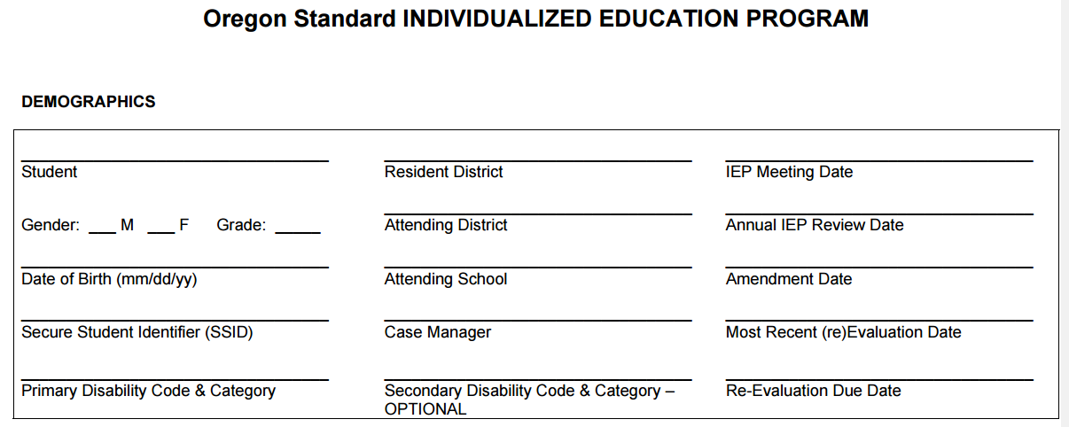
DEMOGRAPHICS
Notes:
SAY:
The demographics page varies from district to district - some may have additional information.
Next slide identifies the changes.

Slide 3
DEMOGRAPHICS
CHANGES:
Additional line for secondary disability
Word changes to include “Resident District”
Additional line for “Most Recent (re)Evaluation

Slide 4
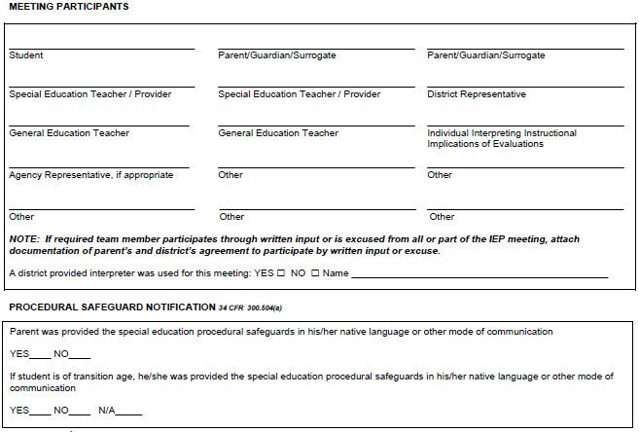
MEETING PARTICIPANTS
Notes:
SAY:
Additional lines were added for Parent, Special Education Teacher/Provider, and General Education Teacher.
Additional sections to document “district provided interpreter” and providing procedural safeguards. Remember, the interpreter is not a team member, the individual is providing a service and not making decisions.

Slide 5
MEETING PARTICIPANTS
CHANGES:
Additional lines for participants (SPED, GE)
Additional section to document interpreter, if needed
Additional section to document the Procedural Safeguards booklet was provided to parent and/or adult student

Slide 6
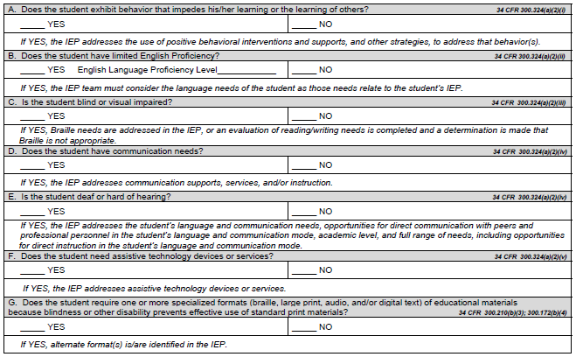
SPECIAL FACTORS
Notes:
SAY:
There was a change with the order that the special factors were listed.
English Language Proficiency Level is required.
Additional special factor to consider is the consideration for “accessible instructional materials”.

Slide 7
SPECIAL FACTORS
CHANGES:
Reorder of the list of Special Factors
Additional information required for English Proficiency - need to include English Language Proficiency Level
Additional “Special Factor” to consider - Accessible Instructional Materials (AIM)

Slide 8
SPECIAL FACTORS
Behavior
English Proficiency
Blind/Visually Impaired
Communication
Deaf/Hard of Hearing
Assistive Technology
AIM - Specialized Formats (NEW)

Slide 9
SPECIAL FACTORS
AIM - Accessible Instructional Materials
Specialized formats of educational materials
Braille
Large Print
Digital
Audio
Designed for students who are unable to read and/or access standard print materials
Content does NOT change, only the format

Slide 10
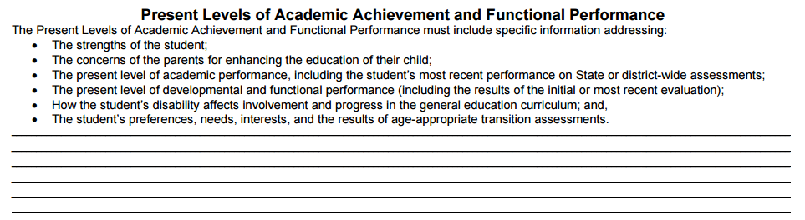
PRESENT LEVELS - PREVIOUS
This is how we typically think about the PLAAFP...
Notes:
SAY:
This was the previous format of the Present Levels. We have been trained to think about it as a list of bullets.

Slide 11
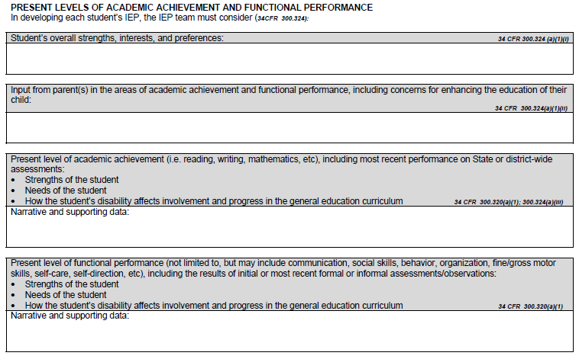
PRESENT LEVELS - NEW
Notes:
SAY:
This is the new format of the Present Levels.

Slide 12
PRESENT LEVELS
CHANGES:
Expanded statement for parent input
For both academic and functional performance, teams will identify:
Student strengths
Student needs
Disability impact statement
Present level includes narrative and supporting data
Notes:
Explain the changes.

Slide 13
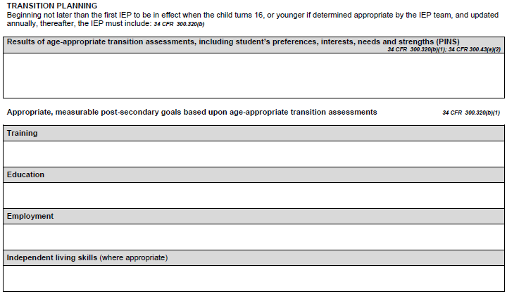
TRANSITION PLANNING

Slide 14
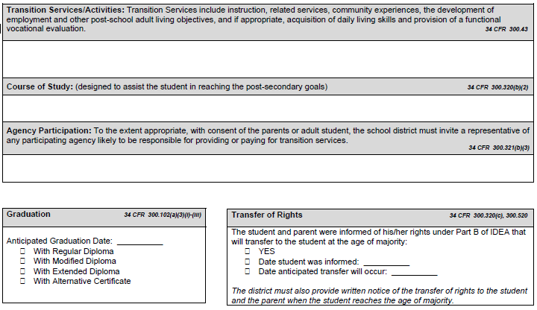
TRANSITION PLANNING

Slide 15
TRANSITION PLANNING
CHANGES:
Two pages within the one IEP document; no longer two IEP forms
Separate boxes for Post Secondary Goals – must consider all four areas (Education, Training, Employment and if appropriate, Independent Living)
Separate box for Transition Services/Activities

Slide 16
TRANSITION PLANNING
Eight Components of a Transition IEP:
Student Invited
Age Appropriate Transition Assessment
PINS - Preferences, Interests, Needs & Strengths
Post-Secondary Goals - Education, Training, Employment, & when appropriate, Independent Living
Transition Services
Course of Study
Participating Adult Agency
Annual Goals

Slide 17
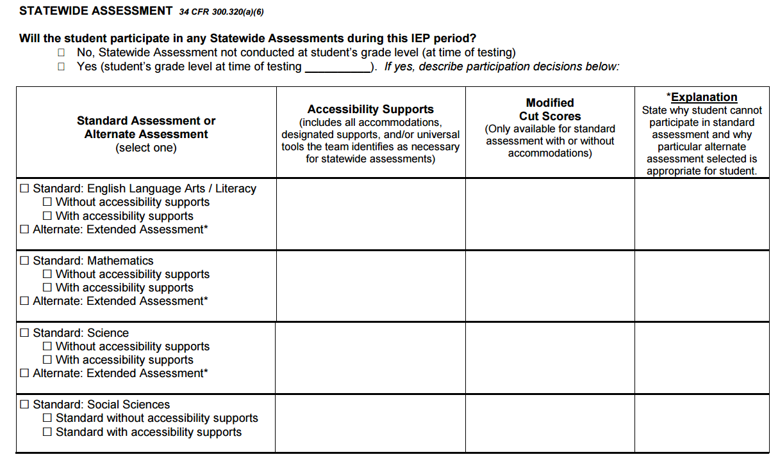
ASSESSMENT
Notes:
Point out changes (modified cut scores, Accessibility supports language, with or without accommodations)
An IEP team CANNOT exempt a student from taking the statewide assessment even if the parent is requesting for his/her child to not participate in statewide assessment. The IEP team must make the decision between taking the standard or alternate, and identify accessibility supports for each assessment.

Slide 18
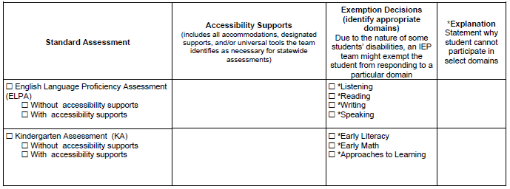
ASSESSMENT
Notes:
Point out changes (Accessibility supports language, with or without accommodations, exemption decisions)
An IEP team CANNOT exempt a student from taking the statewide assessment even if the parent is requesting for his/her child to not participate in statewide assessment. The IEP team must make the decision between taking the standard or alternate, and identify accessibility supports for each assessment.

Slide 19
ASSESSMENT
CHANGES:
All assessments included
Check one of the other – “with” or “without” accessibility supports for each assessment
Modified Cut Score included
Exemption of domains for ELPA and KA included with explanation
Notes:
An IEP team cannot exempt a student from participating in all domains for ELPA and the student must participate in at least one. As for KA, the domain “Approached to Learning” is a rating scale and all students can have one completed by the teacher/evaluator.

Slide 20
ASSESSMENT
Requirements for districts:
All accessibility supports are accommodations under IDEA
Since Universal Tools are available to all students, only document on the IEP, if a tool must be “turned off” to avoid distraction during testing
Designated Supports and Accommodations must be documented on the IEP
If a student receives an accommodation on the statewide assessment, it should also be an accommodation he/she receives during instruction

Slide 21

ASSESSMENT
Standard vs. Alternate Assessment?
Guidance
Checklist
Flowchart
http://www.ode.state.or.us/search/results/?id=178
Notes:
New guidance and tools are available.
TOOLS:
Decision making Guidance
Decision making Checklist
Decision making Flowchart

Slide 22
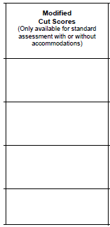
ASSESSMENT
Modified Cut Scores:
An IEP team may determine an alternate score on the statewide assessment for GRADUATION PURPOSES ONLY
This is an INDIVIDUAL score, and should be based on a review of student data and present levels of performance
Teams may change this score at any point
Modified cut scores may NOT be used for Essential Skills for a standard diploma (only modified diploma)

Slide 23
GOAL WRITING
Measurable Annual Goal
must stand alone without assistance of short-term objectives
Measurable Short-Term Objective
incremental steps toward the annual goal
must be identified for students taking the alternate assessment
Notes:
Group discussion, take a minute, then share out.
We have looked at many IEP goals and we haven’t seen much of a difference between them. Also, we see IEPs that are written the the objective being more measurable than the overall goal.
BENCHMARKS
OAR 581-015-2000(34): Short Term-objectives means measureable intermediate performance steps that will enable parents, students and educators to gage, at intermediate times during the year how well the child is progressing toward the annual goals by either:
Breaking down the skills described in the goal into discrete components, or
Describing the amount of progress the child is expected to make within specified segments of the year
What do you do in your district? Do you write objectives for all goals?

Slide 24
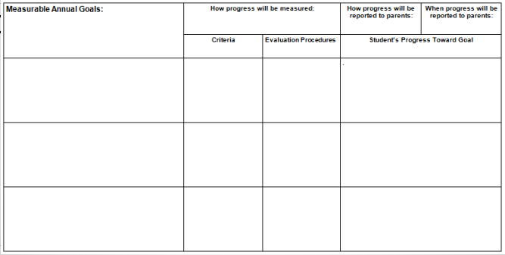
GOAL WRITING - PREVIOUS
Notes:
Group discussion, take a minute, then share out.
We have looked at many IEP goals and we haven’t seen much of a difference between them. Also, we see IEPs that are written the the objective being more measurable than the overall goal.
BENCHMARKS
OAR 581-015-2000(34): Short Term-objectives means measureable intermediate performance steps that will enable parents, students and educators to gage, at intermediate times during the year how well the child is progressing toward the annual goals by either:
Breaking down the skills described in the goal into discrete components, or
Describing the amount of progress the child is expected to make within specified segments of the year
What do you do in your district? Do you write objectives for all goals?

Slide 25
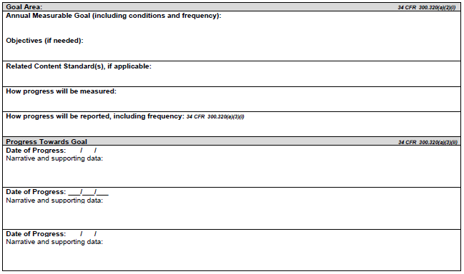
GOAL WRITING - NEW
CRITERIA

Slide 26
GOAL WRITING
CHANGES:
Layout of information if different
Additional line for “Related Content Standards, if applicable”
One goal page with objectives, if needed
Progress towards goal - narrative and supporting data
“How progress will be measured” includes “criteria”

Slide 27
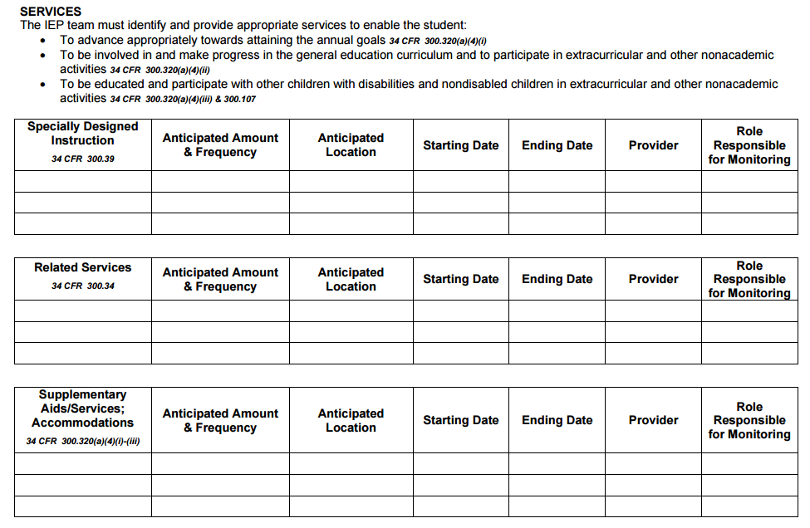
SERVICE SUMMARY
Notes:
SDI
Related Services
Supplemental Aids/Services: Accommodations
Supplemental Aids/Services: Modifications
Program Modifications/Supports for school personnel
Frequency
Location
Start/End Date
Provider
Role Responsible for Monitoring
Share out. (10 minutes)

Slide 28
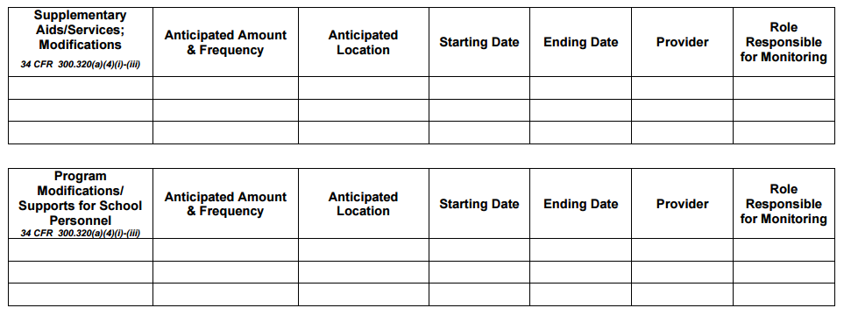
SERVICE SUMMARY

Slide 29
SERVICE SUMMARY
CHANGES:
Additional column “Role Responsible for Monitoring”
Two separate sections for supplementary aids and services - one for Accommodations and one for Modifications

Slide 30
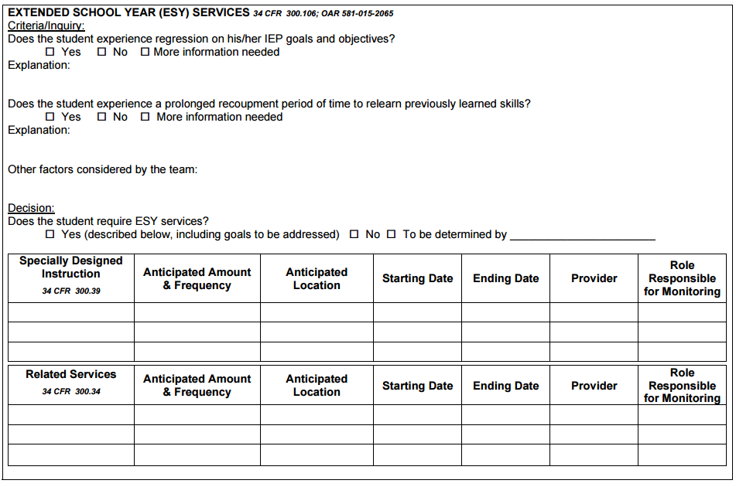
EXTENDED SCHOOL YEAR (ESY)
Notes:
Above is the new look of the ESY section of the IEP. We have include the portions required by rule.
Do you you know your district’s policy regarding ESY? Look at the guidance document and discuss with your group.

Slide 31
EXTENDED SCHOOL YEAR (ESY)
CHANGES:
Additional criteria/inquiry questions addressing both required components:
Regression
Recoupment
Separate “Service Summary” section
Notes:
Above is the new look of the ESY section of the IEP. We have include the portions required by rule.
Do you you know your district’s policy regarding ESY? Look at the guidance document and discuss with your group.

Slide 32
OVERVIEW OF RESOURCES
Oregon IEP / Toolkit / Guidance Document http://www.ode.state.or.us/search/page/?id=1163
Standards-based IEPs
http://www.ode.state.or.us/search/page/?id=4157
Transition
http://www.transitionta.org/
http://www.ode.state.or.us/search/page/?=4279

Slide 33
OVERVIEW OF RESOURCES
Accessible Instructional Materials http://www.ode.state.or.us/search/page/?id=1827
http://www.douglasesd.k12.or.us/otap/
Accessibility Manual
http://www.ode.state.or.us/search/page/?id=487

Slide 34
OVERVIEW OF RESOURCES
IDEA Legacy - http://idea.ed.gov/explore/home
OSEP Dear Colleague Letters - http://www2.ed.gov/policy/speced/guid/idea/letters/revpolicy/index.html
Federal Register - http://idea.ed.gov/download/finalregulations.pdf
Oregon Administrative Rules (OARs) - http://arcweb.sos.state.or.us/pages/rules/oars_500/oar_581/581_tofc.html
581-015-XXXX
581-022-XXXX
OR Revised Statutes (ORS) - http://www.oregonlaws.org/ors/volume/9

Slide 35
Final Questions and Feedback
Contact:
Laura Petschauer, ODE Education Specialist
laura.petschauer@state.or.us

