Slide 1
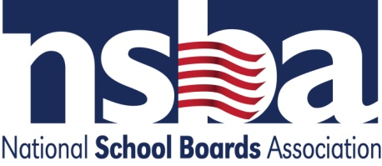
The National School Law Docket: A Survey Of Selections From The NSBA Legal Advocacy Agenda Oregon School Law Conference Eugene, Oregon December 2015
Francisco M. Negrón, Jr.
General Counsel/Associate Executive Director
National School Boards Association
fnegron@nsba.org

Slide 2
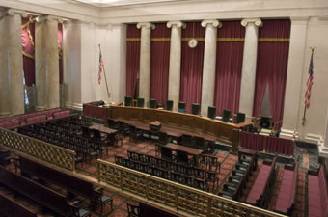
Goal of This Presentation
▪ To shine some light on developments in school law in the last year across the federal court and agency dockets.
▪ To share NSBA perspective around these developments.

Slide 3
Overview…
The federal overreach. Representative Cases: Tustin, Does v. Prince George’s County, MD.
To Impute or Not Impute under Title IX: Salazar.
Child abuse reporting is a constitutional violation? Ohio v. Clark, Wenk v. Riley.
The trend towards national bullying legislation.
Religious Discrimination, or bonafide business requirement? EEOC v. Abercrombie & Fitch.
The power of the federal policy maker: Perez v. Mortgage Bankers Ass’n.
When FAPE isn’t enough: MR v. Ridley School District.
A marriage by any other name: Obergefell v. Hodges.
Race Redux: Fisher v. University of Texas.

Slide 4
K.M. v. Tustin Unified School District, Nos. 11-562259/12-56224 (9th Cir. Aug. 6, 2013), cert. denied, Nos. 13-770, 13-777 (U.S. Sup. Ct. Mar. 4, 2014)
Issue: Does providing FAPE under IDEA satisfy access requirements under the ADA?
Notes:
This case raises the issue of whether a school district satisfies its obligations under the Americans with Disabilities Act (ADA) “effective communications” regulation by providing deaf and hearing impaired students with a free appropriate public education (FAPE) as set forth in a valid Individualized Education Program (IEP) developed in accordance with the Individuals with Disabilities Education Act (IDEA).

Slide 5

Background…
A high school student with hearing disabilities asked school for a word-for-word translation service called Communication Access Realtime Translation (CART) in the classroom.
School district denied request, but offered other accommodations.
Parents argued ADA’s effective communications regulation provides additional relief and is not preempted by IDEA.
Notes:
The case is a consolidation of two matters involving the same issue. In each case, a high school student with hearing disabilities requested that the school district provide Communication Access Realtime Translation (CART), a word-for-word translation service, in the classroom. In each case, the district denied the request for CART, but offered other accommodations.

Slide 6
Hearing Officer and Fed. Ct. rule for school…
School district complied with IDEA; and
ADA claims were foreclosed by the failure of the IDEA claims.
Plaintiffs appeal to 9th Circuit:
ADA’s effective communications regulation creates obligations in addition to IDEA requirements.
Notes:
In each case, both the administrative hearing officers and the district court found that the school district had fully complied with the IDEA and that the plaintiffs’ ADA claims were foreclosed by the failure of the IDEA claims. The plaintiffs each appealed to the Ninth Circuit, claiming that the ADA’s effective communications regulation imposes on public schools additional obligations that are independent of, and not co-extensive with, the schools’ obligations under the IDEA.

Slide 7
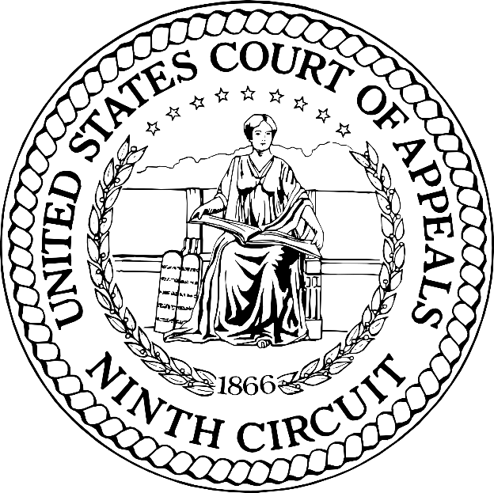
At the 9th Cir…
Ruled in favor of students…
Parents entitled to “Primary consideration” regarding specific services…
Regardless of appropriateness of IEP team determinations.
Notes:
The Ninth Circuit consolidated the cases, and held in favor of the plaintiffs. Under the Ninth Circuit’s ruling, school districts must give “primary consideration” to the parents’ desire for specific services, programs, placements, or supports – regardless of the appropriateness of those services as determined by the IEP team.

Slide 8
NSBA joined CSBA’s brief on certiorari…
Need to clarify IDEA is the governing statute re: educational services students with disabilities.
ADA’s effective communications regulation provides some rights, but must be interpreted in pari materia IDEA’s collaborative framework.
Such interpretation should not alter the IEP process, causing undue financial and administrative burdens on schools.
Notes:
As you can imagine this type of ruling fundamentally alters the meaning of the IDEA collaborative process. As result NSBA joined the brief filed by the California School Boards Association in January, 2014, urging the U.S. Supreme Court to review the Ninth Circuit’s decision, given the need for clarity that the IDEA is the guiding statute governing school districts’ responsibilities for providing educational services to DHH students and students with other disabilities. To the extent that the ADA’s effective communications regulation provides some rights to such students, the regulation must be interpreted in a manner that is consistent with the IDEA’s collaborative framework and that does not fundamentally alter the IEP process, causing undue financial and administrative burdens on schools. Under IDEA’s cooperative team approach, a multi-disciplinary IEP team determines a child’s educational needs based on comprehensive evaluations by qualified professionals. The Ninth Circuit erred by altering fundamentally the IDEA’s resolution process. Under this decision, even if a school district is determined through due process or court proceedings to have provided FAPE, it is subject to additional legal claims under the ADA.

Slide 9
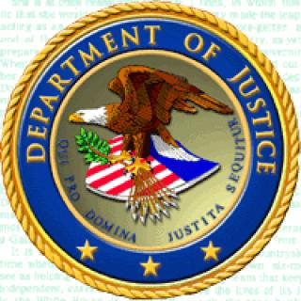
DOJ involvement…
9th Cir. Deferred to U.S. Department of Justice;
DOJ argued that because it enforces the ADA, it has authority to opine on the IDEA as it relates to the ADA.
NSBA argued DOJ’s interpretation of IDEA is outside its legal purview and should not be entitled to deference.
The U.S. Supreme Court denied review on March 4, 2014.
Notes:
Finally, CSBA and NSBA implored the Court to grant review to rectify the Ninth Circuit’s improper deference to the U.S. Department of Justice’s views on the relationship of claims made under both the IDEA and the ADA. Although DOJ enforces the ADA, it exercises no authority under the IDEA, making its views on that statute outside its legal purview.
The U.S. Supreme Court denied review on March 4, 2014.

Slide 10

OCR seizes on Tustin ruling… to issue Effective Communication “Dear Colleague Letter” (DCL)

Slide 11

But, this time OCR is not alone…
To round out the triumvirate, OCR enlists the support of OSERS and DOJ.
Together on November 12, 2014, the agencies issues a DCL with a multi-page FAQ whose salient purpose is the application of the Tustin standard across the country.
Notes:
of Pompey and Crassus

Slide 12
What OCR said… inter alia
Parents are entitled to primary consideration of a request to accommodate the communications needs of their children regardless of the existence of an IEP or its pendency.

Slide 13
On March 5, 2015, NSBA responded. To OCR…
Departments’ Reliance on Tustin to Express a National Standard is Misplaced.
This Erroneous Standard Will Confuse Parents and School Districts Across the Country About the Requirements of the Law.
Confusion about the Applicable Standard Will Promote Needless Litigation.

Slide 14
II. The Departments Should Further Clarify:
The Role of the IEP Process vis-à-vis Section 504 and the ADA.
The Standard to Use to Determine a Fundamental Alteration in the Nature of a Service, Program, or Activity.
The Standard to Use to Determine an Undue Financial and Administrative Burden on Schools.

Slide 15
Unclarified federal guidance can have some unintended consequences: -misplaced litigation -confusion of legal standards -delay in implementation of policies -loss of general revenue dollars

Slide 16
Doe v. Prince George’s County Board of Education, (4th Cir.)
Issue. Is a school district liable under Title IX for alleged harassment and sexual assault by a classmate when school officials respond to alleged harassment, but have no knowledge of alleged assaults until after close of school year?

Slide 17
Doe v. Prince George’s County Board of Education, (4th Cir.)
Facts:
Student alleged that during 4th and 5th grade he was repeatedly sexual harassed another student.
The district responded to each incident of which it received notice.
For instance alleged perpetrator was given ISS, and was not allowed to use restroom at same time as alleged victim.
Alleged victim continued to participate in school activities with no decline in academic performance.
However, alleged victim’s parents withdrew him from the school at the end of the fifth grade year.
Notes:
Facts: The case involves a male student who attended a public Montessori school in Prince George’s County Maryland for fourth and fifth grade. He alleges that during this time he was subjected to repeated sexual harassment by a male classmate. The district responded to each incident of which it received notice. Over the two year period, the student missed only seven days of school, continued to participate in school activities and suffered no decline in academic performance. However, the student’s parents withdrew him from the school at the end of the fifth grade year. Shortly after that, he reported to the police that the classmate had sexually assaulted him at school on several occasions. The police conducted an investigation and eventually closed the case as “unfounded.” The parents subsequently sued the district, asserting a Title IX sexual harassment claim along with a state law claim for negligence. The district court ruled in favor of the school district on the Title IX claim, finding that its response to reported incidents could not be deemed deliberately indifferent and that it had no actual notice of the other alleged assaults. The parents now appeal to the U.S. Court of Appeals for the Fourth Circuit. J.D. began attending Robert Goddard Montessori School (RGMS) in fall 2008. In October 2008, he told his parents that a classmate was making sexually explicit comments to him. The parents reported this incident to his teacher and the RGMS’s principal. They claim the school took no action. As time went on, J.D. reported to his parents that the same classmate continued to harass him sexually and expressed a desire to change schools. The parents allegedly notified the teacher and the vice principal of the harassment and were told that the incident was under investigation. Later in the year, the classmate allegedly exposed his genitalia to J.D. and forced J.D. to touch them. J.D. reported the incident to his teacher, who in turn informed the principal and vice-principal.

Slide 18
Facts…
Alleged victim then reported to police that classmate had sexually assaulted him at school on several occasions.
Police closed case as “unfounded” after investigation.
The parents subsequently sued the district, asserting a Title IX sexual harassment claim along with a state law claim for negligence.
Parents claimed school “should have known” of alleged sexual assault. (Negligence standard NOT Davis v. Monroe Standard).

Slide 19
What did the federal court do?
The district court ruled in favor of the school district on the Title IX claim, finding that :
1. School District response to reported incidents could not be deemed deliberately indifferent; and
2. School District had no actual notice of the other alleged assaults.
The parents appealed to the U.S. Court of Appeals for the Fourth Circuit.

Slide 20
NSBA Legal Strategy:
The deliberate indifference standard established in Davis v. Monroe County Bd. of Educ., 526 U.S. 629 (1999), should NOT be relaxed to incorporate common law negligence principles.
4th Circuit should reject the plaintiff plea to expand Davis using the U.S. Department of Education‘s (ED) Office for Civil Rights (OCR) enforcement guidance and expert opinions on proper investigations or interventions.
Local school officials are in the best position to respond to known incidents of harassment or bullying---so, retain long-standing precedent deferring to school officials around climate & discipline even if claims involve federal civil rights statutes.
Notes:
Legal Strategy: The National School Boards Association (NSBA) and the Maryland Association of Boards of Education (MABE) filed an amicus curiae (friend of the court brief which addresses the issue of whether the deliberate indifference standard established in Davis v. Monroe County Bd. of Educ., 526 U.S. 629 (1999), should be relaxed to incorporate common law negligence principles. NSBA/MABE’s brief urges the Fourth Circuit to reject the plaintiffs’ plea to expand Davis using the U.S. Department of Education‘s (ED) Office for Civil Rights (OCR) enforcement guidance and expert opinions on proper investigations or interventions.
In addition to arguing against adoption of OCR’s enforcement guidance on the ground it fails to meet the Davis standard’s higher bar, the brief asserts that local school officials are in the best position to respond to known incidents of harassment or bullying, as demonstrated by long-standing judicial precedent deferring “to school officials’ decision-making in matters of student discipline and maintaining an orderly, safe learning environment, including peer harassment claims under federal civil rights statutes.”

Slide 21
4th Circuit rules in April 7, 2015 unpublished opinion:
Court reaffirmed Davis standard.
School district only liable under Title IX when:
it acts with deliberate indifference and
has actual knowledge of harassment.
Notes:
In its April 7, 2015 decision in Does v. Board of Education of Prince George’s County, the U.S. Court of Appeals for the Fourth Circuit reaffirmed that a school district may be held liable under Title IX for peer harassment only where it acts with deliberate indifference to sexual harassment of which it has actual knowledge. This standard was established by the U.S. Supreme Court in Davis v. Monroe County Board of Education (1999).
Consistent with NSBA’s position, the court strongly rejected the plaintiffs’ attempt to hold the district liable under standards set forth in guidance documents issued by the Office for Civil Rights (OCR) of the U.S. Department of Education. The court emphatically refused to adopt OCR’s negligence and constructive knowledge as the appropriate analysis for imposing Title IX liability.
The decision will serve as important authority to stave off attempts by plaintiffs in future Title IX peer harassment cases to hold school districts liable based on OCR enforcement guidance.

Slide 22
Takeaways...
Decision consistent with NSBA’s position.
Districts are not liable under OCR enforcement standard stated in guidance documents.
Deliberate indifference and severe, pervasive and persistent standards remain viable defense in Title IX peer harassment cases.

Slide 23





Slide 24
The Transgender Student Landscape.
The legal framework is lagging behind rapidly changing social norms.
No single court decision controls at this time. (Supreme Court has yet to hear a case.)
Schools are struggling to balance competing demands from students, parents, federal government and the courts.
Conflict between federal courts & federal government on Title IX’s application.

Slide 25
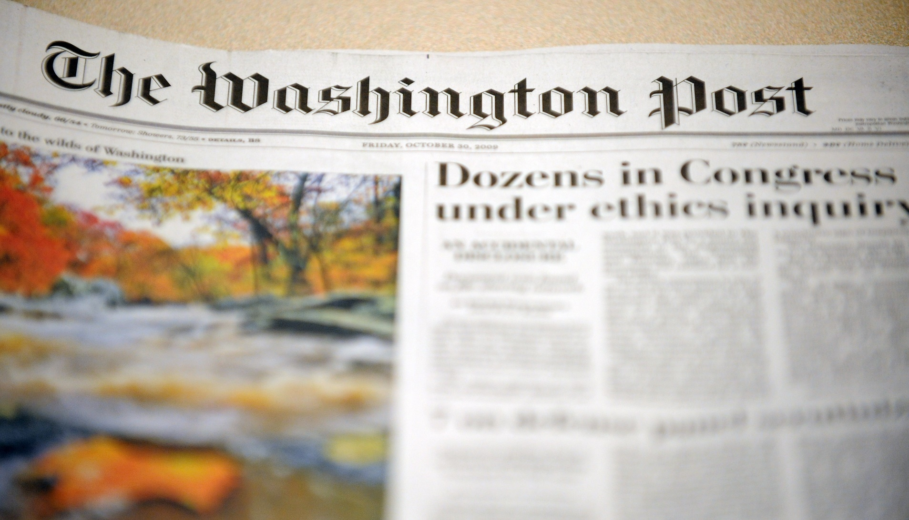
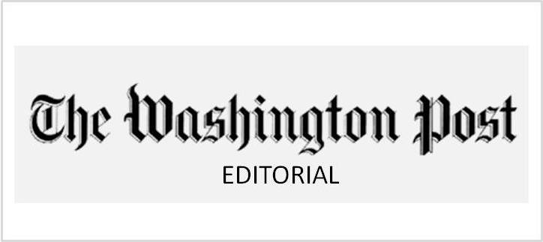

Township High School District 211 in Palatine, Illinois
“An Illinois H.S.’s tragic discrimination against a transgender student.”

Slide 26
Facts…
Transgender high school student (born male but identifying as female) requested use of girl’s locker room.
District permitted student to change inside the girls’ locker room, but only behind a curtain.
The student has said she would probably use the curtain to change.

Slide 27
Facts…
District recognizes transgender students who consistently and uniformly assert a different gender identity than biologically assigned,
Or, if legal or medical documentation indicates gender identity is sincerely held as part of student’s core identity.
District permits name changes, use of opposite sex bathroom where there are private stalls, and sex-identified sports participation under IHSAA rules.

Slide 28
OCR asserts that:
However, student and OCR’s position is that decision to use curtain is voluntary.
Requiring transgender students to use private changing & showering facilities violates Title IX.
Transgender students should be given unfettered access to all student facilities of the gender with which they identify.

Slide 29
Catherine Lhamon, Assistant Secretary for Civil Rights
“All students deserve the opportunity to participate equally in school programs and activities---this is a basic civil right. Unfortunately, Township High School District 211 is not following the law because the district continues to deny a female student the right to use the girls’ locker room.”

Slide 30
Loss of federal funding?
District receives $6M in federal funds out of a $240M budget.
Superintendent says revocation of federal funding would be “unconscionable.”

Slide 31
But, not all courts agree… G.G. v. Gloucester Cnty. Sch. Bd., No. 15-54 (E.D.Va. Sept. 17, 2015).
Transgender student was allowed to use boys’ restroom at beginning of 2014-2015 school year.
Community members complained.
School district passed a policy:
Limiting the use of male and female restroom and locker room facilities “to the corresponding biological genders, and students with gender identity issues shall be provided an alternative appropriate private facility.”
Principal told student he would be disciplined if he used the boys’ restroom.

Slide 32
Student claimed a violation of Title IX and requested an injunction to permit him to use the boys’ restroom at Gloucester High School.
The federal district court in Virginia denied the student’s motion.
The Court premised its ruling on US ED’s regulations which expressly allow “schools to provide separate bathroom facilities based upon sex, so long as the bathrooms are comparable.” 34 C.F.R. 106.33

Slide 33

Court also rejected the request for injunction based on 14th Amendment Equal Protection…
Court focused on balancing interests of the parties:
vs.
Schools’ interest in protecting students’ bodily privacy
Overturning history of segregated bathrooms on basis of sex.

Slide 34
The court reasoned that the expectations of privacy of do not apply solely to the transgendered student.
“must consider [the student’s] claims of stigma and distress against the privacy interest of the other students protected by separate restrooms…
“Not only is bodily privacy a constitutional right, the need for privacy is even more pronounced in the state educational system.”
Student has appealed to the 4th Circuit.

Slide 35
Takeaways…
Context matters. Engage your community! Be aware of shifting legal and social environment. State laws vary.
Understand the limits of federal agency “guidance” vis-à-vis the requirements of Title IX.
What are your policy goals?
Privacy
Safety
Student Welfare
Working with your COSA attorney is essential.
More than assessing your legal exposure.
How do you achieve policy goals within legal framework?

Slide 36
What is happening on the congressional front? The trend towards a federal definition of bullying and harassment.
There is no federal definition of “bullying,” but issue likely to arise next session of Congress.
Since the DCL in 2010 on Bullying and Harassment, there have been 11 bills floated.
This year alone 3 bills were making the rounds.
1 by Sen. Franken (D-MN) and Sen. Baldwin (D-WI) made it to the floor for discussion during cloture.

Slide 37
Issues with B&H bills in 2015…
Congress turns to DOE OCR and federal agencies first for legal framing regardless of party.
NSBA was expert on reframing bills as to correct legal framework.
Strategy by supporters:
To equate B&H with same protections as gender and race.
Letter by 68 congresspersons to Sec’y Duncan.

Slide 38
NSBA supports safe school environments, but urges Title IX analysis.
Sen. Franken’s bill would have supported a greater standard for liability than Title IX. (i.e., the OCR standard for enforcement: severe, pervasive OR persistent).
Title IX analysis holds liability for schools only:
where harassment is severe, pervasive and objectively offensive, AND
School was deliberately indifferent

Slide 39
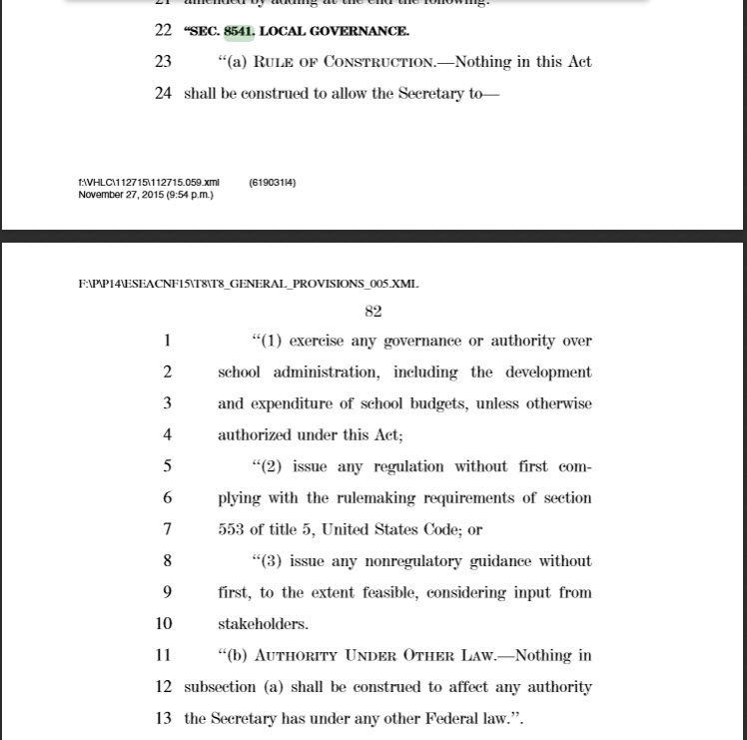
NSBA Local governance language in ESEA reauthorization will impact how federal agencies approach federal guidance and rulemaking!

Slide 40
Salazar v. South San Antonio Independent Sch. Dist. (5th Cir.)
Issue. Whether a school district is liable under Title IX for the sexual assault of a student by a school principal when the abuser was the only school official with actual knowledge of the wrongdoing.
Notes:
National significance. This case tests the limits of the “actual notice” requirement under Title IX for imposing liability on a school district for the sexual assault committed by an employee—in this case, the principal of an elementary school. The U.S. Supreme Court has ruled that a school district may be held liable for monetary damages under Title IX only if an official with authority to address the alleged discrimination and to institute corrective measures has actual knowledge of discrimination and fails to adequately respond. The knowledge of the wrongdoer himself is not enough to hold the district liable. Despite this established law, the trial court allowed a multi-million dollar judgment against the district on the grounds that the school principal knew of his own misconduct and was in a position to take corrective action but failed to do so. This result creates a broad regime of vicarious liability based solely on a school official’s secret wrongdoing, even when that wrongdoing directly contravenes district policies. Under this framework, a school district could be held liable for unlawful sex discrimination of any type by an employee deemed to have authority to address the misconduct, even though the perpetrator has kept his actions secret. This issue has not been addressed by any other U.S. Court of Appeals, making the decision by the Fifth Circuit especially important as it would establish legal precedent that other courts might follow.
Legal Strategy. NSBA would argue that the liability regime created by the district court’s decision will dramatically expand school district liability under Title IX in a manner not contemplated by the law. In urging the Court of Appeals to reverse the lower court ruling, NSBA would point out that the Title IX liability standard set forth by
Members of the Executive Committee
August 11, 2015
Page 2
the U.S. Supreme Court in Gebser v. Lago Vista Indep. Sch. Dist., 324 U.S. 274 (1998), specifically noted that the knowledge of a wrongdoer of his own sexual misconduct does not satisfy the actual knowledge requirement.
Because a wrongdoer is likely to keep his misdeeds secret, the district has no actual knowledge of the harm and no opportunity to take steps to correct the situation. The lower court’s ruling would make a school district strictly liable for the covert sexual misconduct of all school officials authorized to remedy sex discrimination, despite the fact that the offending official’s activities violate the district’s own policies. School districts should not be held responsible for wrongdoing of which they have no knowledge or opportunity to correct.

Slide 41
Facts of the Case.
Student Adrian Salazar, filed a Title IX claim against the South San Antonio Independent School District and its former employee, Michael Alcoser, based on the alleged sexual abuse of Salazar by Alcoser.
The parties stipulated to the following facts:
(i) Alcoser abused Salazar while Alcoser was the vice principal and principal of two elementary schools in the District;
(ii) no one with the District other than Alcoser had knowledge of Alcoser’s abusive conduct; and
(iii) Alcoser’s abusive conduct violated the District’s policies.
Notes:
Prior to trial, the parties stipulated that (i) Alcoser abused Salazar while Alcoser was the vice principal and principal of two elementary schools in the District; (ii) no one with the District other than Alcoser had knowledge of Alcoser’s abusive conduct; and (iii) Alcoser’s abusive conduct violated the District’s policies.

Slide 42
Based on the stipulations, School District moved for judgment as a matter of law on the ground that it lacked “actual notice” of the alleged abuse.
District court denied the motion.
Jury found District liable for damages under Title IX, and awarded Salazar $4.5 million in compensatory damages.
The district court permitted the award, imputing perpetrator’s knowledge to the district.
Notes:
After a two-day trial, the jury found the District liable for damages under Title IX, and awarded Salazar $4.5 million in compensatory damages. The district court permitted the award, reasoning that, because the perpetrator was an official who ordinarily would have authority to take corrective action against sexual harassment, his knowledge of his own wrongdoing could be imputed to the District and satisfy the Title IX liability requirements of actual knowledge and failure to respond.

Slide 43
NSBA’s brief written by Lisa Brown of Thompson & Horton argues…
Liability regime created by the district court’s decision will dramatically expand school district liability under Title IX in a manner not contemplated by the law.
5th Cir. should apply standard set forth by Supremes in Gebser v. Lago Vista Indep. Sch. Dist., 324 U.S. 274 (1998), that the knowledge of a wrongdoer of his own sexual misconduct does not satisfy the actual knowledge requirement.
Rationale: Likelihood of wrongdoer not reporting his/her misdeeds means district has no actual knowledge of harm and no opportunity fix it.
Ruling would make school district strictly liable for covert misconduct of officials, even where offending official’s activities violate the district’s own policies.
Actual knowledge or opportunity to correct is essential to school liability under Title IX.
Notes:
NSBA would argue that the liability regime created by the district court’s decision will dramatically expand school district liability under Title IX in a manner not contemplated by the law. In urging the Court of Appeals to reverse the lower court ruling, NSBA would point out that the Title IX liability standard set forth by the U.S. Supreme Court in Gebser v. Lago Vista Indep. Sch. Dist., 324 U.S. 274 (1998), specifically noted that the knowledge of a wrongdoer of his own sexual misconduct does not satisfy the actual knowledge requirement.
Because a wrongdoer is likely to keep his misdeeds secret, the district has no actual knowledge of the harm and no opportunity to take steps to correct the situation. The lower court’s ruling would make a school district strictly liable for the covert sexual misconduct of all school officials authorized to remedy sex discrimination, despite the fact that the offending official’s activities violate the district’s own policies. School districts should not be held responsible for wrongdoing of which they have no knowledge or opportunity to correct.

Slide 44
Ohio v. Clark, No. 13-1352 (cert. granted, U.S. S. Ct.)
Issue: Whether teachers or other school personnel who are mandatory child abuse reporters should be treated as law enforcement agents for purposes of the Confrontation Clause.
Notes:
In this case the U.S. Supreme Court will decide whether teachers or other school personnel who are mandatory child abuse reporters should be treated as law enforcement agents for purposes of the Confrontation Clause. Although this is a criminal case asking the Court to resolve a narrow issue concerning the rights of an accused to confront the witnesses against him at trial, the Court’s decision has potentially important implications for school personnel as mandatory reporters of child abuse. All states require teachers and other school personnel to report suspected child abuse to child protective services or law enforcement agencies responsible for investigating the reports and determining whether further legal proceedings should be initiated against the abuser. School districts provide mandated training and put in place policies and procedures to ensure that all mandatory reporters know how to carry out their responsibilities. As with the reporting statutes themselves, the primary motivating force behind these activities is protecting the safety of the child and not investigation of a potential crime.

Slide 45
Facts:
his girlfriend’s three year old son.
Charge stemmed from CPS and Police Investigation.
CPS and Police had received a report of suspected abuse from a teacher at a Head Start center.
Teacher notice injuries on child’s body and asked child how he received the injuries.
Child eventually identified Clark as perpetrator.
Because child was deemed incompetent to testify.
But, teacher’s testimony admitted to support charge that Clark was the perpetrator.
Clark was convicted and sentenced to 28 years in prison.
Darius Clark was charged with abusing.
Notes:
The case arose when Darius Clark was charged with abusing his girlfriend’s three year old son. The charge resulted from an investigation by child protective service workers and the police after they received a report of suspected abuse from a teacher at a Head Start center in Cleveland. After noticing several injuries on the child’s body, the teacher asked the child how he received the injuries. After initially indicating that he had fallen, the child in response to further questioning stated that someone named “Dee” had inflicted the injuries and that Dee was “big.” The teacher and other adult witnesses testified as to the statements the child had made concerning “Dee.” (The child was deemed incompetent to testify.) Dee was convicted and sentenced to 28 years in prison. A state appellate court later reversed the conviction. The Ohio Supreme Court upheld the reversal, finding that when teachers suspect and “investigate” child abuse, including asking questions about the identity of the perpetrator, they are acting as law enforcement agents. Any statements obtained from the victim, thus become subject to the Confrontation Clause. The U.S. Supreme Court granted the State of Ohio’s request for review. The Executive Committee approved NSBA entering the case to advise the Court of the implications its decision will have for teachers and other school staff who are mandatory child abuse reporters.

Slide 46
Plaintiff wins in state courts…
State appellate court later reversed the conviction.
The Ohio Supreme Court upheld the reversal, finding that when teachers suspect and “investigate” child abuse, including asking questions about the identity of the perpetrator, they are acting as law enforcement agents.
Victim statements are subject to the Confrontation Clause.
The U.S. Supreme Court granted the State of Ohio’s request for review.
Notes:
A state appellate court later reversed the conviction. The Ohio Supreme Court upheld the reversal, finding that when teachers suspect and “investigate” child abuse, including asking questions about the identity of the perpetrator, they are acting as law enforcement agents. Any statements obtained from the victim, thus become subject to the Confrontation Clause. The U.S. Supreme Court granted the State of Ohio’s request for review. The Executive Committee approved NSBA entering the case to advise the Court of the implications its decision will have for teachers and other school staff who are mandatory child abuse reporters.

Slide 47
NSBA’s brief argued:
Treating school personnel as LEOs confuses educator role in protecting children.
Schools have responsibility under state laws to report suspected abuse.
School officials play key role in protecting children through mandated reporting.
School’s role in this is not to investigate crime but to prevent further harm.
Schools not equipped to provided law enforcement training to employees.
Problems with potential liability school officials are reclassified as LEOs.
Notes:
In a joint brief with the National Education Association and the American Federation of Teachers filed on November 24, 2014, NSBA argued that a decision treating school personnel as law enforcement agents when carrying out their reporting duties grossly misunderstands their role as educators in protecting children and could raise issues for district training and liability with respect to child abuse prevention. When school staff members question a child about behavioral changes or noticeable marks and injuries on the child’s body, they are acting in accordance with reporting laws primarily intended to protect the child from further harm. These inquiries are intended to ensure a sufficient basis exists for the school staff member to report suspected abuse, not to investigate a possible crime. Questions that relate to the identity of the abuser are necessary to determine any additional responsibilities a school may have beyond making a report. A judicial determination that by asking such questions, school staff are engaging in a criminal investigation for purposes of the Confrontation Clause may be extrapolated to impose on school districts the training and liability standards applicable to law enforcement agencies. This might occur with respect not only to child abuse reporting but also to other matters about which school districts typically question students and staff members to maintain safe learning environments. The U.S. Supreme Court has already recognized that law enforcement standards are ill suited to the responsibility of schools to ensure student welfare so that children can achieve academically.

Slide 48
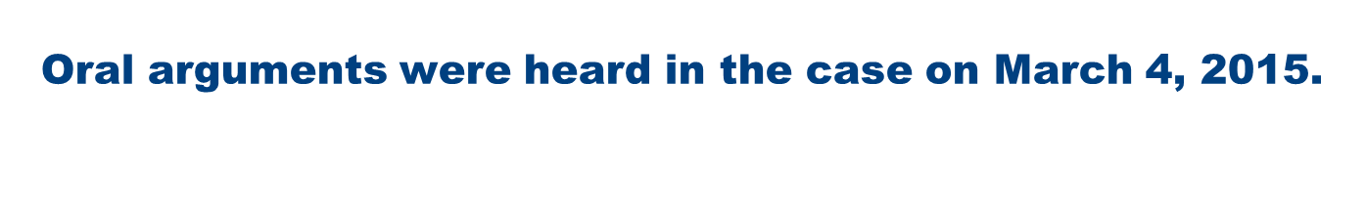
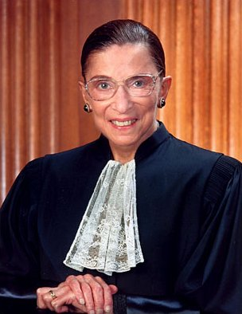
County Assistant Prosecutor and Asst. U.S. Solicitor General argued the lower court rulings misinterpreted the Constitution by “viewing teachers as police.”
Justice Ginsberg questioned why unreliable statements by a child should be deemed reliable enough to admit as evidence if they’re from teachers.
Notes:
Cuyahoga County Assistant Prosecutor Matthew Meyer and Assistant U.S. Solicitor General Ilana Eisenstein told the Justices that the lower court rulings misinterpreted the Constitution by “viewing teachers as police,” as Eisenstein put it. When Justice Ginsberg asked Meyer why statements by a child deemed too unreliable to testify in court should be deemed reliable enough to admit as court evidence if they’re from teachers, Meyer said it would be a mistake to decide that anything such a small child says is unreliable. “It’s a choice between hearsay and nothing when dealing with a three-year-old,” Meyer replied.
Meyer argued that teachers who are concerned about their charges’ well-being would ask them about noticeable injuries even if they weren’t required to report the abuse to authorities. “Ohio’s teachers are horrified to learn that the Ohio Supreme Court views them as cops when talking to students,” he told the Justices.
Stanford University Law Professor Jeffrey Fisher argued on Clark’s behalf that prosecutors in Ohio “want to have it both ways” by admitting the abuse statements that small children give to caregivers, without allowing defense lawyers to cross-examine the children. Fisher said there are “innumerable” reasons a Court might doubt the truth of small children’s statements to teachers, including leading questions that teachers might ask.
At several points in the case, Justices seemed sympathetic to the county’s argument that statements small children give to their teachers should not be treated the same as those given to law enforcement officers. “It’s a leap to assume the child understands the criminal process,” said Justice Sonia Sotomayor. “The teacher is concerned about the safety of the child, period,” declared Justice Samuel Alito.

Slide 49
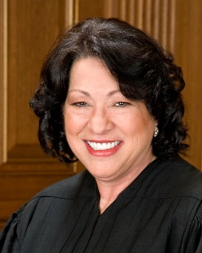
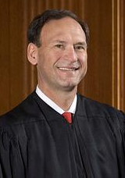
Justices seemed sympathetic to county’s argument that statements small children give to their teachers do not equal statements to LEOs.
“It’s a leap to assume the child
understands the criminal process,” Sotomayor.
“The teacher is concerned about the safety of the child, period,” Alito.
Notes:
At several points in the case, Justices seemed sympathetic to the county’s argument that statements small children give to their teachers should not be treated the same as those given to law enforcement officers. “It’s a leap to assume the child understands the criminal process,” said Justice Sonia Sotomayor. “The teacher is concerned about the safety of the child, period,” declared Justice Samuel Alito.

Slide 50
Sure enough, Court rules in favor of Defendants. Ohio v. Clark, No. 13–1352 (U.S. Jun. 18, 2015)
Supreme Court, with all the justices agreeing in the judgment, reversed the Ohio Supreme Court’s decision.
Justice Alito issued the Court’s opinion.
Notes:
The United States Supreme Court, with all the justices agreeing in the judgment, reversed the Ohio Supreme Court’s decision. Justice Alito issued the Court’s opinion. Justice Scalia, joined by Justice Ginsburg filed an opinion concurring in the judgment. Justice Thomas also filed an opinion concurring in the judgment. At issue was whether the Sixth Amendment’s Confrontation Clause prohibited prosecutors from introducing the child’s out-of-court statements to his teachers when the child was not available to be cross-examined.
Justice Alito first pointed out U.S. Supreme Court precedent established that testimonial statements made to law enforcement officers implicate the Confrontation Clause, but the question of whether similar statements to individuals other than law enforcement officers would raise similar issues under the Confrontation Clause had been reserved. Reviewing the Court’s Confrontation Clause jurisprudence, he found that the Confrontation Clause does not bar every statement that satisfies the “primary purpose” test. Alito concluded that “the primary purpose test is a necessary, but not always sufficient, condition for the exclusion of out-of-court statements under the Confrontation Clause.”
Justice Alito announced the Court would not adopt a categorical rule excluding such statements from the Sixth Amendment’s reach “[b]ecause at least some statements to individuals who are not law enforcement officers could conceivably raise confrontation concerns, we decline to.” However, he emphasized “such statements are much less likely to be testimonial than statements to law enforcement officers.” As a result, Alito held: “L. P.’s statements clearly were not made with the primary purpose of creating evidence for Clark’s prosecution. Thus, their introduction at trial did not violate the Confrontation Clause.”
Justice Alito, based on the relevant facts, found there was “no indication that the primary purpose of the conversation was to gather evidence for Clark’s prosecution.” Instead, he determined that the teachers’ “first objective was to protect L. P.” He also pointed out that L. P.’s age supported the “conclusion” that the statements in question were not testimonial, noting that “[s]tatements by very young children will rarely, if ever, implicate the Confrontation Clause.” In addition, he bolstered his reasoning by stating that “there is strong evidence that statements made in circumstances similar to those facing L. P. and his teachers were admissible at common law.”
Lastly, after reiterating that the Court was declining to adopt a rule that statements to individuals who are not law enforcement officers are categorically outside the Sixth Amendment, Justice Alito stressed “the fact that L. P. was speaking to his teachers remains highly relevant.” He posited:
Statements made to someone who is not principally charged with uncovering and prosecuting criminal behavior are significantly less likely to be testimonial than statements given to law enforcement officers. See, e.g., Giles, 554 U. S., at 376. It is common sense that the relationship between a student and his teacher is very different from that between a citizen and the police.
Alito rejected Clark’s argument that the state’s mandatory reporting obligations made teachers the functional equivalent of law enforcement when dealing with suspected child abuse. He found, instead, that “mandatory reporting statutes alone cannot convert a conversation between a concerned teacher and her student into a law enforcement mission aimed primarily at gathering evidence for a prosecution.”
Alito also found Clark’s assertion that admitting L. P.’s statements would be fundamentally unfair given that Ohio law does not allow incompetent children to testify was unavailing. He stated, “The fact that the witness is unavailable because of a different rule of evidence does not change our analysis.” Finally, Alito rejected Clark ‘s argument that because the “jury treated L. P.’s accusation as the functional equivalent of testimony,” it should be barred. He responded that courts “do not determine whether a statement is testimonial by examining whether a jury would view the statement as the equivalent of in-court testimony.”
Justice Scalia’s concurrence took the Alito majority to task over what he perceived as it “shoveling of fresh dirt upon the Sixth Amendment right of confrontation so recently rescued from the grave in Crawford v. Washington, 541 U. S. 36 (2004).” He contended that the primary purpose test is the sole means of determining if an individual is acting as a witness. Scalia said, “The Confrontation Clause categorically entitles a defendant to be confronted with the witnesses against him; and the primary-purpose test sorts out, among the many people who interact with the police informally, who is acting as a witness and who is not.”
According to Scalia, the majority opinion’s assertion “that future defendants, and future Confrontation Clause majorities, must provide ‘evidence that the adoption of the Confrontation Clause was understood to require the exclusion of evidence that was regularly admitted in criminal cases at the time of the founding,” got “the burden precisely backwards.”
Justice Thomas refused to join with the majority’s opinion because the majority failed to “offer clear guidance on the subject, declaring only that ‘the primary purpose test is a necessary, but not always sufficient, condition’ for a statement to fall within the scope of the Confrontation Clause. ” He wrote his own concurring opinion, but unlike Scalia Thomas found the primary purpose test “an exercise in fiction . . . disconnected from history for statements made to private persons as it is for statements made to agents of law enforcement.”
Thomas stated that instead of that test he “would use the same test for statements to private persons that I have employed for statements to agents of law enforcement, assessing whether those statements bear sufficient indicia of solemnity to qualify as testimonial.” He “identified several categories of extrajudicial statements that bear sufficient indicia of solemnity to fall within the original meaning of testimony.” For example, statements “contained in formalized testimonial materials, such as affidavits, depositions, prior testimony, or confessions.”
Thomas concluded:
That several of these factors seem inherently inapplicable to statements made to private persons does not mean that the test is unsuitable for analyzing such statements. All it means is that statements made to private persons rarely resemble the historical abuses that the common-law right to confrontation developed to address, and it is those practices that the test is designed to identify.
He determined that “L. P.’s statements do not bear sufficient indicia of solemnity to qualify as testimonial,” because “[t]hey were neither contained in formalized testimonial materials nor obtained as the result of a formalized dialogue initiated by police.”
Ohio v. Clark, No. 13–1352 (U.S. Jun. 18, 2015)

Slide 51
Reasoning:
Teachers’ “first objective was to protect [the child].”
“[s]tatements by very young children will rarely, if ever, implicate the Confrontation Clause.” And,
Similar statement were admissible at common law.

Slide 52
Important to Alito was the reality of the teacher-student relationship.
Nature of relationship: “It is common sense that the relationship between a student and his teacher is very different from that between a citizen and the police.”

Slide 53
So, what’s next on the horizon? Wenk v. O’Reilly (on petition for Cert. to US Sup. Ct.)
Issue. Whether teachers or other school personnel who are mandatory child abuse reporters are entitled to qualified immunity against First Amendment retaliation claims asserted by the alleged abuser.

Slide 54
Facts…
Parent aggressively engaged school staff about the needs of his 17-year-old, special ed. daughter.
Father made several unusual demands, including urging district to help daughter find a boyfriend and sponsor a separate prom for students with disabilities.
Two teachers reported to the Director of Pupil Services that student made several statements about home interaction with father.
The DPS made a report of suspected abuse.
Notes:
The case involves a parent who aggressively engaged school staff about the needs of his 17-year-old daughter, who receives special education services under the Individuals with Disabilities Education Act (IDEA). The father made several unusual demands, including urging the district to assist his daughter in finding a boyfriend and to sponsor a separate prom for students with disabilities. After two teachers reported to the Director of Pupil Services that the student had made several statements regarding her father’s interaction with her at home, the administrator made a report of suspected abuse. The daughter stated that her father inserted tampons for her, applied vaginal cream to her labia, took showers with her, licked her face and neck, and scooted naked with her on the floor. She also stated that her genitals were sticky and itchy. Investigations by child protective services and law enforcement resulted in no further legal action against the father. The father brought suit in federal court against several school officials, asserting that they had violated the First Amendment by making the report of suspected abuse in retaliation for his advocacy for his daughter. The district court denied the administrators’ request for qualified immunity and allowed the case against the Director of Pupil Services to proceed to trial. The court denied the administrator’s motion for summary judgment. On appeal the Sixth Circuit upheld the denial of qualified immunity and summary judgment, declaring that a reasonable official would have understood that filing a child abuse report in bad faith violated the parent’s free speech rights.

Slide 55
Disturbing allegations, but no finding of wrongdoing.
Allegations involved touching of private parts and other behavior.
Nonetheless, investigations by child protective services and law enforcement resulted in no further legal action against the father.
As a result, father brought suit in federal court against several school officials, asserting that they had violated the First Amendment by making the report of suspected abuse in retaliation for his advocacy for his daughter.

Slide 56
Federal courts agreed with father.
The federal district court:
Denied the administrators’ request for qualified immunity,
Allowed case against Director of Pupil Services to proceed to trial.
On appeal the Sixth Circuit:
Upheld the denial of qualified immunity and summary judgment.
Declared reasonable official would have understood that filing a child abuse report in bad faith violates parent’s free speech rights.

Slide 57
NSBA’s Legal strategy… builds on Ohio v. Clark.
Urge High Court review and reversal 6th Circuit.
Qualified Immunity is critical to maintaining the important role school personnel play in reporting suspected child abuse.
State law immunity exists to protect mandatory reporters when reasonable grounds exist to suspect abuse.
Investigative findings by CPS or law enforcement of no abuse are irrelevant to qualified immunity.
Reporting laws recognize vulnerability to subsequent legal claims brought by the suspected abuser would discourage mandatory reporting.
Effectiveness of reporting laws intended to protect children from further abuse at the earliest point possible would be severely hindered.

Slide 58

Meanwhile, back at the Bat Cave…
The school district and the parent settled the case.
School district is petitioning the Supreme Court to hear the case, because of its importance as a matter of public policy.

Slide 59



Slide 60
Equal Employment Opportunity Commission (EEOC) v. Abercrombie & Fitch, No. 14-86 (U.S. S. Ct. cert. granted)
Issue: Whether an employer may be held liable under Title VII of the Civil Rights Act for failing to provide a religious accommodation to an applicant when the employer had no actual knowledge of the applicant’s faith or the need for an accommodation.
Notes:
The U.S. Supreme Court will determine whether an employer may be held liable under Title VII of the Civil Rights Act for failing to provide a religious accommodation to an applicant when the employer had no actual knowledge of the applicant’s faith or the need for an accommodation.
The case arose when the EEOC filed a suit on behalf of a young woman who had applied to Abercrombie & Fitch to be a sales associate. Under Abercrombie’s policy, sales associates are required to wear clothes consistent with the Abercrombie style and may not wear hats. The applicant, who was aware of the appearance policy before applying, came to the interview wearing a black head scarf. The Abercrombie manager who interviewed the applicant had no knowledge that the woman was Muslim or that she considered wearing a head scarf a religious obligation. After the manager explained the appearance policy, the applicant did not ask any questions or express any concerns when given an opportunity to do so. Abercrombie did not hire the applicant. The EEOC alleged Abercrombie violated Title VII for failing to accommodate the applicant’s religious practice of wearing a head scarf. The district court ruled in favor of the EEOC, but the Tenth Circuit court reversed that decision, focusing on the applicant’s failure to inform Abercrombie of her need for a religious accommodation. The U.S. Supreme Court granted the EEOC’s request for review.

Slide 61
Facts:
A young woman applied to Abercrombie & Fitch to be a sales associate.
Company requires sales associates to wear clothes consistent with the Abercrombie style. No hat are allowed.
Applicant, who was aware of the appearance policy, and wore black head scarf to interview.
Store manager conducting interview had no knowledge about applicant’s religion or that head scarf was a religious observance.
The manager explained the appearance policy, but applicant had not questions or concerns.
Abercrombie did not hire the applicant.

Slide 62
-The EEOC filed suit on behalf of the plaintiff, alleging Abercrombie violated Title VII for failing to accommodate the applicant’s religious practice of wearing a head scarf.
-Tenth Circuit reversed district court, because plaintiff had failed request a religious accommodation.
-The U.S. Supreme Court granted the EEOC’s request for review.
Notes:
The EEOC alleged Abercrombie violated Title VII for failing to accommodate the applicant’s religious practice of wearing a head scarf. The district court ruled in favor of the EEOC, but the Tenth Circuit court reversed that decision, focusing on the applicant’s failure to inform Abercrombie of her need for a religious accommodation. The U.S. Supreme Court granted the EEOC’s request for review.

Slide 63
The joint brief NSBA filed with other state and local government organizations argued
Supreme should adopt prevailing view that employers may be held liable for failing to provide a religious accommodation only where the applicant/employee has notified the employer of his religious views and the need for an accommodation.
EEOC took a new position on this issue contrary to its previous guidance that placed the burden on employees to inform their employers of the need for religious accommodation.
Notes:
The joint brief NSBA filed with other state and local government organizations argued that the Court should adopt the prevailing view that employers may be held liable for failing to provide a religious accommodation only where the applicant/employee has notified the employer of his religious views and the need for an accommodation. The brief pointed out that the EEOC is taking a new position on this issue contrary to its previous guidance that placed the burden on employees to inform their employers of the need for religious accommodation. The brief argued that not only has the EEOC reversed its position without notice to or an opportunity for employers to comment, but it has also placed local governments, including school boards, in a no-win situation, facing potential liability regardless of the action they take: if they fail to make inquiries about an individual’s need for religious accommodation they risk liability under Title VII, but if they do ask such questions based on stereotypes, they may face claims under other anti-discrimination laws. Requiring employers to assume the burden of inquiring into an employee’s religion is particularly troubling for government employers who must also ensure that they are not violating the First Amendment’s religion clauses. Finally, the brief pointed out that the EEOC’s position is unnecessary given that Title VII provides other avenues for relief for claims of religious discrimination.

Slide 64
EEOC’s shift place school boards, in a no-win situation, facing potential liability regardless of the action they take:
if they fail to make inquiries about an individual’s need for religious accommodation they risk liability under Title VII, but if they do ask such questions based on stereotypes, they may face claims under other anti-discrimination laws.

Slide 65
The case was argued on February 25, 2015.
Chief Justice Roberts and Justices Scalia & Kennedy questioned what level of certainty of a potential religious clash would trigger the need for accommodation.
Deputy Solicitor General: employer doubt about possible clash between workplace rules and applicant’s religious practices should result in dialogue over the issue.
Justice Scalia dismissed DSG’s view and supported the Appellate Court saying, “If you want to sue me for denying you a job for a religious reason, the burden is on you to say, ‘I’m wearing a headscarf for a religious reason.’ ”
Notes:
Chief Justice John Roberts and Justices Antonin Scalia and Anthony Kennedy questioned what level of certainty of a potential religious clash would trigger the need for accommodation. “Your position … is that he must ‘understand.’ You stay away from the word ‘know,’ ” Justice Kennedy said, noting that he found the position confusing. “We think there is sufficient knowledge, notice, when somebody understands … assumes that a practice is religious and then acts upon it, that that is sufficient,” Gershengorn replied.
The deputy solicitor general added that if an employer had some doubt about a possible clash between workplace rules and a job applicant’s religious practices, there should be a dialogue between employer and the person over the issue. No such dialogue took place in the Abercrombie-Elauf case.
Justice Scalia responded by repeating Abercrombie’s argument that it should be up to the applicant/employee to raise the issue of religious accommodation. “You could avoid those hard questions, whether it’s ‘understand,’ ‘believe,’ ‘suspect,’ by adopting the rule the court of appeals adopted here,” Scalia said. “If you want to sue me for denying you a job for a religious reason, the burden is on you to say, ‘I’m wearing a headscarf for a religious reason.’ ”
Abercrombie’s lawyer, Shay Dvoretzky, said that the approach favored by the EEOC and the Obama administration would be “unadministrable.” The government has not identified what level of certainty is required for a “belief” or “suspicion” that an individual might be religious and entitled to an accommodation, he said. “The question before the court is, what level of knowledge does the employer have to have before the duty to accommodate is triggered,” Dvoretzky said. “For 40 years, the EEOC’s own guidance has put the burden to initiate the conversation on the employee because only the employee knows.”
Justice Samuel Alito mentioned the company’s prohibition on employees wearing black. The justice asked if a job applicant arrived to the interview in a black blouse whether Abercrombie would refuse to hire that person on the assumption that she would wear black every day at work. “I don’t think Abercrombie needs to make that assumption about what the person will do later in order to make a judgment based on the person’s appearance at the interview,” Dvoretzky said.
A few minutes later, Justice Alito expanded on his prior question. He wondered why, in Elauf’s case, she wasn’t hired. “There would be no reason for not hiring [Elauf] unless you assumed that she was going to wear a scarf every day,” Alito said. “Just because she wore a scarf on that one day wouldn’t mean that she necessarily was going to wear it every day.” “Maybe she’s just having a bad hair day,” he suggested. “Would you reject her for that? No.” Alito added: “The reason that she was rejected was because you assumed she was going to do this every day, and the only reason why she would do it every day is because she had a religious reason.”

Slide 66
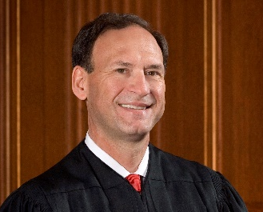
Justice Alito was thought to be the vote that would drive the decision.
“There would be no reason for not hiring [her] unless you assumed that she was going to wear a scarf every day.”
“Just because she wore a scarf on that one day wouldn’t mean that she necessarily was going to wear it every day.”
“Maybe she’s just having a bad hair day,” he suggested. “Would you reject her for that? No.”
“The reason that she was rejected was because you assumed she was going to do this every day, and the only reason why she would do it every day is because she had a religious reason.”
Notes:
He zeroed in on the reason for not hiring Elauf. “There would be no reason for not hiring [Elauf] unless you assumed that she was going to wear a scarf every day,” Alito said. “Just because she wore a scarf on that one day wouldn’t mean that she necessarily was going to wear it every day.” “Maybe she’s just having a bad hair day,” he suggested. “Would you reject her for that? No.” Alito added: “The reason that she was rejected was because you assumed she was going to do this every day, and the only reason why she would do it every day is because she had a religious reason.”

Slide 67
EEOC v. Abercrombie & Fitch Stores, 14-86 (U.S. Jun. 1, 2015)
8-1 split.
Reversed 10th Circuit’s decision.
Held: In a disparate-treatment claim, an applicant need show only that his need for an accommodation was a motivating factor in the employer’s decision, not that the employer had knowledge of his need.

Slide 68
Justice Scalia, writing for the majority, said…
Title VII “does not impose a knowledge requirement.”
Instead, what matter is not what the employer knows, but what he intends, what his motives are.
There is no actual knowledge requirement to Title VII.
Court said that requirement can only be added by Congress, in its legislative capacity.

Slide 69
Rule of the case for practical purposes…
Employer may not take an adverse employment action against an applicant or employee because of any aspect of that individual’s religious observance or practice.
Unless the employer show it is unable to reasonably accommodate that observance or practice without undue hardship.
Burying head in the sand, won’t work: If you see something that doesn’t mesh with your policy (i.e., dress code), just ask, “Do you need a reasonable accommodation?”

Slide 70
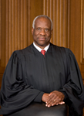
It was 8-1. Who was the 1?
Why? Because, unlike the majority, he said, “Mere application of a neutral policy cannot constitute ‘intentional discrimination,'” Thomas.

Slide 71
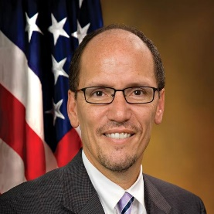

Perez v. Mortgage Bankers Association, No. 13-1041 (U.S. S. Ct. March 9, 2015)
Issue:
Does a federal agency need to provide notice and an opportunity for interested parties to comment when it proposes to alter an interpretive rule adopted to clarify an agency regulation?

Slide 72
Flippy Floppy Facts:
DOL issued an opinion letter changing its interpretation of a regulation under the FLSA regarding exempt employees.
In 2001, DOL had issued opinion letter stating that mortgage loan officers are not exempt administrative employees.
In 2006, DOL issued another letter, stating mortgage loan officers are exempt.
In 2010, DOL withdrew its 2006 opinion letter, reverting to its initial position.
DOL took all these actions without engaging in any notice and comment rulemaking.
Notes:
The U.S. Supreme Court decided that a federal agency need not provide notice and an opportunity for interested parties to comment when it proposes to alter an interpretive rule adopted to clarify an agency regulation.
The case arose when the U.S. Department of Labor (DOL) issued an opinion letter changing its interpretation of a regulation under the Fair Labor Standards Act that exempted administrative employees from coverage. In 2001, DOL had issued an opinion letter stating that mortgage loan officers are not exempt administrative employees. In 2006, DOL issued another letter, stating mortgage loan officers are exempt and therefore FLSA’s minimum-wage and overtime requirements do not apply to them. However, in 2010, DOL withdrew its 2006 opinion letter, thereby reverting to its initial position. DOL took all these actions without engaging in any notice and comment rulemaking. The Mortgage Bankers Association filed an action in district court, seeking to have the 2010 interpretation set aside. The district court agreed with the federal government that DOL was not required to use notice and comment procedures because the agency’s actions involved “interpretive rules.” The court of appeals reversed, siding with Mortgage Bankers. The U.S. Supreme Court granted the U.S. Secretary of Labor’s request for review.

Slide 73
NSBA argued in its brief…
Court should restore the balance between agency discretion and the reliance interests of regulated entities that the Administrative Procedures Act sought to protect.
There are dangers and inequities in allowing federal agencies to be both the author and the interpreter of their own regulations.
Where interpretive rules are given the same force and effect as regulations, notice and comment procedures are necessary to ensure that agencies do not have the power to impose new onerous conditions arbitrarily.
Particularly important to require agencies to consider the financial and operational constraints facing the regulated entities.
Notes:
The joint brief NSBA filed along with several other state and local government organizations argued that the Court should restore the balance between agency discretion and the reliance interests of regulated entities that the Administrative Procedures Act sought to protect. The brief pointed out there are dangers and inequities in allowing federal agencies to be both the author and the interpreter of their own regulations. Where interpretive rules are given the same force and effect as regulations, notice and comment procedures are necessary to ensure that agencies do not have the power to impose new onerous conditions arbitrarily, and without consideration of the financial and operational constraints facing the regulated entities. By providing a method by which regulated entities may provide input to regulators, notice and comment procedures help ensure that agencies are making informed policy decisions and are not overstepping the statutory authority delegated to them. The brief provided the High Court with real life examples of the negative effects endured by state and local governments when federal agencies have suddenly changed their enforcement positions without the opportunity for public comment.

Slide 74
The Court heard oral argument on December 1, 2014 and issued its unanimous decision on March 9, 2015.
Held:
The Administrative Procedures Act (APA) clearly exempted interpretive rules from notice and comment requirements, both when a federal agency initially issues the interpretation and when the agency seeks to change it.
The APA “sets forth the full extent of judicial authority to review executive agency action for procedural correctness.”
Recourse of regulated entities against agency decisions that skirt notice and comment provisions is to challenge in court as arbitrary and capricious.
Notes:
The Court heard oral argument on December 1, 2014 and issued its unanimous decision on March 9, 2015. In that decision, the Court held that the Administrative Procedures Act (APA) clearly exempted interpretive rules from notice and comment requirements, both when a federal agency initially issues the interpretation and when the agency seeks to change it. The Court said the APA “sets forth the full extent of judicial authority to review executive agency action for procedural correctness.” The Court noted that regulated entities have recourse against agency decisions that skirt notice and comment provisions through court actions alleging the agency action was arbitrary and capricious.

Slide 75

Ridley School Dist. v. M.R., No. 13-1547 (U.S. S. Ct. cert. denied May18, 2015)
Issue:
Whether a school district is liable under the stay put provision of the Individuals with Disabilities Education Act (IDEA) for tuition reimbursement for a unilateral private placement of a student with disabilities after a school district is found by a court to have offered the student a free appropriate public education (FAPE) in a public school setting.
Notes:
Ridley School Dist. v. M.R., No. 13-1547 (U.S. S. Ct. cert. denied May18, 2015)
This case raises the issue of whether a school district is liable under the stay put provision of the Individuals with Disabilities Education Act (IDEA) for tuition reimbursement for a unilateral private placement of a student with disabilities after the district is found by a court to have offered the student a free appropriate public education (FAPE) in a public school setting.
In its brief filed on July 28, 2014, NSBA encouraged the Supreme Court to take this case because of its significant impact to our membership. NSBA pointed out that the circuit split illustrates that this issue will arise more frequently for school districts, now that the Third Circuit (along with the Ninth Circuit) has departed from the longstanding interpretation of school districts’ stay put obligations established by the well respected D.C. Circuit in a 1989 case. Likewise, NSBA highlighted that the result in this case penalizes school districts despite their full compliance with their FAPE obligations under the IDEA and encourages parents to continue to pursue costly extended litigation and private placements -- further reasons for the Court to be interested in resolving this issue. Finally, NSBA’s brief urged the Court to accept this case to preserve the incentives for collaborative resolution of IDEA claims and the resulting reductions in the expenditures of limited resources—time, money, and personnel—in special education litigation.
If the Court accepts this case for review, NSBA will argue for an interpretation of the IDEA based upon the plain meaning of the provision that states that during the “pendency of any proceedings conducted pursuant to this section” to resolve disputes over an IEP, the child “shall remain in [her] then-current educational placement ... until all such proceedings have been completed.” NSBA will argue that a literal reading of this language is consistent with Congress’ intent to limit school district’s financial responsibility for children with disabilities who are unilaterally placed in private schools by their parents and with well established Spending Clause doctrine requiring clear notice to IDEA funding recipients of their obligations under the statute. On October 6, 2014, the Court requested that the U.S. Solicitor General provide its view of whether the Court should grant review in this case. On November 14, NSBA General Counsel Francisco Negrón and Deputy General Counsel Naomi Gittins along with Ridley School District’s counsel met with the U.S. Deputy Solicitor General to advocate our position urging the Supreme Court to grant certiorari. The Solicitor General submitted its views to the Court on April 10, 2015.
On May 18, 2015, the Court denied review.

Slide 76
Facts…
Parents disagreed with proposed IEP after Kindergarten and 1st grade.
Beginning second grade parents enrolled student in a private school.
Parents claimed lack of FAPE.
Nearly two years later, court ruled in favor of the school district, finding the IEP had offered FAPE.
On appeal Third Circuit Court of Appeals agreed.
Parents filed a separate action seeking tuition reimbursement through the end of all the judicial appeals.
Third Circuit granted the parents’ request for reimbursement.
Notes:
The case arose when the parents of a student with disabilities who received special education services in a public school setting during kindergarten and first grade disagreed with the IEP proposed by the district prior to the beginning of second grade and withdrew her and enrolled her in a private school. The parents requested a due process hearing, and the hearing officer found the IEP failed to provide FAPE. The school district brought a challenge to this decision in federal district court. Nearly two years later, the district court ruled in favor of the school district, finding the IEP had offered FAPE. On appeal by the parents, the Third Circuit Court of Appeals agreed. The parents filed a separate action seeking tuition reimbursement for the period beginning with the hearing officer’s decision through the completion of all the judicial appeals. Despite the two previous judicial rulings that the district had provided FAPE, the district court and the Third Circuit granted the parents’ request for reimbursement. The school district is now seeking review by the U.S. Supreme Court and has requested NSBA’s support. The Executive Committee approved NSBA’s participation in the case.

Slide 77
Supremes ask Obama Administration for input…
On October 6, 2014, the Court requested that the U.S. Solicitor General provide its view of whether the Court should grant review in this case.
On November 14, NSBA General Counsel Francisco Negrón and Deputy General Counsel Naomi Gittins along with Ridley School District’s counsel met with the U.S. Deputy Solicitor General to advocate our position urging the Supreme Court to grant certiorari.
Notes:
On October 6, 2014, the Court requested that the U.S. Solicitor General provide its view of whether the Court should grant review in this case. On November 14, NSBA General Counsel Francisco Negrón and Deputy General Counsel Naomi Gittins along with Ridley School District’s counsel met with the U.S. Deputy Solicitor General to advocate our position urging the Supreme Court to grant certiorari. The Solicitor General submitted its views to the Court on April 10, 2015.
On May 18, 2015, the Court denied review.

Slide 78
NSBA’s position:
Encouraged the Supreme Court to take this case because of its significant impact to our membership.
There is a circuit split.
Court rulings:
1. Penalize school districts despite their full compliance with their FAPE obligations under the IDEA.
2. Encourage parents to continue to pursue costly extended litigation and private placements.
3. Discourage collaborative resolution of IDEA claims.
________________________________________
The Solicitor General submitted its views to the Court on April 10, 2015, urging court not to take the case.
On May 18, 2015, the Court denied review.
Notes:
In its brief filed on July 28, 2014, NSBA encouraged the Supreme Court to take this case because of its significant impact to our membership. NSBA pointed out that the circuit split illustrates that this issue will arise more frequently for school districts, now that the Third Circuit (along with the Ninth Circuit) has departed from the longstanding interpretation of school districts’ stay put obligations established by the well respected D.C. Circuit in a 1989 case. Likewise, NSBA highlighted that the result in this case penalizes school districts despite their full compliance with their FAPE obligations under the IDEA and encourages parents to continue to pursue costly extended litigation and private placements -- further reasons for the Court to be interested in resolving this issue. Finally, NSBA’s brief urged the Court to accept this case to preserve the incentives for collaborative resolution of IDEA claims and the resulting reductions in the expenditures of limited resources—time, money, and personnel—in special education litigation.

Slide 79

Obergefell v. Hodges
SCOTUS issues its first sweeping civil rights decision in 40+ years.
a. 14th Amendment and Equal Protection analysis
b. State law changes and how they will affect school districts:
i. Employment considerations
ii. Student-related issues (parent rights)

Slide 80
NSBA Resource.
SAME-SEX MARRIAGE
WHAT THE OBERGEFELL DECISION MEANS FOR SCHOOL DISTRICTS
JULY 2015 | VERSION 1.0
On June 26, 2015, the United States Supreme Court issued a landmark ruling in Obergefell v. Hodges, legalizing same-sex marriage across the country.1 Intrinsic to the decision was the Court’s determination that marriage, regardless of whether it is between persons of the same or opposite sex, is a fundamental constitutional right protected by the Fourteenth Amendment of the U.S. Constitution. It follows that under both federal and state laws, lawfully married same-sex spouses are now entitled to the same rights and benefits as opposite-sex partners. This is consistent with the position taken by the Obama administration, as announced by U.S. Attorney General Loretta Lynch, who stated that federal marriage benefits will be available to same-sex couples nationwide, beginning with social security and veterans benefits.2 Because of its breadth, the Obergefell ruling will affect school districts in their roles as public employers. Collectively, school districts form the largest employer in the country, with over 6.9 million employees.
1 In the Obergefell decision, the Court held that “[t]he Fourteenth Amendment requires a State to license a marriage between two people of the same sex and to recognize a marriage between two people of the same sex when the marriage was lawfully licensed and performed out-of-State.” As a result of this decision, the bans on same-sex marriages that remained prior to Obergefell are now invalid, and same-sex individuals have the right to marry and have their marriage recognized in every state within the United States.

Slide 81

FAQ Format…
Who should be interested in the Obergefell ruling?
School boards, school superintendents, school district human resource departments, payroll departments, benefit administrators, employees, employee associations, and third-party plan or benefits administrators also should be interested in the decision in Obergefell.
Do school districts need to provide benefits to same-sex spouses?
Yes. School districts should provide employees with same-sex spouses the same benefits provided to other employees who have opposite-sex spouses, which may include federal benefits, state benefits, and any benefit conferred pursuant to a district policy or a collective bargaining agreement. Additionally, states that did not recognize same-sex marriages prior to Obergefell now are required to provide marital benefits to same-sex married couples who were married in states that licensed and recognized same-sex marriages prior to the Court’s ruling.
Which school board policies and benefits are affected?
Every policy and benefit that defines or refers to marriage or spouses in the application of federal benefits, state benefits, or benefits conferred by school district policy or collective bargaining agreements are affected. The reference to marriage may occur through the use of the term “husband,” “wife,” or “spouse.” Examples of major areas that likely will be affected include, but are not limited to, health benefits, retirement benefits, insurance benefits, leave of absence benefits, FMLA policies, collective bargaining agreements, beneficiary designations, health care spending accounts, dependent child care, COBRA benefits, nepotism statutes, and any rights already provided to opposite-sex spouses under any school district policy or collective bargaining agreement.

Slide 82


Fisher v. University of Texas at Austin
Can the Fifth Circuit’s re-endorsement of the University of Texas at Austin’s use of racial preferences in undergraduate admissions decisions be sustained under the Equal Protection Clause of the Fourteenth Amendment, including Fisher v. Univ. of Texas at Austin?

Slide 83

Facts…
Two Texas residents denied undergraduate admission sued UT for racial discrimination.
UT used “a holistic, multi-factor approach, in which race [was] but one of many considerations.“
Policy premised on Grutter.
Texas Top Ten Percent Law. (May be the undoing of the policy on the basis of necessity.)
Notes:
Two Texas residents who were denied undergraduate admission to UT filed suit alleging that UT's admissions policy discriminated against them on the basis of race.
The challenged race-conscious portion of the larger UT admissions policy, which considers race as one of many factors for admission, was implemented in 2004, largely in response to Grutter.
5th Circuit said:
UT evaluates each applicant "using a holistic, multi-factor approach, in which race is but one of many considerations." Drilling down into each major, classrooms not just overall admissions. Attempt to promote minorities in the hard sciences and “self-segregated” academic areas.
Upheld the admissions policy based on the "compelling" ends and the admissions policy design that the court viewed as appropriate ("narrowly tailored") to achieve UT’s diversity goals.
The majority of UT students are admitted under the Texas Top Ten Percent Law. Kennedy Implications. (May be the undoing of the policy on the basis of necessity.)

Slide 84
Court Dynamics in first round…
Justice Kagan recused herself.
This left a 5-3 court with conservatives in a strong majority position.
Only Ginsburg and Breyer on original Grutter decision remain on the court.
Kennedy was expected to be a crucial voice.

Slide 85
NSBA’s approach… broad policy arguments aimed at retention of Grutter & Kennedy’s concurrence in PICS
1) 21st Century K-20 educational excellence goals necessarily include diversity.
2) Consideration of race is appropriate and essential educational concern.
3) Schools rely on Grutter and PICS framework to guide educational policy development, and should not be undone.
Notes:
Our approach in this case was again to speak to Justice Kennedy, even though as I mentioned already he is not a swing vote given the total number of justice hearing this case. But, his vote could prevent the wholesale gutting of GRUTTER. So we used broad policy arguments aimed at the retention of Grutter & Kennedy’s concurrence in PICS, in which Justice Kennedy acknowledged that Grutter was still GOOD law. First we said, that, 1) 21st Century K-20 educational excellence goals include diversity in order to ensure an environment of robust learning, our nation's economic success, and the continued vitality of our democracy;
2) In certain contexts, the consideration of race is both appropriate and essential in educational judgments; and
3) The appropriately balanced and workable Grutter and PICS framework has been effectively relied upon by educational professionals and leaders to guide their policy development, and should not be undone.

Slide 86
Supreme Court ruled June 24, 2013…
Vacated 5th Circuit’s decision upholding the constitutionality of UT admission policy.
“Strict scrutiny” analysis requires a court to conduct an exacting analysis, which 5th Cir. didn’t do.
5th Cir. to “assess whether the University has offered sufficient evidence that would prove that its admissions program is narrowly tailored to obtain the educational benefits of diversity.”
Notes:
On June 24, 2013 in a 7-1 decision, the U.S. Supreme Court vacated the U.S. Court of Appeals for the Fifth Circuit’s decision upholding the constitutionality of the University of Texas’ (UT) admission policy, which considers race as one of many factors in undergraduate admissions because “the Court of Appeals did not hold the University to the demanding burden of strict scrutiny articulated in Grutter and . . . Bakke . . . .” The Court noted that the line of cases upholding the use of race in university admissions when it is narrowly tailored to the compelling government interest in the educational benefits that flow from a diverse student body had not been challenged. This “strict scrutiny” analysis requires a court to conduct an exacting analysis, however, which the Supreme Court found the Fifth Circuit had not done. The Court directed the Fifth Circuit to “assess whether the University has offered sufficient evidence that would prove that its admissions program is narrowly tailored to obtain the educational benefits of diversity.”
The Court took as “given” the standard laid out in the Court’s previous decisions in Gratz v. Bollinger, 539 U. S. 244 (2003), Grutter v. Bollinger, 539 U. S. 306 (2003) and Regents of Univ. of Cal. v. Bakke, 438 U. S. 265 (1978), all of which “directly address the question of considering racial minority status as a positive or favorable factor in a university’s admissions process, with the goal of achieving the educational benefits of a more diverse student body.” In Grutter and Gratz the Court endorsed Justice Powell’s recognition in Bakke that “obtaining the educational benefits of ‘student body diversity is a compelling state interest that can justify the use of race in university admissions.’”
The Court also emphasized that the Equal Protection Clause “demands that racial classifications … be subjected to strict scrutiny,” and that “strict scrutiny imposes on the university the ultimate burden of demonstrating, before turning to racial classifications, that available, workable race-neutral alternatives do not suffice.” Under Grutter a court defers to a university’s judgment that diversity in the student body is essential to its educational mission. This showing establishes the “compelling interest” party of strict scrutiny. But then the university must show that the admissions process meets strict scrutiny in its implementation by being narrowly tailored to the identified interest. “On this point, the University receives no deference.” Strict scrutiny demands that the Fifth Circuit “assess whether the University has offered sufficient evidence that would prove that its admissions program is narrowly tailored to obtain the educational benefits of diversity.” Noting that strict scrutiny must be neither “strict in theory, but fatal in fact,” nor “strict in theory but feeble in fact,” the majority vacated its decision and remanded the case to the Fifth Circuit for further proceedings consistent with its opinion.

Slide 87
Good News…
Nothing new for K-12.
Standard laid out in the Court’s previous decisions is a “given.”
Standard permits schools to consider race to achieve educational benefits of a more diverse student body.
But, Court said university’s needed to look toward race neutral alternatives.
PICS (2007) decision restated for higher education.

Slide 88
Fisher v. University of Texas at Austin, ___ F.3d ___, 2014 WL 3442449 (5th Cir. Jul. 15, 2014)
On remand a Fifth Circuit panel again rejected Fisher’s claim that UT’s race-conscious admissions policy violated the Fourteenth Amendment.

Slide 89
Applying “more exacting scrutiny” to UT’s policy as ordered by the Supreme Court.
The Fifth Circuit concluded that the “holistic review” of “what little remains after over 80% of the class is admitted on class rank alone— does not, as claimed, function as an open gate to boost minority headcount for a racial quota.”

Slide 90
Instead, the Court found: “Minorities being under-represented in holistic review admission relative to the impact of holistic review on the class as a whole holds true almost without exception for both blacks and Hispanics for every year from 1996–2008...”
The Court cited Supreme Court precedent in Bakke and Grutter, because the UT holistic policy patches “the holes that a mechanical admissions program leaves in its ability to achieve the rich diversity that contributes to its academic mission.”

Slide 91
NSBA again argues in favor of UT’s diversity policy…
Court should retain the concept of diversity as an educational goal/benefit.
Diversification process is essential not only college wide, but also with regard to programs/degrees, i.e., STEM programs.
As society and communities voluntarily resegregate, schools remain one of the last vehicles for pluralistic educational experiences.
Diverse settings ensure not only access, but deliver cognizable academic benefits across all backgrounds.

Slide 92
Thank you.

Slide 93
Resources
1. NSBA Comments on the DOJ Proposed Rule for Amendments to the Americans with Disabilities Act, Titles II and III: http://www.regulations.gov/#!documentDetail;D=DOJ-CRT-2014-0001-0042
2. NSBA Comments on the ED Notice re Request for an Information Collection on the Impact of Professional Development in Fractions for Fourth Grade:
http://www.nsba.org/sites/default/files/reports/NSBA%20Comments%20on%20ED%20Fractions%20Notice%20%284-7-14%29.pdf.
3. NSBA Comments on the USDA’s Proposed Rule on Expanded Local School Wellness Policy Requirements:
http://www.nsba.org/sites/default/files/reports/4-28-2014%20Comments%20onLocal% 20School%20Wellness%20Policy%20Implementation%20under%20the%20Healthy%2C%20Hunger-Free%20Kids%20Act%20of%202010.pdf
4. 2013 DCL on Student in Extra Curricular Athletics:
http://www.nsba.org/sites/default/files/reports/Letter%20to%20Hon%20%20Seth%20Galanter%20%28Re-DCL-1-125-13%29May%202013.pdf
5. 2013 Proposed Expansion of Data Collection:
http://www.nsba.org/sites/default/files/reports/NSBA%20Comments%20on%20ED%20Fractions%20Notice%20%284-7-14%29.pdf

Slide 94
National School Boards Association Working with and through our State Associations, to advocate for equity and excellence in public education through school board leadership. www.nsba.org
Notes:
End Slide.

