Slide 1
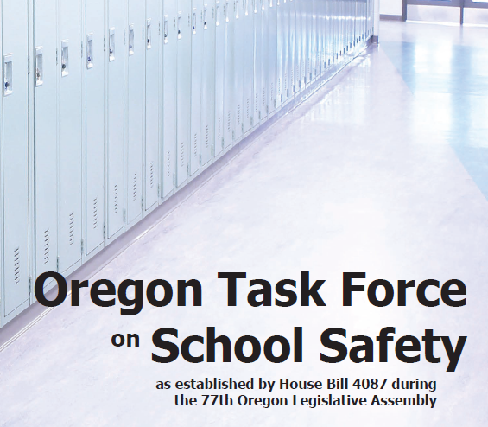








Slide 2

Recommendations
Establishing a Statewide
Threat Assessment System for
Oregon Schools

Slide 3
Threat Assessment
Threat assessment is a proven method of early intervention that can help prevent acts of violence in school environments. Recommended by the FBI and US Secret Service.
Threat assessment is an investigative, fact-based approach that requires a team to work together to determine the nature of the threat, the level of risk and resources for addressing the threat and supporting the student.

Slide 4
Threat Assessment
The threat assessment model utilizes a two tiered approach for assessing risk…
  Level 1 is a school-based assessment completed by a trained site team.
  Level 2 is a community based assessment completed by a multi-agency, multi-disciplinary team.
A threat assessment team assists in intervention, management and supervision planning and ensures safety plans are implemented.

Slide 5
Threat Assessment
The OSSTF recommends establishing a statewide threat assessment system to support Oregon schools.
  Eight (8) regions – 8 FTE
A statewide system will
  Assist school personnel in identifying students who present a potential risk for...
    Reactive and targeted violence
    Non-normative and predatory sexual behavior
    Suicidal and self-injurious behavior

Slide 6
Threat Assessment
A statewide system will…
  Provide training and standardized protocols for school personnel.
  Provide supervision strategies for students who are in at-risk situations.
  Help connect students and families with community-based services and related support.
  Mitigate education community risk and liability.

Slide 7
Recommendations
Establishing a Statewide
Floorplan Database & Standardized Terminology

Slide 8
Mapping System/Database
Multi-hazard Benefits of Mapping System:
  Guide responding public safety to the portions of a facility to be checked in an active threat/barricaded subject situation.
  Large common areas can be quickly accessed by first responders
  Crucial for building evacuation planning in the event that a portion of the building cannot be used.
  First responders from outside the immediate area would have access to view floor plans enroute to a scene.
  A mapping system with a database would provide current contact information for vital school personnel.
  Key structural components can be easily located
Current Status

Slide 9
Standardized Terminology
First Responder Terminology is not consistent
Importance of Plain Speak
Subcommittee Task
  Lockdown: Quickly secure all school staff, students and visitors in rooms away from immediate danger.
  Lockout: School’s exterior doors are locked. Used in a potentially dangerous situation outside of a school. “Lockout” is a term that may be used in combination with “Lockdown.”
  Shelter in Place: Take immediate shelter where you are and isolate your inside environment from the outside environment.
  Evacuate: Remove from a place of danger to a safer place.
Based on SRP Model
Simplistic
Easy to understand

Slide 10
Recommendations
Establishing a Statewide
Tip Line

Slide 11

Statewide Tip Line

Slide 12
Questions

