Slide 1
OREGON EARLY LEARNING SYSTEM UPDATE
Government to Government Meeting
September 19, 2013
PRESENTED BY
+MEGAN IRWIN
[Early Learning System Design Manager]

Slide 2

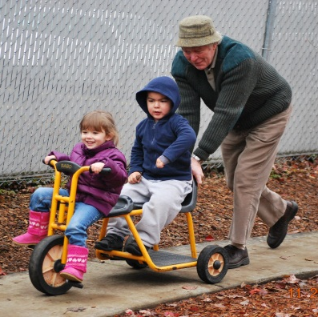


Ensuring high-quality experiences in all settings
Early Screening
High Quality Environments
(QRIS)
Kindergarten Assessment (2013)
Full Day Kindergarten (2015-2016)
Connection to Health Care
Reading at grade level in 3rd grade
Notes:
To start, let’s look at a high-level visual of early learning in Oregon. The Oregon early learning system continuum – ensuring high-quality experiences in all early childhood settings. This continuum is the path for not only getting children ready for Kindergarten, but mapping the course for health care in early learning services.
From the time a child is born, to the first 1000 days, to first walking in that Kindergarten classroom, it’s my job to ensure Oregon children have high-quality experiences in every setting they encounter. These settings are what molds their healthy well-being, their future, their readiness, and their ability to meet 3rd grade reading goals.

Slide 3
Our vision
ENSURE ALL CHILDREN ARE READY FOR KINDERGARTEN & READING AT GRADE-LEVEL IN 3rd GRADE.
CHILDREN RAISED IN STABLE AND ATTACHED FAMILIES.
INTEGRATE RESOURCES AND SERVICES STATEWIDE.
1
2
3
Notes:
We’ve applied these challenges and realities to our vision. Oregon Governor Kitzhaber’s vision and our vision is the lifeblood of what we’re doing [Refer to slide].
Governor Kitzhaber is also a doctor and has made the connection between health and education a top priority – to help support his vision. Through this, programs in health, education, and human services come together under the early learning system umbrella.

Slide 4
Our Structure
Moved into the Oregon Department of Education July 1, 2013 and officially became the Early Learning Division.
Pulled the Office of Child Care into our Division.
Governed by the Early Learning Council
Notes:
We are beginning to implement two years worth of policy ideas and planning. A big step in that direction is changing our structure.

Slide 5
Areas of focus
Connection to health care
Community lead system coordination (Hubs)
Ensuring high quality child care
Connection to K-3

Slide 6
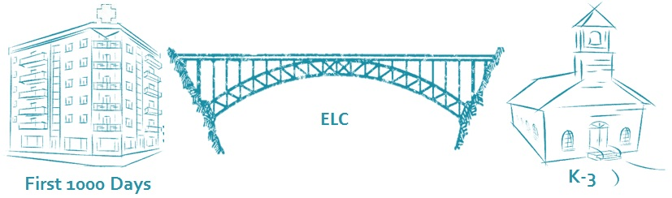
The connection to healthcare.
Healthy kids feel better and learn better.
It begins for children at the intersection of healthcare and early education.
Notes:
First and foremost, the success of Oregon’s Early Learning System relies on connecting our programs to healthcare for Oregon children.
The Early Learning System is the bridge between healthcare and K-3 and K-12 education:
Joint governance through ELC/Oregon Health Policy Board joint subcommittee
Shared goals & metrics across early learning programs with health programs
Early Identification and screening priorities
Referral and care coordination

Slide 7
Community-Based Responsibility:
Hubs.
EMPOWERING COMMUNITIES TO ENSURE ALL CHILDREN ARE READY FOR KINDERGARTEN.
KEY CHANGES
  Integrating services at a state and community level;
  Focusing on children with the highest risk; and
  Tracking outcomes at all levels.
Notes:
Hubs are the glue that brings community services together in a coordinated fashion. It’s accomplished by bridging healthcare and education; creating a comprehensive children’s budget, and collectively sharing outcomes (through accountability) for Oregon’s children.
Reaching the most at-risk, and supporting diverse communities:
Making Hubs a reality represents a new approach to reaching the highest-risk children.
We are facilitating the conversation, bringing parents and families to the table. Communities know best.
We will provide guidance, technical assistance, and data as communities identify children and families at the highest risk.
We will help communities connect to share success stories and identify models to move this work forward.

Slide 8
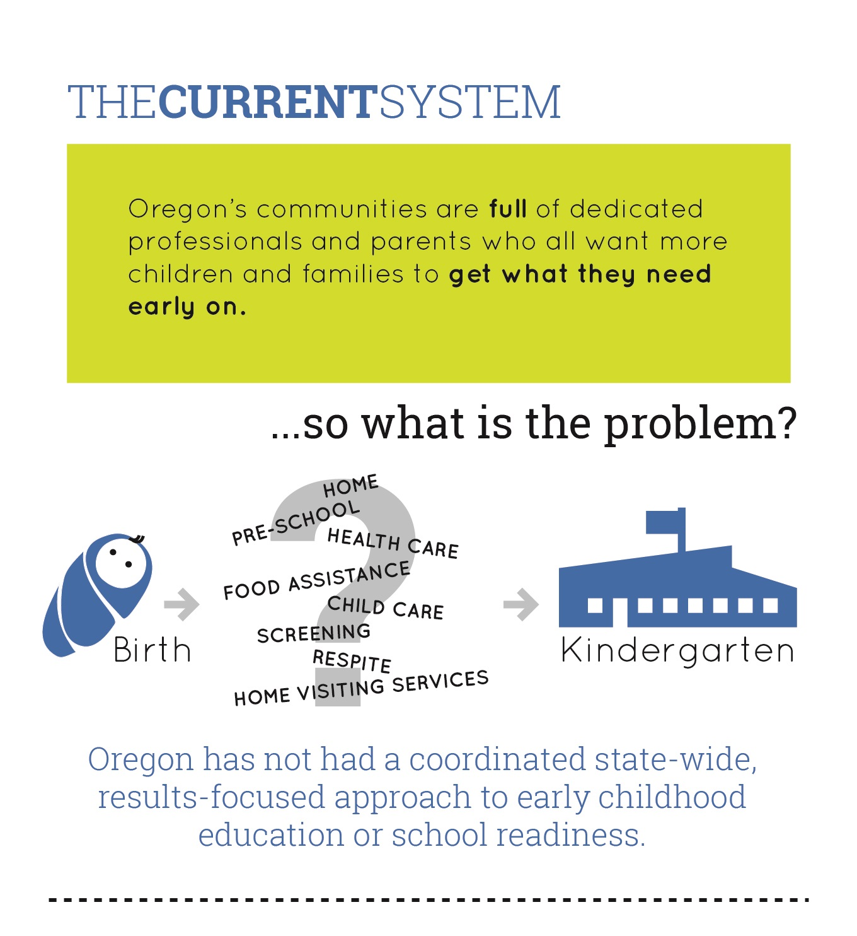
Where are we missing the mark?

Slide 9
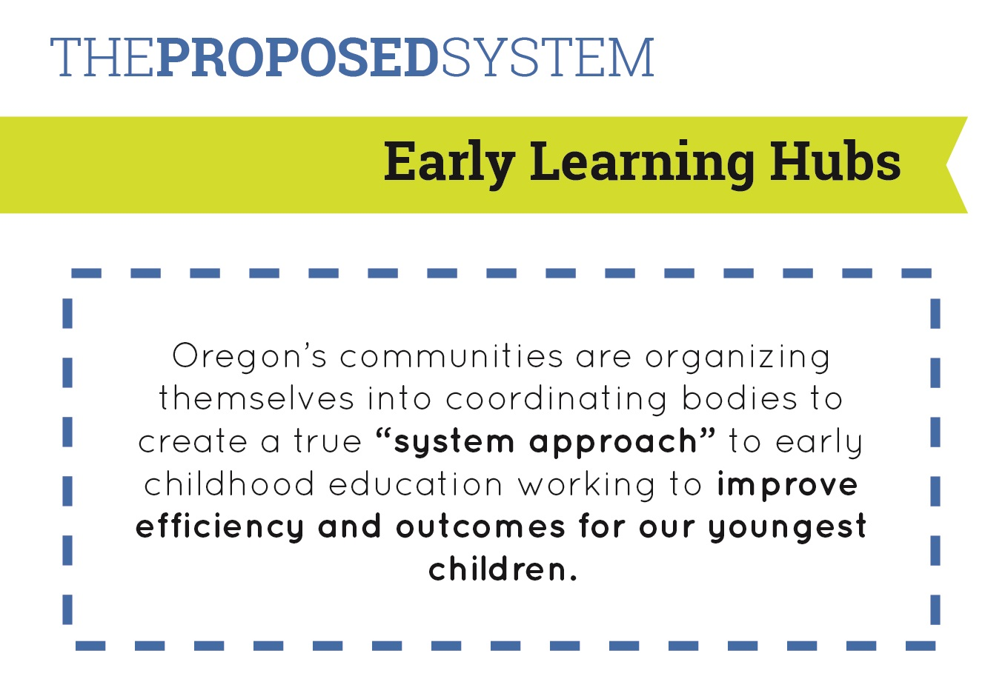
Building a system for shared responsibility.

Slide 10
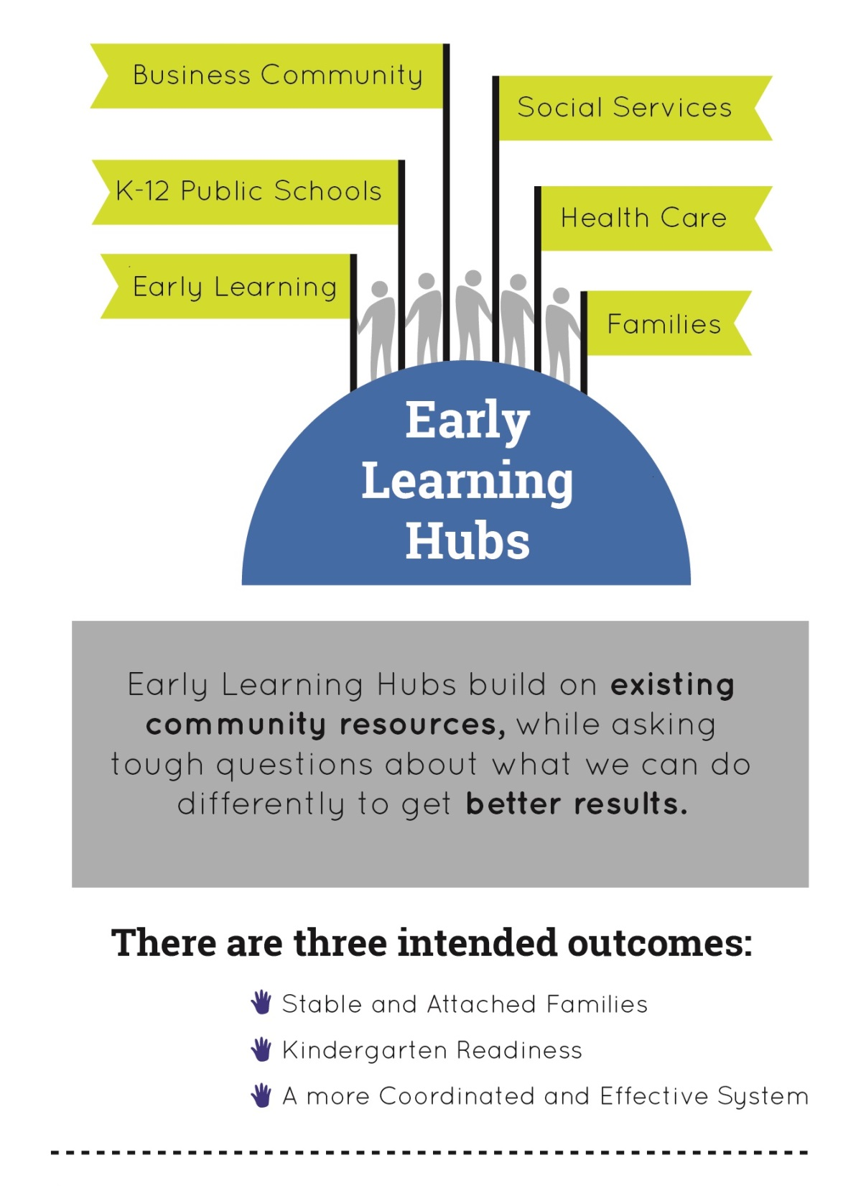
Early Learning Hubs

Slide 11
Oregon Quality Rating Improvement System
Ensuring high quality early learning environments

Slide 12
Improving child care.
Quality Rating Improvement System (QRIS).
A national movement providing options for parents and professional development for providers.
Regional field testing: Counties throughout Oregon.
Connects families to child care and early learning programs with the help of an easy-to-understand rating system.
Offers coaching and resources for child care providers to support each child’s learning and development.
Notes:
Throughout we need to be improving child care so that parents have options, can differentiate between what’s quality, and that child care providers are receiving the training and professional development they need to continue to improve [refer to IMPROVING CHILD CARE SLIDE].
Research shows professional development assistance helps providers improve the quality of their programs. And when more young children are ready for school, we all benefit.

Slide 13
Where we are today
Preparing to implement in early 2014
Financial incentives to programs – between $500 and $2,500 to help programs achieve and maintain quality.
Working to streamline the process for nationally accredited programs and for Head Start Programs to access and participate in the QRIS

Slide 14
QRIS Contact people
Dawn Woods
Office of Child Care
Dawn.woods@state.or.us
Head Start specific questions:
Christa Rude
Head Start Collaboration Director
Christa.rude@state.or.us

Slide 15
The Oregon Kindergarten Assessment

Slide 16
Oregon Kindergarten Assessment: Background
HB 4165 directs ELC and ODE to jointly develop a kindergarten readiness assessment to pilot in fall 2012 and implement statewide in fall 2013
Fall 2012 Pilot
Statewide assessment adopted into rule March 8, 2013
Statewide implementation-statewide window August 15-October 24
Notes:
HB 4165
Assembled a workgroup, November 2011
Contracted with University Researchers from U of O and OSU
Considered kindergarten assessments already used in the state and those used nationally
Conducted superintendent survey, community forums and focus groups
Adopted composite approach in July 2012
Pilot
16 schools across Oregon
13 school districts
1,200 children
Full day/half day kindergarten
Rural/urban
Diverse race and ethnicity
English Language Learners
Children with special needs
Geographic and economic diversity
Large and small elementary schools
Pilot Process Evaluation conducted by Portland State University
Used “lessons learned” to plan for statewide implementation
OAR
March 8, 2013
The State Board of Education adopted OAR 581-022-2130
Directs all school districts to administer the Oregon Kindergarten Assessment to students enrolled in kindergarten beginning with the 2013-2014 school year
Statewide Window
Schools are imposing their own 6 week window within the wider statewide window. To get a true picture of a child’s learning and development at kindergarten entry, it is imperative that the assessment is administered in the first 6 weeks.

Slide 17
Oregon Kindergarten Assessment:
Three Segments
Early literacy (direct assessment)
easyCBM English letter names
easyCBM English letter sounds
easyCBM Spanish syllable sounds*
*only for Spanish Speaking English Language Learners
Early math (direct assessment)
easyCBM Numbers and Operations
Approaches to Learning (observational assessment)
Child Behavior Rating Scale
Notes:
This fall children entering kindergarten are participating in a statewide assessment that includes measures in early literacy, early math and approaches to learning.
Directions for these assessments are available in both English and Spanish.
Early Literacy Measures
Letter Names
The student sees a chart with upper and lowercase letters. This is a timed assessment, at 60 seconds, to measure fluency. The student has 60 seconds to identify as many letters as he/she can.
Letter sounds
The student sees a chart with upper and lowercase letters and some letter blends. This is a timed assessment, at 60 seconds, to measure fluency. The student has 60 seconds to make as many letter sounds as he/she can.
Spanish Syllable Sounds
Spanish-speaking English language learners will also take the Spanish Syllable Sound assessment. The student sees a chart with Spanish syllables. This is a timed assessment, at 60 seconds, to measure fluency. The student has 60 seconds to identify as many letters as he/she can. There is a waiver available to districts for the 2013-2014 year. All districts will administer Spanish Syllable Sounds in the 2014-2015 year.
Math: Numbers and Operations
Numbers and Operations has two sample items and 16 items. It is not timed. Students view items that include counting, simple addition, simple subtraction, and recognizing number patterns. The assessment is multiple choice, students choose (by pointing) from three possible answers. For instance, a student might see a row of five stars and the assessor would ask, “How many?”
Child Behavior Rating Scale
The child behavior rating scale has 15 items that teachers score based on observation of the student in the classroom during regular classroom activities and routines. The scale focuses on approaches to learning, self-regulation, and social-emotional. For instance, one of the items is: “Completes tasks successfully.” The teacher uses a five point scale, ranging from never exhibits the behavior to always exhibit the behavior.
We are very excited about this measure. Recent research strongly indicates that how a child approaches their learning and how they self-regulate has a strong correlation to their future academic achievement.

Slide 18
Oregon Kindergarten Assessment: Timeline
August 12-October 24, 2013 : Statewide assessment window
October 2013: KA Specifications and Blueprints
November 1, 2013: Data Entry Deadline
November 2013: KA Interpretive Panel
December 2013: Report back to districts
January 2014: State Report
February 2014: Hubs/Regional Report
February 2014: Lessons Learned
Notes:
Statewide Assessment Window
Schools are required to impose their own 6 week window within the wider statewide window. To get a true picture of a child’s learning and development at kindergarten entry, it is imperative that the assessment is administered in the first 6 weeks.
Test Specs
While we cannot share items on the actual kindergarten assessment, we are excited to announce that the Kindergarten Assessment Test Specifications and Blueprints document has been posted on the ODE website. The Specifications are designed for educators administering the 2013-2014 Oregon Kindergarten Assessment and the general public who are interested in understanding the content being assessed and the format criteria used. You can review the Specifications document that is now posted on the ODE Website at http://www.ode.state.or.us/search/page/?id=496. In addition, we are working on a one-two page document that is more accessible for parents and community partners.
Data Entry Deadline
The data is due to be submitted to ODE by November 1, 2013
November KA Interpretive Panel
In November, we will host a Kindergarten Assessment Interpretive Panel. This panel will include K-3 teachers, researchers, ODE Staff, special education, ELL, and early learning partners.
Draft guidelines for the interpretation of KA results at the state, hub, district, school, classroom and individual student levels.
o What interpretations and uses of KA scores are valid?
o Should readiness standards be developed, and if so, how should they be used?
o What are the purposes of the KA?
Provide guidance for report design at the state, hub, district, school, classroom and student levels
Provide advice on standard-setting purposes and procedures (if this is the direction endorsed by the group)
Identify additional information or changes in the measures that would help make the KA useful for various stakeholders
Report Back to districts (December)
We anticipate having initial reports back to districts in December. Some of this will hinge on how clean the data is. Given that this is an Operational Field Test year and the fact that we don’t have other years to compare to, this year reporting will be norm. The norm-referenced reporting can show how students/schools/districts performed as compared to peers who took the same assessment. We could report scores as a percentile ranking.
State Report (January)
State Norms
HUBS/Regional Report (February)
For the February report, we can share how regions and hubs compare to the state norms.
The norm-referenced reporting would show how students/schools/districts performed as compared to peers who took the same assessment. We could report scores as a percentile ranking.

Slide 19
Key Kindergarten Assessment Contact Person
Kara Williams
Oregon Department of Education
ECE & Kindergarten Specialist
Kara.williams@state.or.us

Slide 20
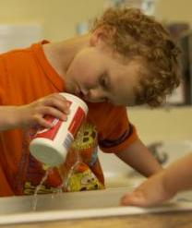
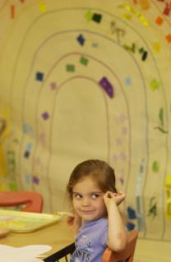
Oregon’s
Quality Rating and Improvement System
QRIS

Slide 21



Quality
Rating & Improvement System
Supports early learning and development, and assist programs in providing high-quality care and education by offering supports and incentives.
Help parents and caregivers find high-quality learning and development programs that fit their needs with an easy to understand rating system.
Helps ensure that children have high-quality learning opportunities so that more children are ready for success in school and life.
Notes:
The QRIS aligns with Oregon’s priorities for young children: Helping Oregon’s children enter Kindergarten ready to succeed, ensuring that parents have the support and resources to create a positive family environment, and streamlining pockets of services under one umbrella for parents and families.

Slide 22
Overview of the QRIS
The Quality Rating and Improvement System uses a set of progressively higher program standards to evaluate the quality of an Early Learning and Development Program and to support program improvement.
Building Block Approach
5 tiers
Portfolio system of documentation
Family and Center languaged versions

Slide 23
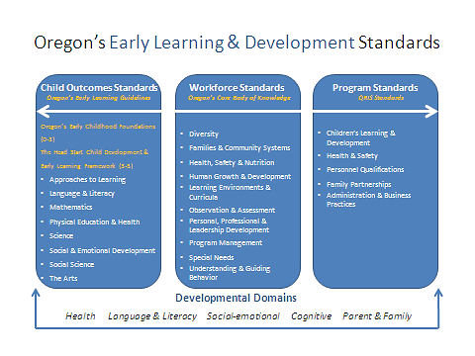
Oregon’s Standards
The standards establish the State’s quality framework and articulate a vision for moving programs to a level of quality that will support healthy development and school success for all children. The QRIS incorporates and aligns early learning guidelines, practitioner knowledge, and program standards that apply across sectors and age ranges.

Slide 24
5 Tier Building Block System
Supports
Incentives
Commitment to Quality
Licensed

Slide 25
Portfolio System
For a Commitment to Quality designation programs complete an application.
★ For a 3, 4 or 5 Star designation programs develop and submit a Program Portfolio.
Balance of evidence
  Data
  Documentation
  Report
  Observation
Reviewed by experts

Slide 26
Oregon QRIS Process
Attend Increasing Quality Training
Learn about the Program.
Submit Application
Decide where you are and where you want to go.
Receive support
Assistance and money available for the QRIS process.
Submit Portfolio
Get a financial incentive to help support your quality and a QRIS rating that you can use to show off your program to parents and the community!

Slide 27
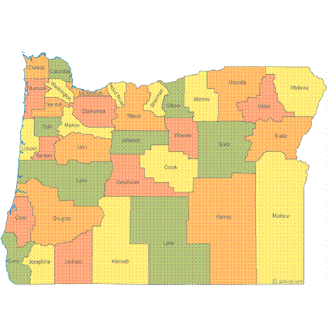
Field Test Regions
Multnomah County
Crook/Deschutes/
Jefferson Counties
Linn/Benton Counties
Lane/Douglas Counties
Notes:
Oregon’s QRIS provides participating programs with a star rating that communicates their level of quality they have demonstrated. Programs in four regions are currently eligible to apply for a star rating. We are thrilled to be announcing today the first quality rated programs in Oregon !

Slide 28
QRIS Contact Person
Dawn Woods
Early Learning Division
Quality Improvement Manager
Dawn.a.woods@state.or.us
QRIS information
www.wou.edu/tri/QRIS

