Slide 1
The AdvancED Protocol:
Continuous Improvement through Accreditation for Schools
An Overview

Slide 2
Consider these questions…
Why do football coaches tell players to get in the film room?
Why don’t painters show up on Day #1 and just start painting right away?
Don’t they already have the TOOLS they need for success?

Slide 3
For truly Successful, Lasting, Meaningful Continuous Improvement Efforts at your school…..
We can teach you the tools for the AdvancED process.
But you need the commitment to the needed PREPARATION for real success.
That preparation requires frequent, quality communication and collaboration and effective use of the tools.

Slide 4
Workshop Goals
Understand the relationship between continuous improvement and accreditation
Gain awareness of the AdvancED protocol
Explore how to use diagnostic tools for meaningful self assessment and continuous improvement
Understand the AdvancED External Review process as the foundation for continuous improvement
Notes:
Explain that participants will learn about the roles and responsibilities of both the system and its schools in fulfilling and honoring the elements of continuous improvement and AdvancED accreditation.
Weave this concept as a theme throughout the workshop.
The new protocol provides an opportunity to celebrate the power of internal review and its value to the institution for continuous improvement. The emphasis on the comprehensive diagnostics accompanied by analysis and reflection illustrates that accreditation is about informed and meaningful improvement. While external review still carries a high value, it is not viewed as the essence of accreditation. It is the relationship/ combination of internal and external review that define the whole of accreditation. As institutions become aware of this, a major shift in thinking occurs – they are not going through the requirements for AdvancED but rather for the improvement of their institution (empowerment) and impact on their students. (and thus continuous improvement).
Session has 3 segments
An overview of the Standards and Protocol for accreditation and continuous improvement.
An overview of the diagnostic tools comprising internal review.
Includes ASSIST
Introduces tools and resources

Slide 5
AdvancED
The World’s Largest Educational Community
32,000 public and private schools
50 states, the Navajo Nation, and Puerto Rico
Department of Defense Education Activity
71 countries
16 million students
18,000 volunteers
3 million plus teachers
200+ staff members
Notes:
5
NWAC had 7 states and international division, but this is obviously huge growth in our organization!
5

Slide 6
Regional Accrediting Agencies
New England
Northwest*
Middle States
North Central*
Western
Southern*
*AdvancED Accreditation Divisions
Notes:
AdvancED offers school improvement and accreditation services to education providers of all types in their pursuit of excellence in serving students. Continuous improvement through process, content and technology is our business. We operate three regional accrediting agencies, accrediting 30,000 institutions in over 70 countries serving over 16 million students.
The North Central Association Commission on Accreditation and School Improvement (NCA CASI), Northwest Accreditation Commission (NWAC), and the Southern Association of Colleges and Schools Council on Accreditation and School Improvement (SACS CASI) are accreditation divisions of AdvancED.

Slide 7
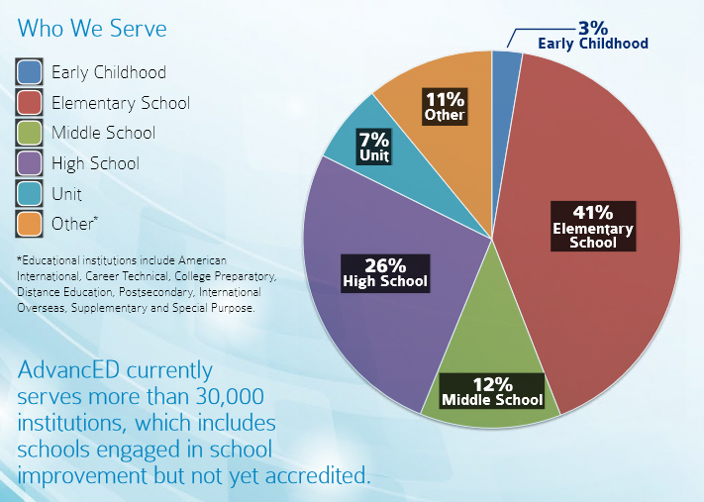
Who We Serve
Percentages of Schools
Notes:
One surprise in the PNW may be that 44% of the schools we serve are elementary! That’s not as common in PNW as in some other areas of the country.

Slide 8

Institution Expectations
Meet AdvancED Accreditation Standards for Quality Schools
Implement a continuous improvement process
Conduct Internal Review
Demographics
Executive Summary
Standards Self Assessment
Stakeholder Feedback Diagnostic
Student Performance Diagnostic
Improvement Plan
Assurances
Host External Review once every 5 years
Respond to Required Actions
Notes:
This slide summarizes what institutions must due to honor and fulfill the requirements of accreditation.
It provides an overview of the work from the school’s perspective.
Here is where you introduce the components of internal review.
This is also the place where you “marry” those components with the technology partner (ASSIST)
At this point – focus on the big picture. Either name or briefly define the bullets on this slide. (If you prefer - you can use the next slide to briefly define the internal review components and just name them here.)
It is also important to stress the importance and tradition of standards, continuous improvement, and external review – these have always been hallmarks of accreditation. (each has evolved and improved over time as we too strive to continuously improve)
State the “Respond to RA” as a means for the school to be responsible and accountable for acting on the findings of the review team. It also promotes improvement and illustrates the continuous nature of the protocol.

Slide 9
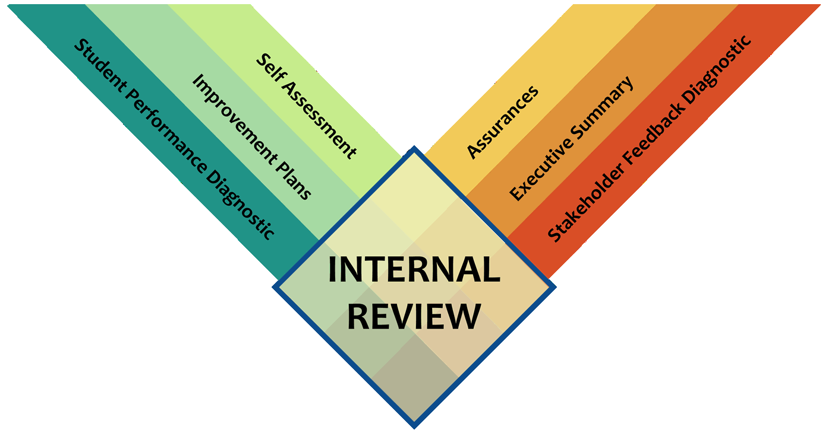
Accreditation
Notes:
This slide just shows the 6 elements of the internal review process. It zeros in on what was shared on other slides.

Slide 10
Self-Assessment
AdvancED School Standards for Continuous Improvement
SELF ASSESSMENT
Notes:
For this session, you will need the Learning Guide and the Abbreviated Standards.
Do introductions, audience demographics (characteristics) and some type of ice-breaker
If the audience is large, have them introduce themselves to 2-3 people in the room that they don’t know – make them walk around to do this. Provide a 3 minute time limit. If time is an issue, have them take a few minutes to introduce themselves to the rest of their table group or to the people around them (if seated theater style).
Why the changes? Just as we ask our schools to continue to improve, AdvancED continuously seeks to improve the accreditation process based on research and feedback from our schools and districts as well as to provide schools with increasingly helpful and effective resources and tools.

Slide 11
The AdvancED Process for Continuous Improvement
The process is a performance-based model that employs diagnostic tools for schools to
Conduct Internal Reviews focused on evaluating performance related to
Standards and Indicators
Student Performance
Stakeholder Feedback
Notes:
The New Protocol capitalizes on ...and incorporates valuable data schools have …. into the accreditation process. In addition to standards and indicators - schools will share their summative student performance results and perceptions of their key stakeholders (students, parents and staff).
This will provide a richer picture of the performance of the school and provide a broader foundation from which to make meaningful decisions and take appropriate action. This will also enhance the school’s ability/opportunity to effectively monitor, impact and demonstrate improvement.

Slide 12
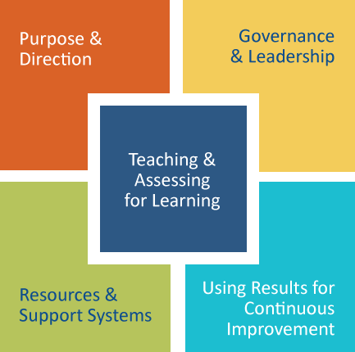
AdvancED School Standards for Continuous Improvement
1
2
3
4
5
Early Learning
Resources &
Support Systems
Notes:
These are the five standards that went into effect July 1, 2012.
By policy, standards are reviewed every 5 years. This is to ensure they are reflective of current pedagogy and practice and are of quality and educational relevancy. (We practice what we preach and strive to continuously improve.)
Note – it is not the number of standards but (as you will see) the comprehensive picture of quality they define and describe.
Together, the standards provide a complete and rich whole. It is their connectedness that makes them rich and powerful. The standards provide a roadmap toward excellence.
New Information: One of the new changes that you will encounter as you begin your External Reviews is the addition of the Early Learning component for schools that house a Pre-K component. When your school logs onto ASSIST to begin the completion of their Self Assessment they will choose one of two options (see notes under “Applying the Proper Standards”).
Note that you’ll deal with early learning Standard 4 only if the school has an early learning program.
Applying the Proper Standards:
1. Early Learning Schools—Use Early Learning Standards: If the early learning school also offers Kindergarten, that is okay. For the Kindergarten grade, we will ask the External Team to verify teacher qualifications and other state requirements that apply to Kindergarten in that state.
2. Elementary Schools with Pre-School Grades—Use School Standards: In addition to the 5 school accreditation standards, these schools will be asked to address Early Learning Standard 4 (Early Learning Resources and Support Systems) in the self-study diagnostic.
Early Learning Resources Webpage: www.advanc-ed.org/earlylearningresources: This extranet resources web-page is intended for early learning schools and provides the standards, workbooks, and additional tools to support the early learning protocol.

Slide 13

Standards
Statements (5)
Indicators (33)
Focus of internal review
Rated individually
Contain multiple concepts
Quality Evidence (multiple sources)
Performance Rubrics
Four levels
Notes:
Architecture of the Standards.
The five AdvancED Standards are comprehensive statements of quality practices and conditions that research and best practice indicate are necessary for schools to achieve quality student performance results and organizational effectiveness.
Comprising each standard are indicators. The indicators are operational definitions or descriptions of exemplary practices and processes. When seen together, the indicators provide a comprehensive picture of each standard. Mention that Teaching and Assessing for Learning (Standard 3) has 12 indicators. What does this tell us? The 33 indicators will be rated individually on a 1-4 scale (four descriptive levels) that detail varying degrees of performance. No longer use labels (not evident – highly functioning) The performance levels contain rich, detailed descriptors of what this indicator looks like in practice.
Evidence identifies the practices and/or processes being implemented that demonstrate the degree to which the school is meeting the indicator. It supports (provides proof) the claim made and answers the how do we know we are doing what we say.
We have a great analogy to use here. Think of the USA as a big jigsaw puzzle. Each standard represents a section of the country. The indicators represent the states. When all of the pieces exist – a complete picture results. If the performance level is a 4, the color of the piece is rich and vibrant. If it is a 1, the piece is dull and flat – looking like a hole or missing part. You get the idea! Elaborate.

Slide 14
AdvancED Standards for Quality Schools
The AdvancED Standards are research-based comprehensive quality statements that:
Describe conditions that are necessary to achieve higher levels of student performance and organizational effectiveness
Offer a road map for the pursuit of excellence in education
Guide continuous improvement efforts
Notes:
Examines organizational effectiveness
Analyzes student performance
Engages stakeholders in deliberate reflection
Promotes deep and collective understanding of practices, processes and impact
Involves stakeholders in the continuous improvement of the school
Provides a framework for rich dialogue and important discussion
Produces valid evidence to inform and guide action
Positions school to strategically improve
Provides context and information to the External Review Team

Slide 15
Standards Self Assessment
Standards – statements of quality
Create a process to gather and analyze data
Rate Indicators – descriptive targets
Determine Performance Level
Identify supporting evidence
Write a short standard narrative
Notes:
The Standard Workbook located on the Resources and Tools page will guide you through this process.
Stakeholders: It is important that you employ a process that systematically and purposefully engages and involves your stakeholders. They have a great deal to contribute to the validity and reliability of your assessment. Plus, stakeholder involvement builds ownership that in turn builds commitment and deepens understanding. The rich discussion surrounding the analysis and decision-making is very productive and valuable.
Process
For each standard, rate every individual indicator as 1-4 using the descriptive performance levels. (The language within the levels help to build consensus.) Identify the evidence that supports your rating. The individual indicator ratings will roll up to compute an over-all standard rating. For the standard (as a whole) the system will write a short narrative by responding to a series of guiding questions. (Describe)
After completing ratings of all indicators and standard narratives, describe the process you used to gather and analyze data for the self-assessment. This is important as the process, not just the product, has value.

Slide 16
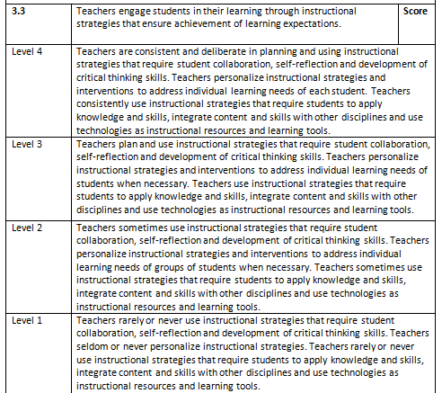

Slide 18
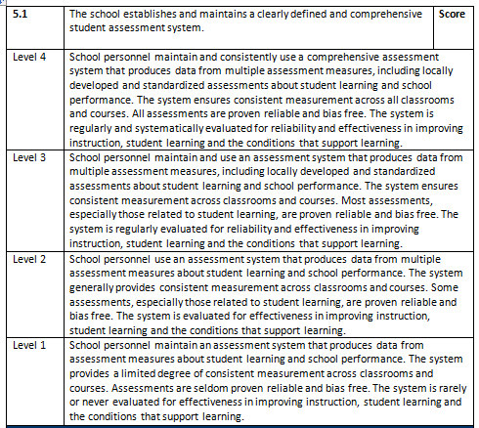

Slide 20
Characteristics of Evidence
Quality Matters
If the quality of evidence is high, it provides value to the continuous improvement process.
Provide the quality evidence that led to your self ratings. It is not the quantity of evidence that is most important.
Quality
Results
Notes:
NOTES
Evidence has to be high quality. What if the quality ISN’T high?
If evidence is not high quality, then results don’t matter.
Make sure your evidence is aligned to the indicator and relevant!!!
Keep this in mind:
Quality matters
Results matter
We don’t accredit on weight but on quality and results!

Slide 21
Standard Narrative
Based on responses to each of the Indicators and Performance Levels respond to the following questions when drafting your narrative response.
Use language from the Performance Level descriptions to guide your writing. Cite sources of evidence the External Review Team members may be interested in reviewing.
What were the areas of strength you noted?
What were areas in need of improvement?
What actions are you implementing to sustain the areas of strength?
What plans are you making to improve the areas of need?
Notes:
This is the prompt you will see after you have responded to each of the indicators. This is an EXTREMELY important piece! This is only one of two opportunities (ES is the other one) you have in the self assessment to inform the team WHY you made the selections you made!!! One person has called this “the most valuable real estate in the self assessment.” Use your 6,000 characters WISELY!
Perhaps you could have each standard committee write a response in a Word document and share it with everyone to get ideas and consensus, then paste it into the self assessment.

Slide 22
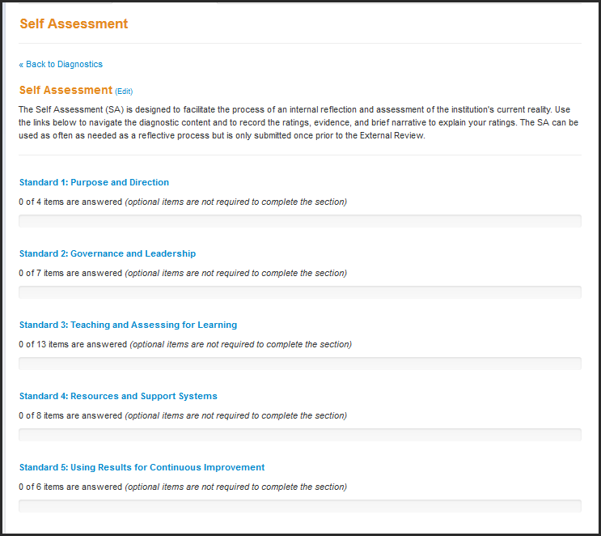

Slide 23
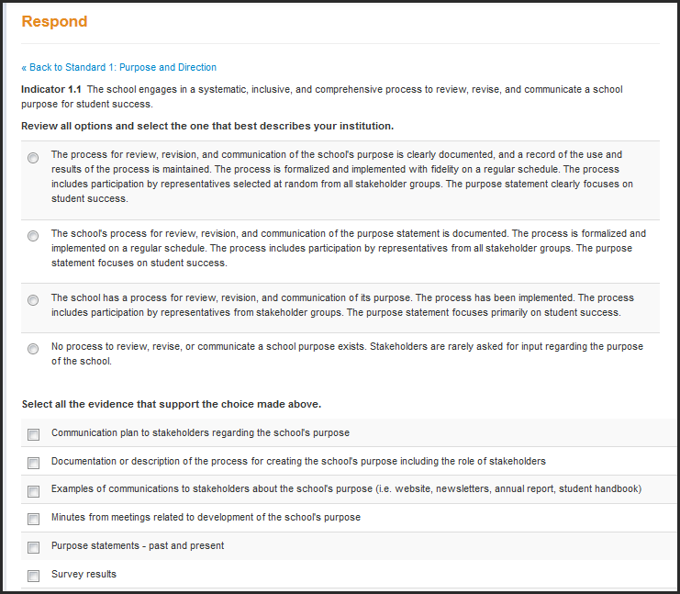

Slide 24
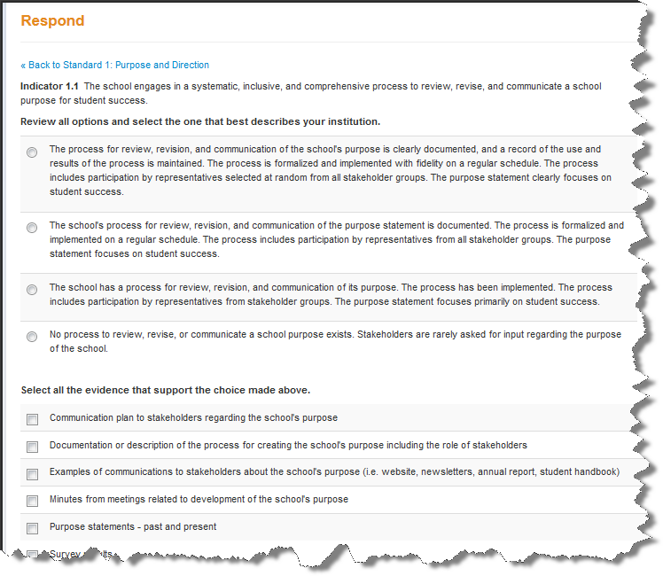
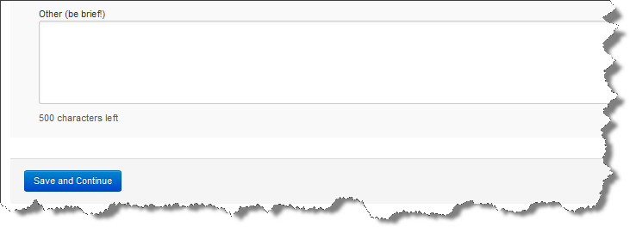

Slide 25
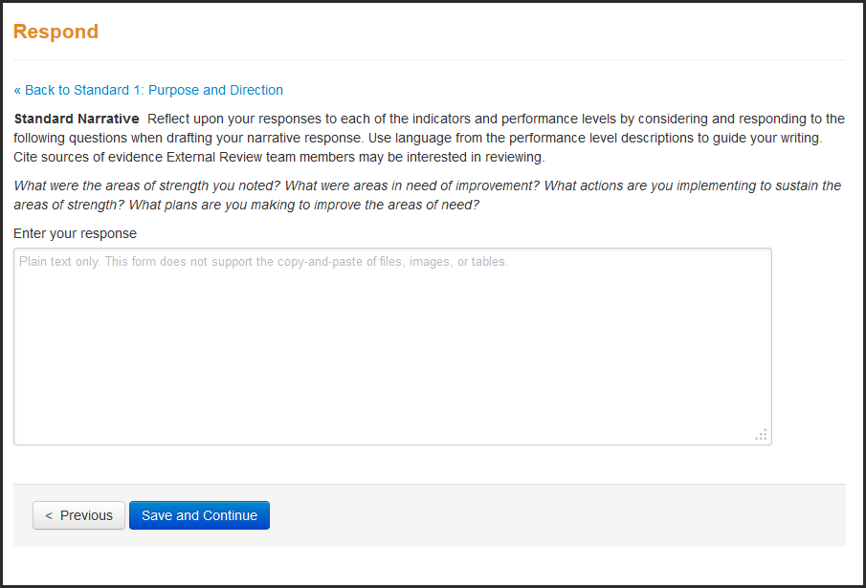

Slide 26
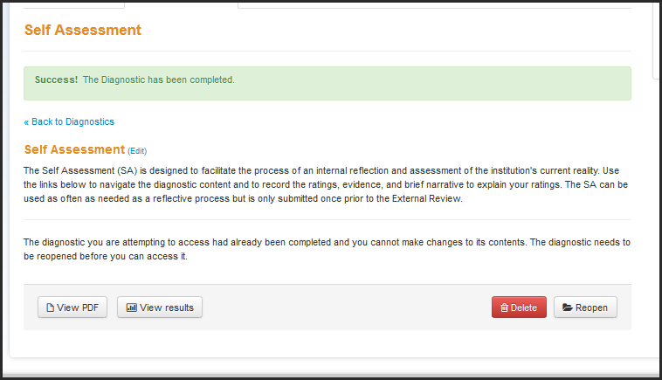
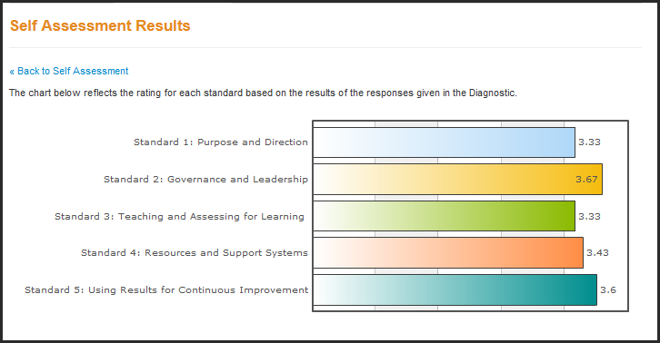

Slide 27
Continuous Improvement
How might the Self Assessment become part of your continuous improvement process?

Slide 28
Student Performance
AdvancED Student Performance Diagnostic for Continuous Improvement
STUDENT PERFORMANCE
Notes:
For this session, you will need the Learning Guide and the Abbreviated Standards.

Slide 29

AdvancED Approach to Student Performance
Allows multiple assessments and multiple administrations
Provides a comprehensive picture of student performance over time
Allows review of results through the lens of status, improvement and/or growth
Notes:
These are relatively self-explanatory. Focus on the first two bullets, especially the second.
If you get questions about weighted scores, you’ll talk more about that in the upcoming slides, but for now, know that though the AdvancED process weights scores by the number of students tested, it also allows multiple tests that may better represent the performance of the student population.
Diagnostics: If someone says, “We already analyze our results! Why do we have to do your analysis?” First, AdvancED has found that the institutions today are “data rich” and “analysis poor.” People are so overwhelmed by data, they don’t know what to do with it. Remember: COLLECTING data is not equivalent to ANALYZING data. Second, if you are already doing a thorough analysis, you can simply copy the results into our diagnostic: no extra analysis work involved.

Slide 30
Using Student Performance Results
Student learning is the core business of educational institutions.
Institutions should consider all student performance data when determining their achievement and needs.
Analyzing student learning results along with the Standards and Indicators provides the basis for root cause analysis and development of continuous improvement plans.
Notes:
We’ve been questioned about this a great deal. Here are some questions and potential answers.
Q1: Isn’t this just another way to “hammer” schools – setting up another way for them to fail?
A1: No! AdvancED has always agreed with the intent of NCLB, but we have NEVER agreed with the metrics. You will see how our new process is much more fair than NCLB.
Q2: Who is “the public” and why does AdvancED care what the public thinks?
A2: For over 100 years, the intent of accreditation has been “to protect the public’s trust” in accredited organizations. That’s a big part of our mission. Who is “the public”? Of course it includes parents, but more and more we are focusing on legislators so that they won’t continue to enact laws and regulations that simply don’t work.
Q3: Hasn’t student performance always been considered as part of the review of the Standards?
A3: Yes, but only in an indirect way. By adding a specific component for student performance, AdvancED can demonstrate to the world that ACCREDITED schools are GOOD schools.

Slide 31

Three Main Components in the Process
Student Performance Data
Evaluative Criteria
Diagnostic Questions
Data Document Guidelines
www.advanc-ed.org/systemsresources
Notes:
The DIAGNOSTIC is part of ASSIST, and they will need to do both.
Copies of the worksheet can be downloaded at this address or off the school or district resource pages (www.advanc-ed.org/schoolresources).
ASSIST Technical Guide Administering Diagnostics pg. 9 – 12 Contain very specific directions for completing the Diagnostic

Slide 32
Student Performance Data
Provide assessment results in tables, graphs or other depictions that provide summative assessment data.
Data provided includes longitudinal results that are disaggregated by appropriate subgroups for the institution.
Complete these as a part of the Student Performance Data Document and upload into ASSISTTM.

Slide 33
Evaluative Criteria
Four Criteria with Performance Levels
Assessment Quality
Test Administration
Quality of Learning
Equity of Learning
Used by the External Review team to evaluate student performance results
Forms the basis for continuous improvement planning

Slide 34
The Diagnostic
Diagnostic Questions
Six questions for areas of notable achievement and six for areas in need of improvement
Consider
Do your identified data sources answer these questions?
What additional data might you need to answer the questions?
34
Notes:
Have participants discuss the questions that are part of the Student Performance Diagnostic, then respond to the questions in the second bullet on this slide. Allow about 4 or 5 minutes maximum. Ask for some reports.

Slide 35
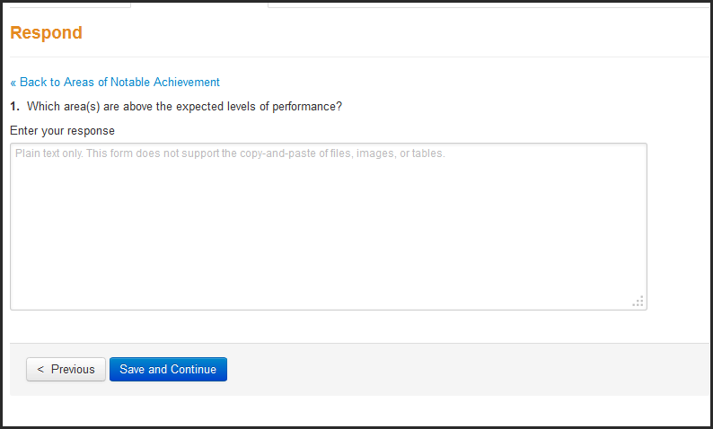

Slide 36
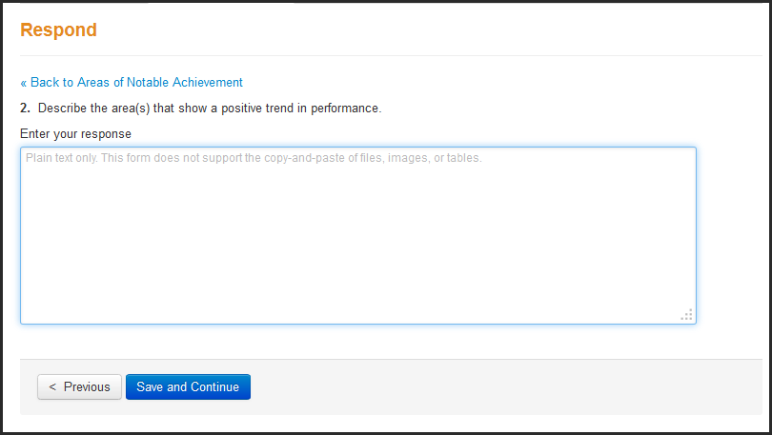

Slide 37
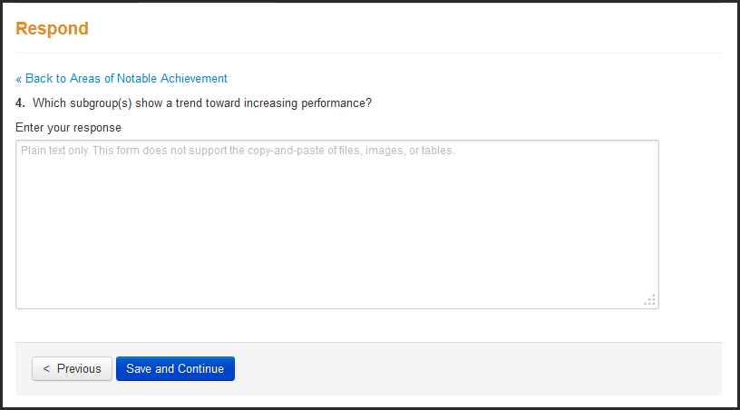

Slide 38
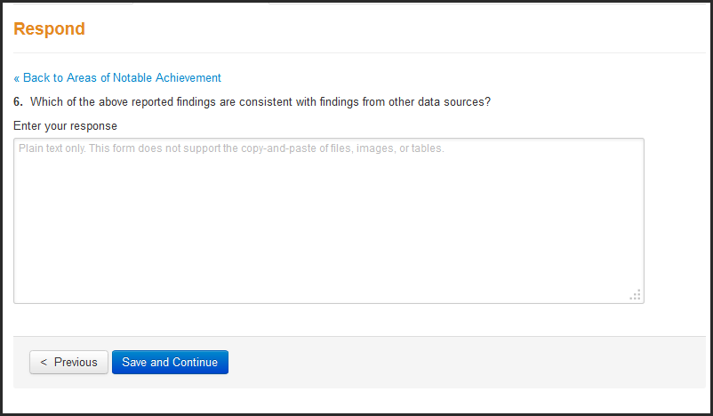

Slide 39
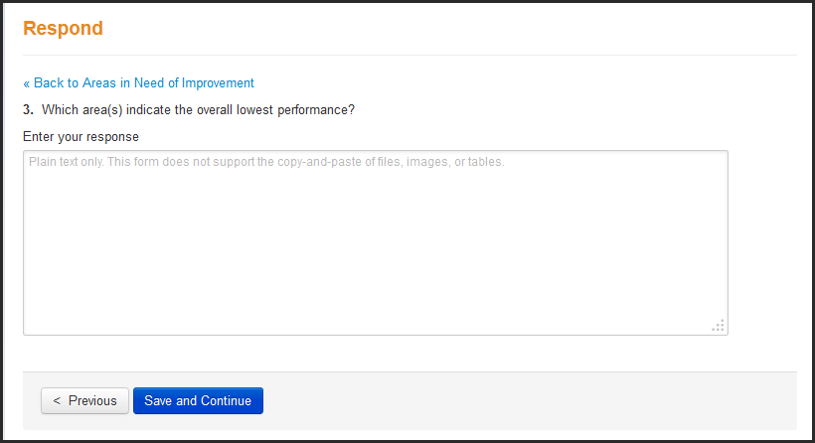

Slide 40
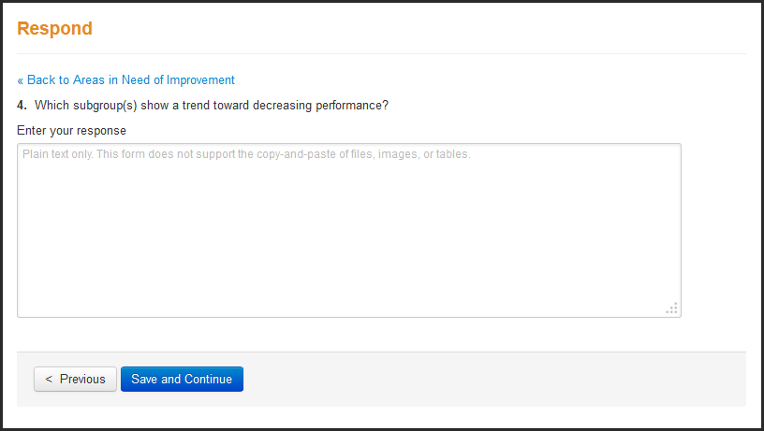

Slide 41
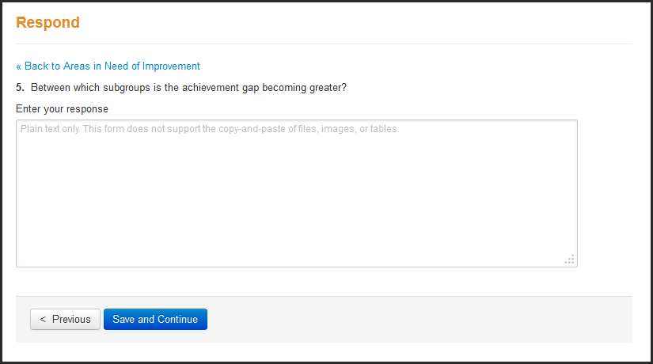

Slide 42
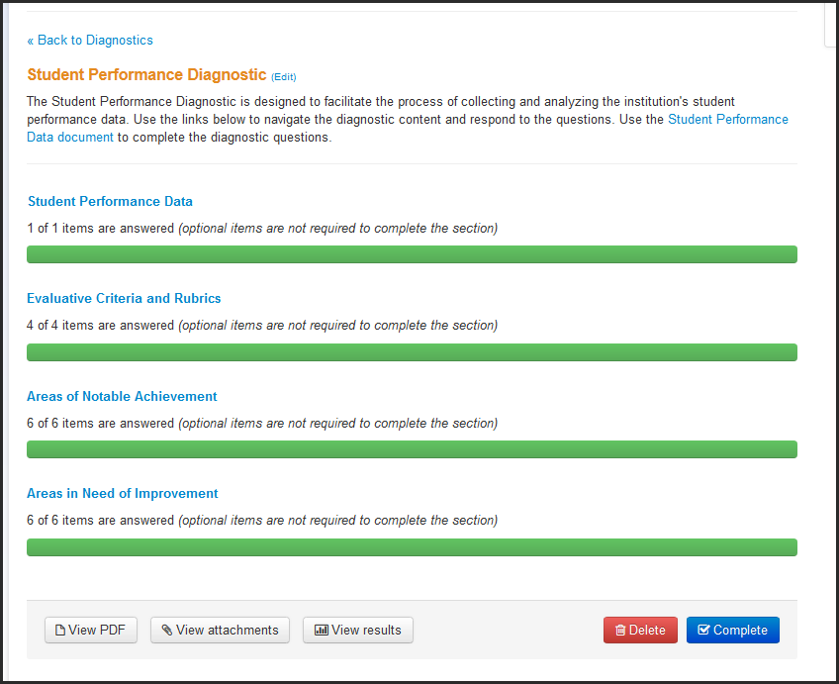
ASSIST

Slide 43
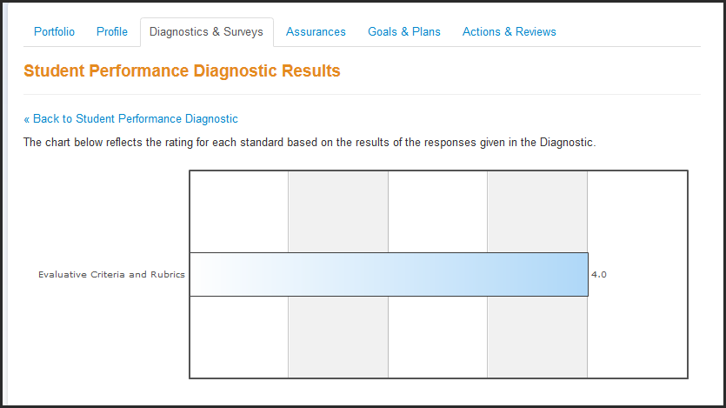
ASSIST

Slide 44
What Assessments Should You Include?
Summative instruments
Any assessments that the institution is required to administer
Assessments for all core academic areas
Longitudinal results of the same assessment
Comparison data to like institutions
Disaggregation by appropriate subgroups for the institution
Data are reported using status, improvement and/or growth
Notes:
A wide variety of questions may come up here—keep track of the ones you get stuck on and let us know.
The “ASSESSMENT MATRIX “ WordArt appears on the next click. The assessment matrix (in the Learning Guide – p 2) is OPTIONAL, but a great tool for institutions to determine where the “holes” in their assessment package exist.
Core Content areas are language arts, math, science, social studies. Participants may say they don’t have an assessment in science or social studies—they MUST have something, even if it’s a comprehensive exam or two semester exams. Else how do they know the students “passed”? [sometimes they don’t but that’s another issue entirely]

Slide 45
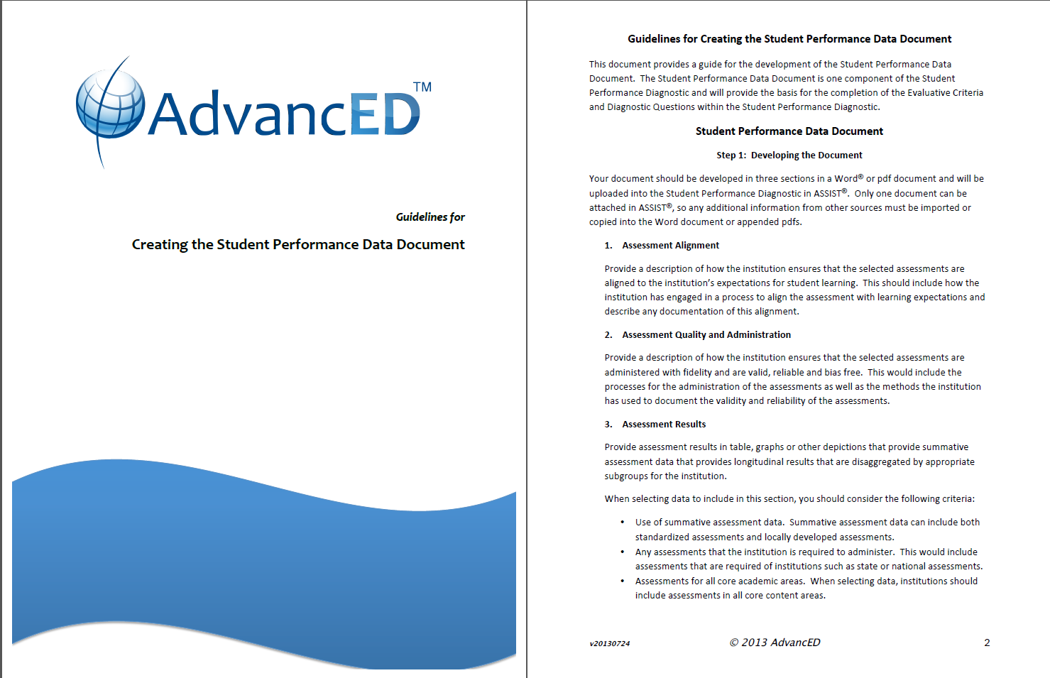

Slide 46
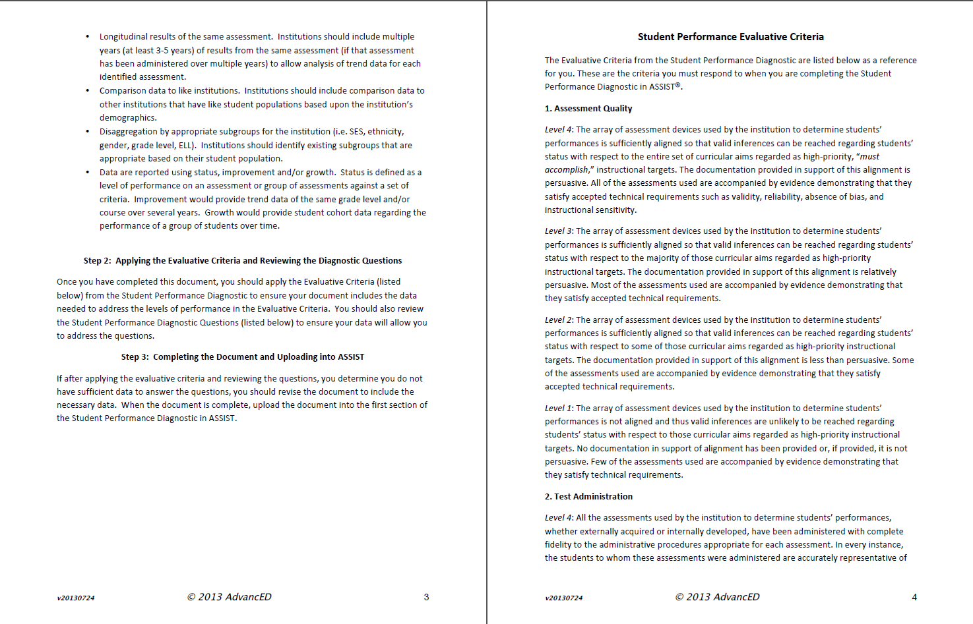

Slide 47
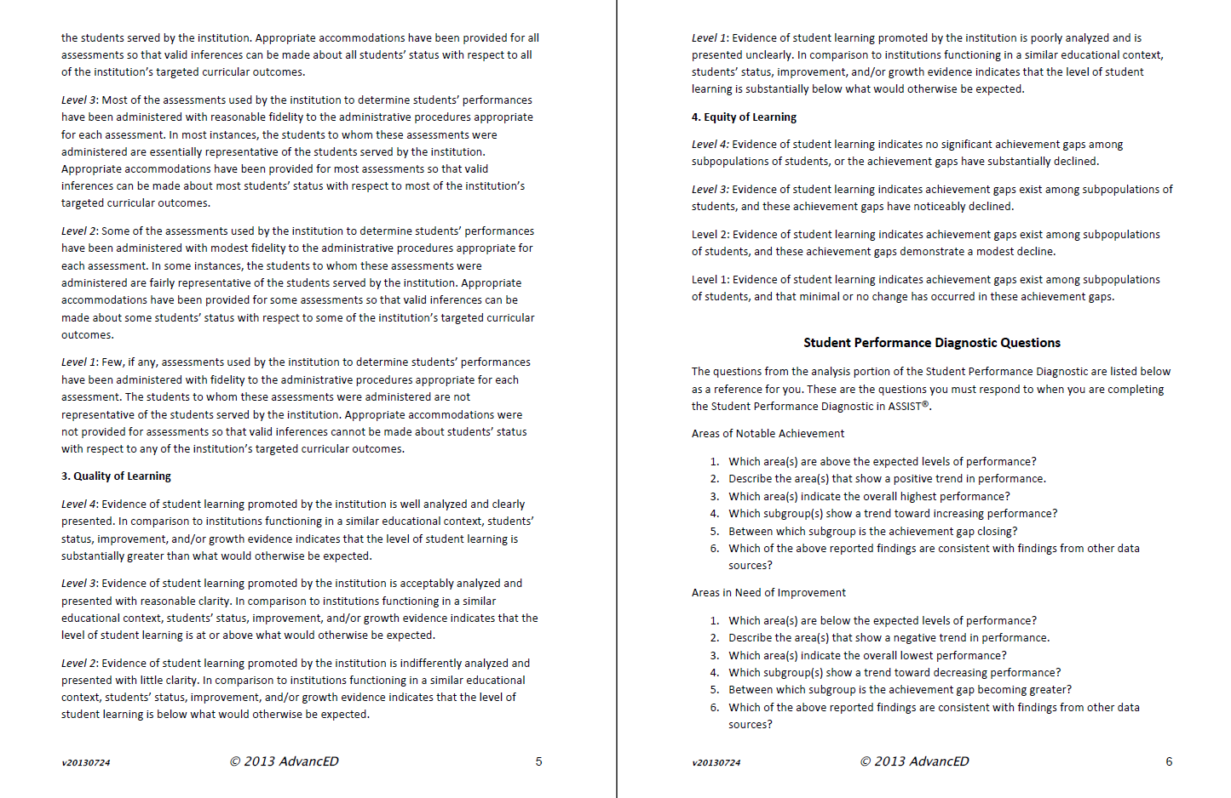

Slide 48
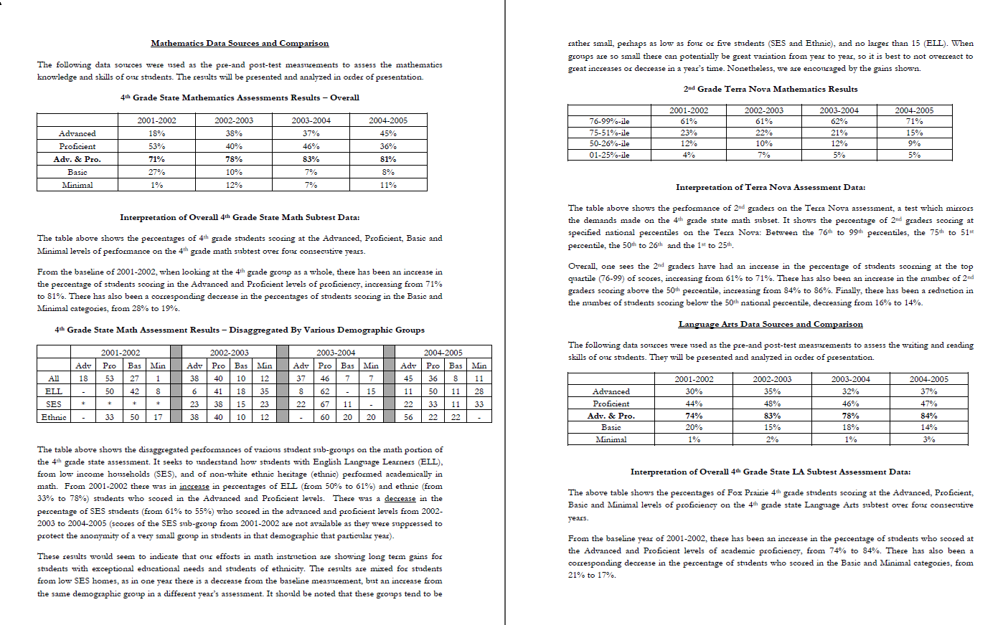

Slide 49
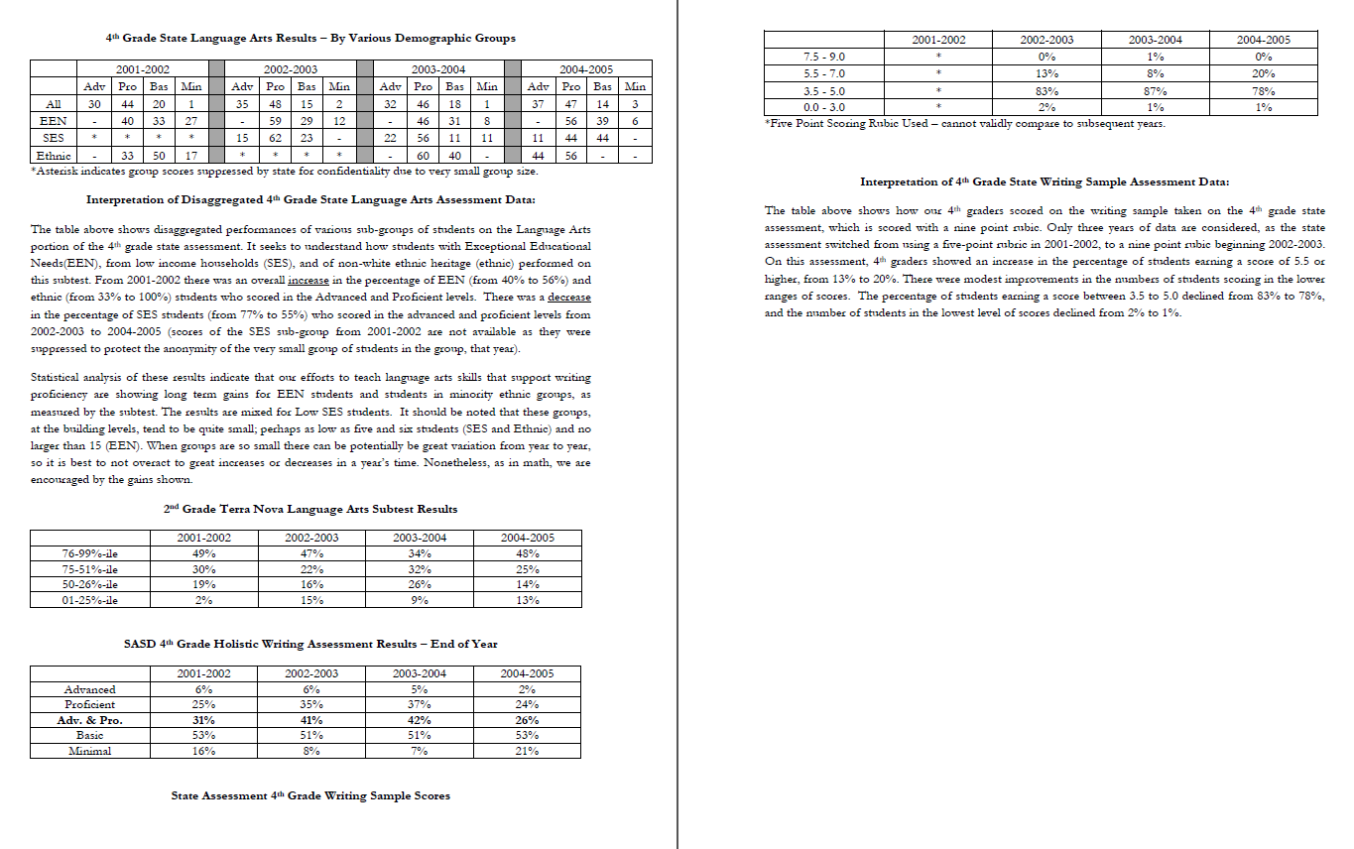

Slide 50
Continuous Improvement
How might the Student Performance Diagnostic become part of your continuous improvement process?

Slide 51
Stakeholder Feedback
AdvancED School Surveys for Continuous Improvement
STAKEHOLDER FEEDBACK
Notes:
For this session, you will need the Learning Guide and the Abbreviated Standards.
Do introductions, audience demographics (characteristics) and some type of ice-breaker
If the audience is large, have them introduce themselves to 2-3 people in the room that they don’t know – make them walk around to do this. Provide a 3 minute time limit. If time is an issue, have them take a few minutes to introduce themselves to the rest of their table group or to the people around them (if seated theater style).
Why the changes? Just as we ask our schools to continue to improve, AdvancED continuously seeks to improve the accreditation process based on research and feedback from our schools and districts as well as to provide schools with increasingly helpful and effective resources and tools.

Slide 52
Goals: Stakeholder Feedback
Understand significance of Stakeholder Feedback in continuous improvement process
Understand the importance of analyzing and using survey data
Brainstorm ideas on how to maximize returns
Increase understanding of Evaluative Criteria rubrics and narrative requirements
Practice writing sample narratives

Slide 53
Overview: Stakeholder Feedback
Engages all stakeholders (parents, students, staff)
Characterized as valid and reliable - tied to research
Administered prior to the External Review
Requires minimum response rates
(20% parents, 40% students, 60% staff)
Informs school improvement
Limit response window, similar timeframe for each group
Available for use at any time
Notes:
There are several advantages and benefits to using the surveys.
They provide a means for stakeholders to give input (not just be on the receiving end of your communications)
There are versions for staff, students and parents that are aligned so comparisons among groups and over time can be made.
Schools will be able to benchmark their results with schools around the world.
All questions align with the indicators so results easily transfer to and contribute to your standard assessment.
A technical guide will be posted – demonstrating validity and reliability of surveys
Data from surveys can inform and guide school improvement initiatives – priorities and actions.
Surveys add to the collection of data schools have available to help them “better know” their institution.
You must administer these the year of your review – however- they are available anytime and can be given to all or selected segments of your stakeholder populations.
Surveys are free and available in the following languages English and Spanish and in Portuguese, Mandarin, Arabic, Haitian Creole

Slide 54
Stakeholder Feedback Surveys
Online
English
Paper
English
Spanish
Arabic
Haitian Creole
Portuguese
Mandarin
Dine’
Notes:
Online or paper? If you are going to use English surveys, online is the way to go to get the responses quickly and to be able to monitor progress. Even in poor districts, you can get good parent responses on online surveys. Many survey companies, in fact, no longer offer paper surveys.
There is no cost for the AdvancED paper surveys other than postage to mail the completed surveys to Alpharetta once the surveys are closed and all surveys collected.
We also have Catholic Identity Surveys if there is interest in them. Some Catholic systems require it.

Slide 55
Four Main Steps
Administer surveys
Analyze results from students, parents, staff
Complete Stakeholder Feedback Diagnostic
Stakeholder Feedback Data Document
Evaluative Criteria
Diagnostic Questions
Utilize results for continuous improvement
Notes:
Tell participants that the “Stakeholder Feedback Worksheet” is an Excel spreadsheet.
The DIAGNOSTIC is part of ASSIST, and they will need to do both.
Copies of the worksheet can be downloaded at this address or off the school or district resource pages (www.advanc-ed.org/schoolresources).

Slide 56

Stakeholder Feedback Diagnostic
Areas of Notable Achievement Three questions:
Which area(s) indicate the overall highest level of satisfaction or approval?
Which area(s) show a trend toward increasing stakeholder satisfaction or approval?
Which of the above reported findings are consistent with findings from other stakeholder feedback sources?
Notes:
Review of what they need to do in terms of the Diagnostic. Questions are in the learning guide.

Slide 57

Stakeholder Feedback Diagnostic
Areas in Need of Improvement
Four questions:
Which area(s) indicate the overall lowest level of satisfaction or approval?
Which area(s) show a trend toward decreasing stakeholder satisfaction or approval?
What are the implications for these stakeholder perceptions?
Which of the above reported findings are consistent with findings from other stakeholder feedback sources?

Slide 58
Complete Evaluative Criteria
1. Questionnaire Administration
Level 4:
All required AdvancED questionnaires were used by the institution to receive stakeholder feedback. The minimum response rate for each population was met (parent questionnaire: equal to or greater than 20%, student questionnaire(s): equal to or greater than 40%, staff questionnaire: equal to or greater than 60%). Questionnaires were administered with complete fidelity to the appropriate administrative procedures. In every instance, the stakeholders to whom these questionnaires were administered fully represented the populations served by the institution. Appropriate accommodations were provided as necessary for all participants.

Slide 59
Complete Evaluative Criteria
2. Stakeholder Feedback Results and Analysis
Level 4: Two or more of the stakeholder questionnaires had average item values of 4.30 or higher (on a 5.0 scale). All questionnaires had an average item value of 3.20 or above (on a 5.0 scale). Results of stakeholder feedback collected by the institution were well analyzed and clearly presented.

Slide 60

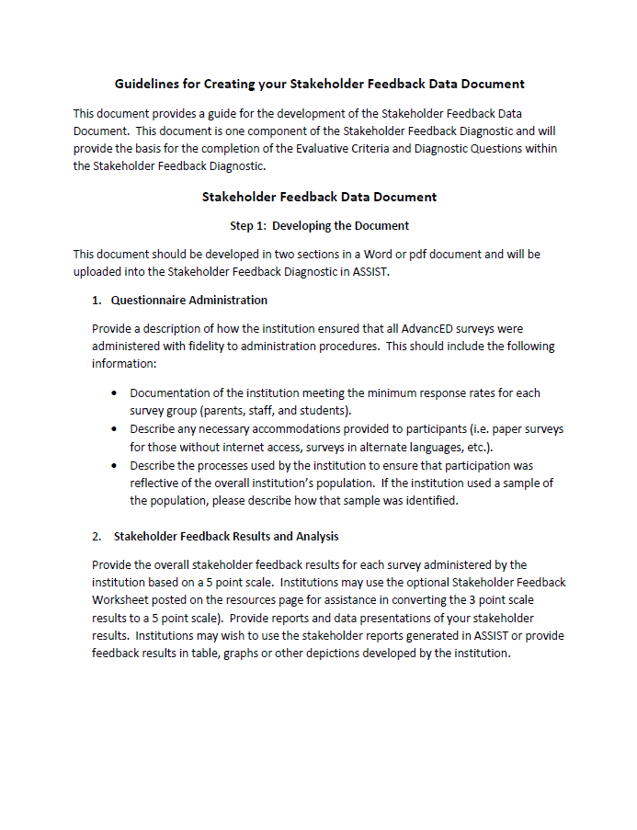
Creating the Stakeholder Feedback Data Document

Slide 61
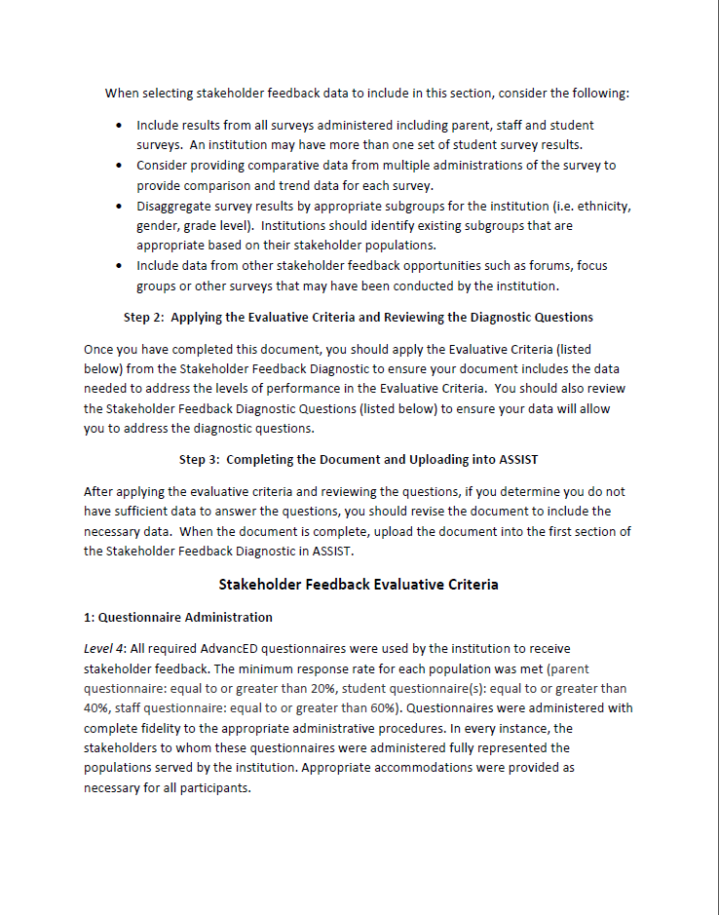
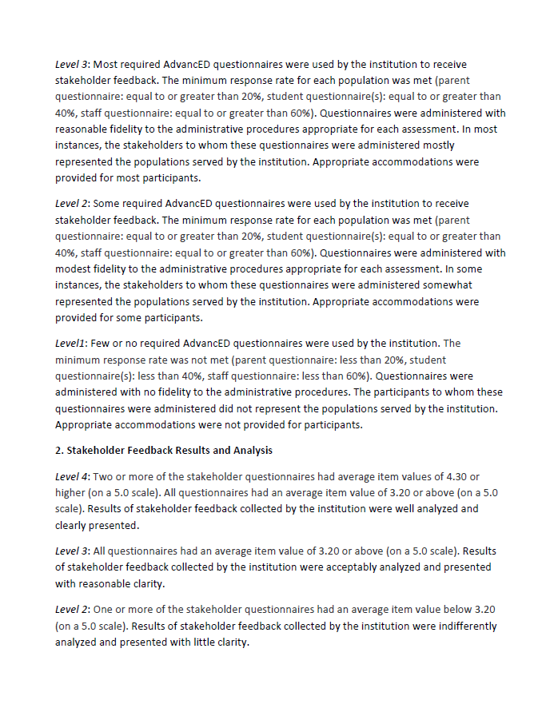

Slide 62
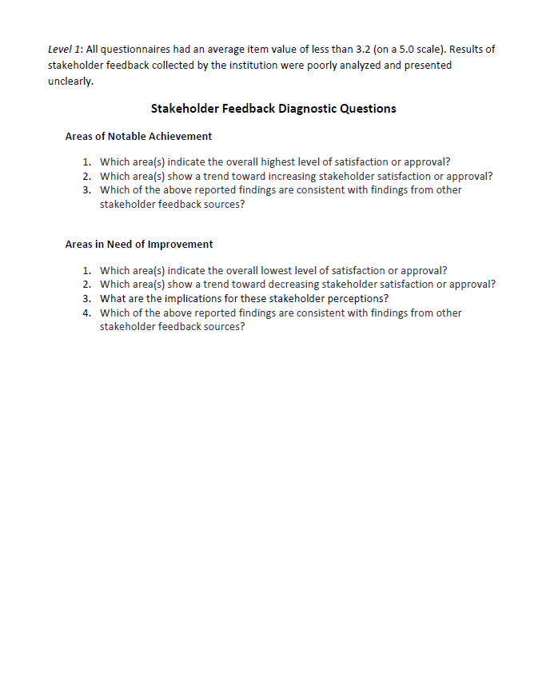

Slide 63
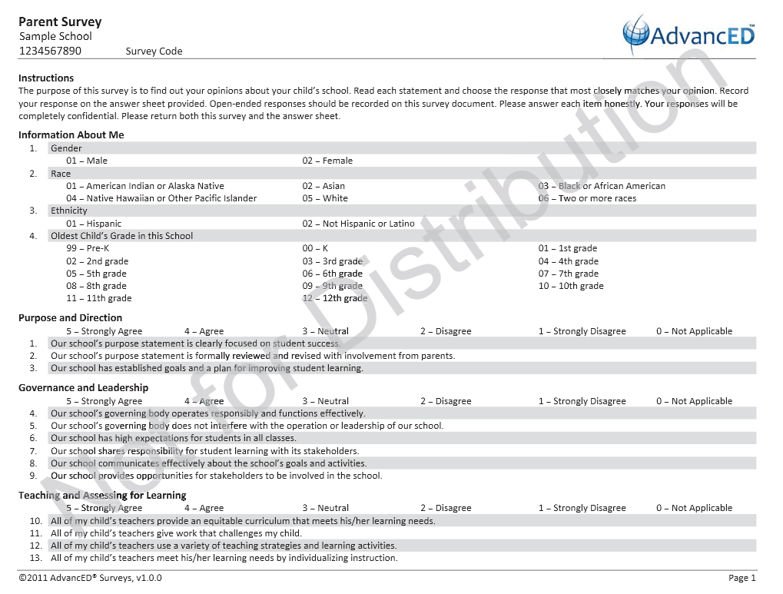

Slide 64
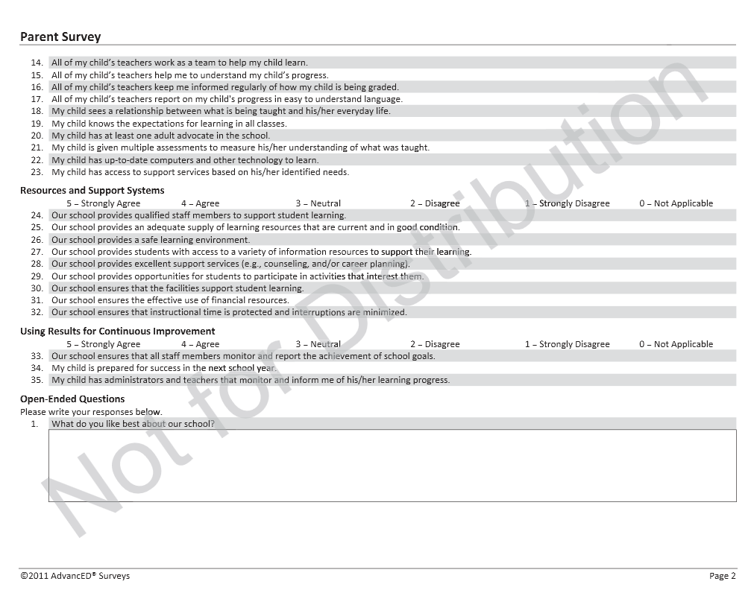

Slide 65
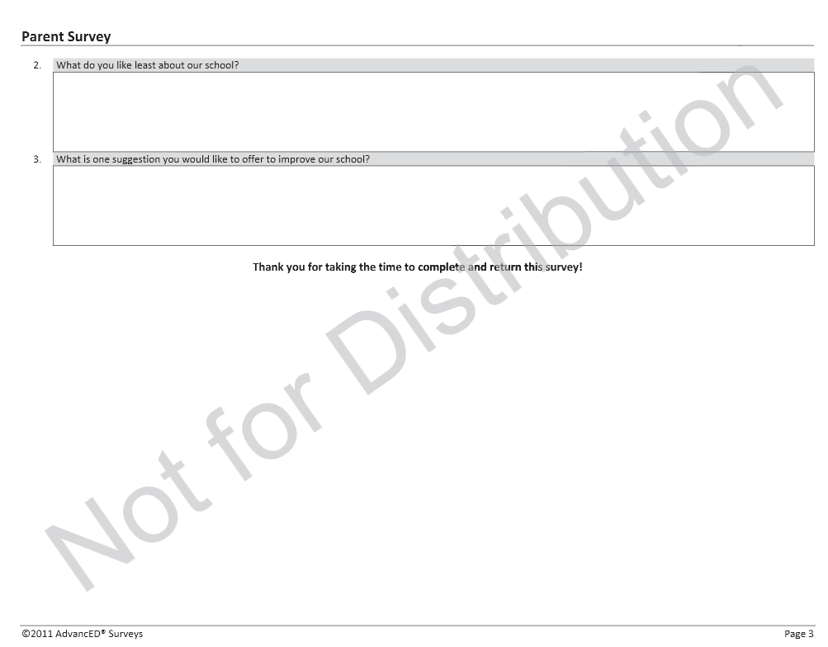

Slide 66
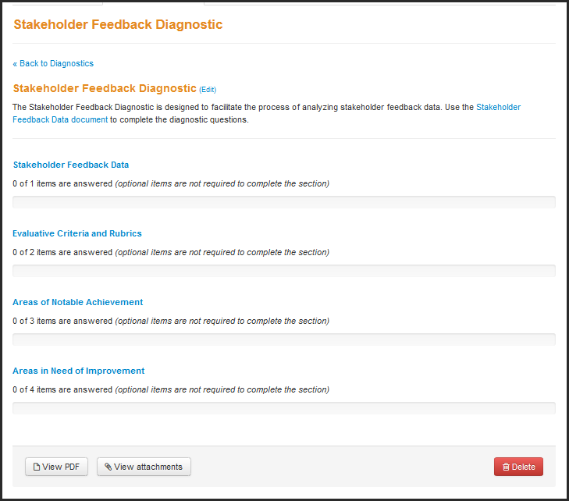

Slide 67
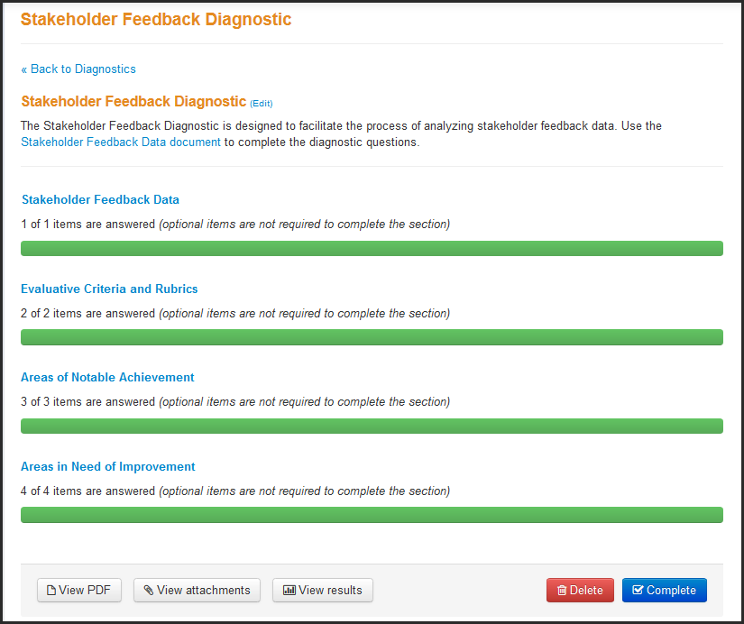
Click edit to change the name of the diagnostic

Slide 69
Tools
Technical Guide: Administering Diagnostics
Technical Guide: Administering Stakeholder Surveys
Guide to Administering Surveys and Generalizing Survey Results
Guidelines for Creating the Stakeholder Feedback Data Document
Instructions for Administering Paper Surveys
www.advanc-ed.org/assistresources
www.advanc-ed.org/schoolresources
Notes:
Here are some excellent tools and resources for schools.

Slide 70
Continuous Improvement
How might the Stakeholder Feedback Diagnostic become part of your continuous improvement process?

Slide 71
Assurances
AdvancED School Assurances for Continuous Improvement
ASSURANCES
Notes:
For this session, you will need the Learning Guide and the Abbreviated Standards.
Do introductions, audience demographics (characteristics) and some type of ice-breaker
If the audience is large, have them introduce themselves to 2-3 people in the room that they don’t know – make them walk around to do this. Provide a 3 minute time limit. If time is an issue, have them take a few minutes to introduce themselves to the rest of their table group or to the people around them (if seated theater style).
Why the changes? Just as we ask our schools to continue to improve, AdvancED continuously seeks to improve the accreditation process based on research and feedback from our schools and districts as well as to provide schools with increasingly helpful and effective resources and tools.

Slide 72
Assurances
Respond to the AdvancED and other applicable assurances
Upload documents and cite evidence where appropriate
Assurances not met will result in a Required Action

Slide 73
The AdvancED Assurances
Complies with AdvancED policies and procedures
Reports all substantive changes
Has a written crisis and security management plan
Monitors financial transactions – audit system
Engages in continuous improvement and implements an improvement plan
Notes:
The institution has read, understands, and complies with the AdvancED Policies and Procedures.
The institution has reported all substantive changes in the institution that affect the scope and/or has an impact on the school's ability to meet the AdvancED
Restructuring (merging, opening, or closing) of the institution or institution(s) within its jurisdiction.
* Mission and purpose of the institution
* Governance structure of the institution including changing to a charter school/school system, being the subject of a state takeover, or a change in ownership
* Grade levels served by the institution
* Staffing, including administrative and other non-teaching professionals personnel
* Available facilities, including upkeep and maintenance
* Level of funding
* School day or school year
* Establishment of an additional location geographically apart from the main campus
* Student population that causes program or staffing modification(s)
Available programs, including fine arts, practical arts and student activities
The institution possesses a written security and crisis management plan which includes emergency evacuation procedures and appropriate training for stakeholders.
The institution monitors all financial transactions through a recognized, regularly audited accounting system.
The institution engages in a continuous improvement process and is implementing an improvement plan. If this plan is not located in the Adaptive System of School Improvement Support Tools (ASSIST) provided by AdvancED, please attach the improvement plan to this Assurance.
In some cases, institutions with partner agencies or some states may have additional assurances to complete. Know before you go!
For additional resources, see the Technical Guide: Completing Assurances at www.advanc-ed.org/assistresources.

Slide 74
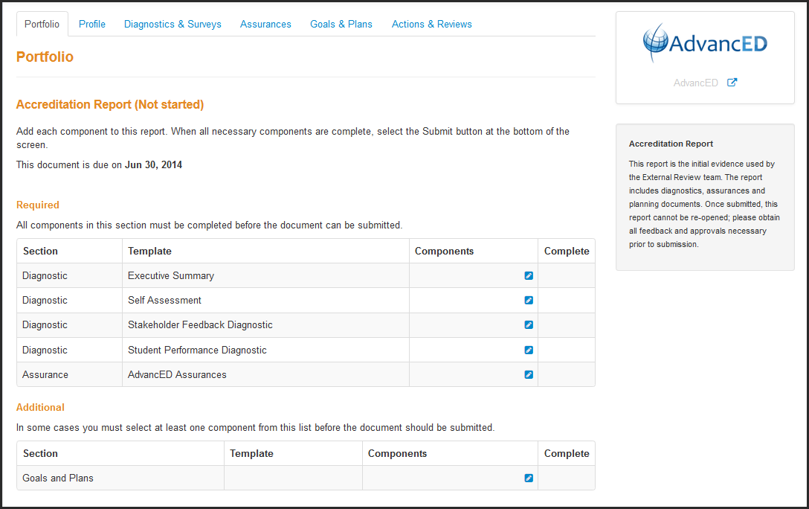

Slide 75
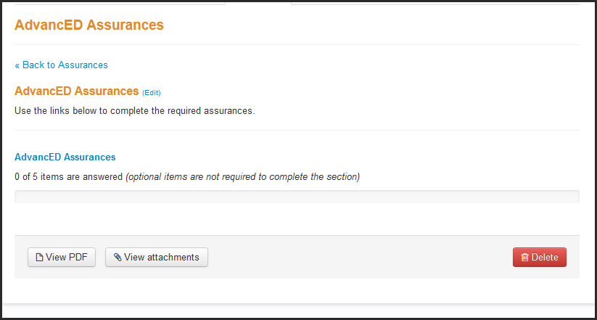

Slide 76
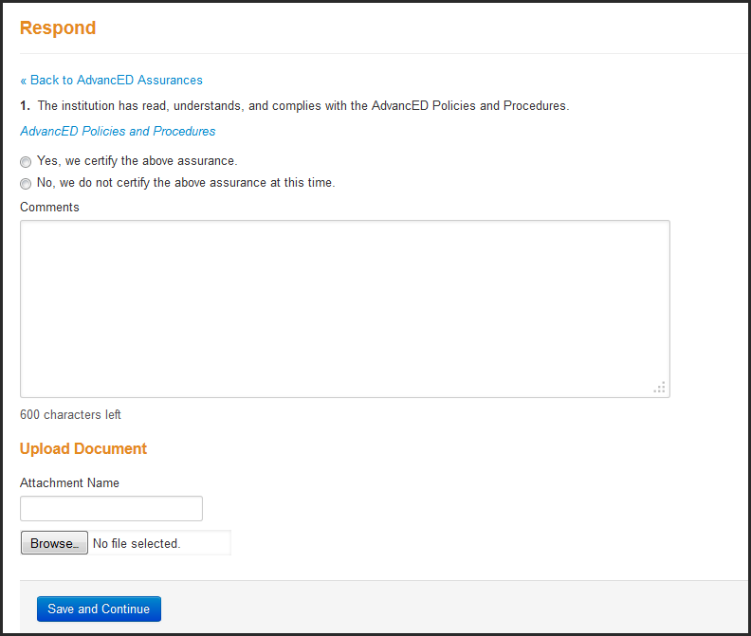

Slide 77
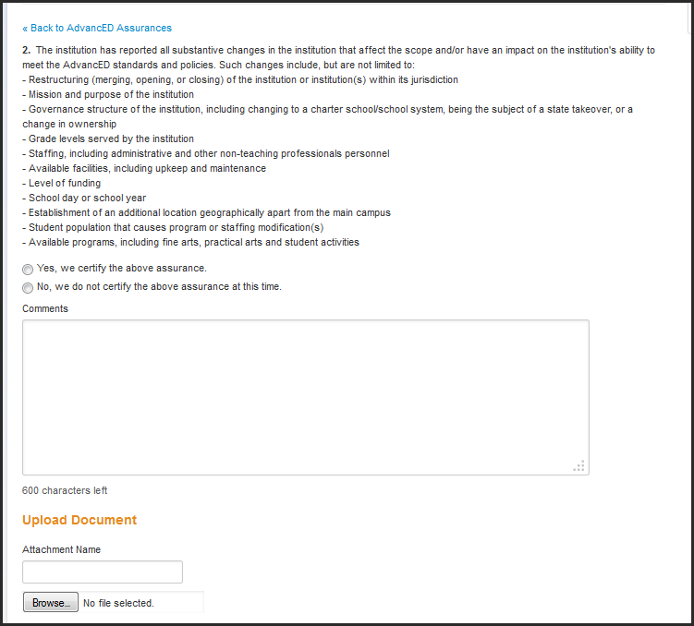

Slide 78
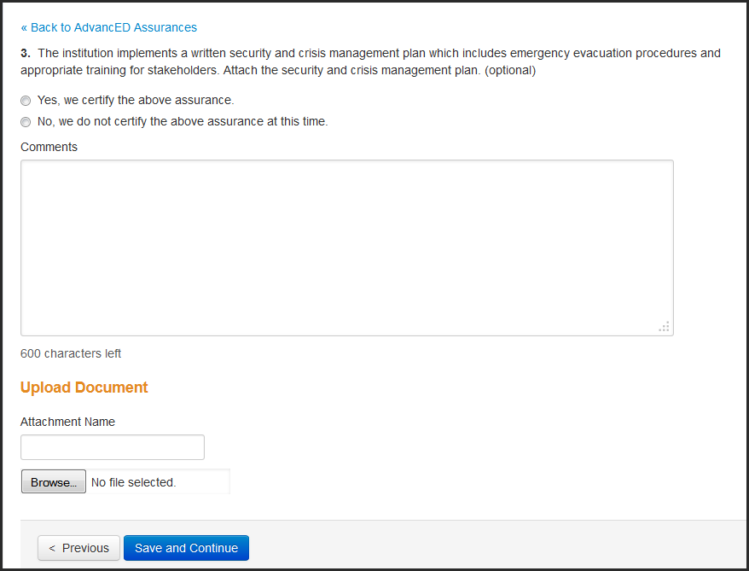

Slide 79
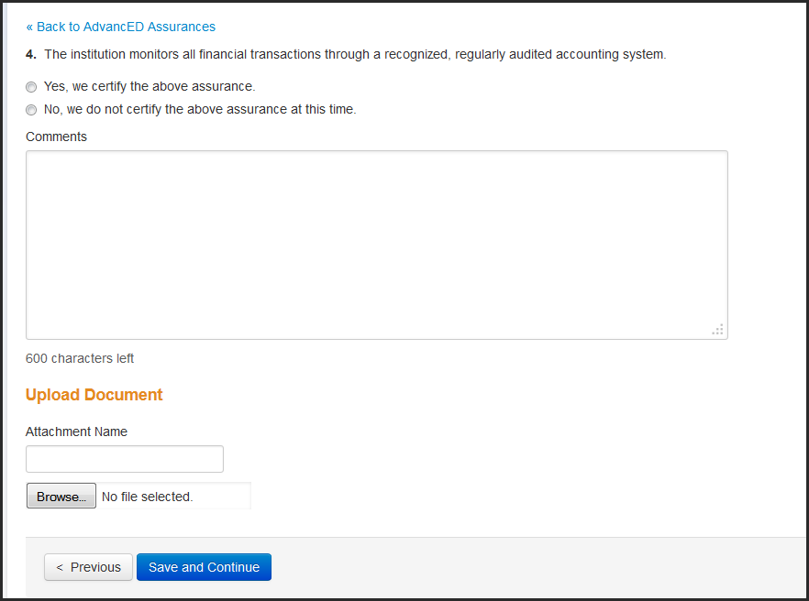

Slide 80
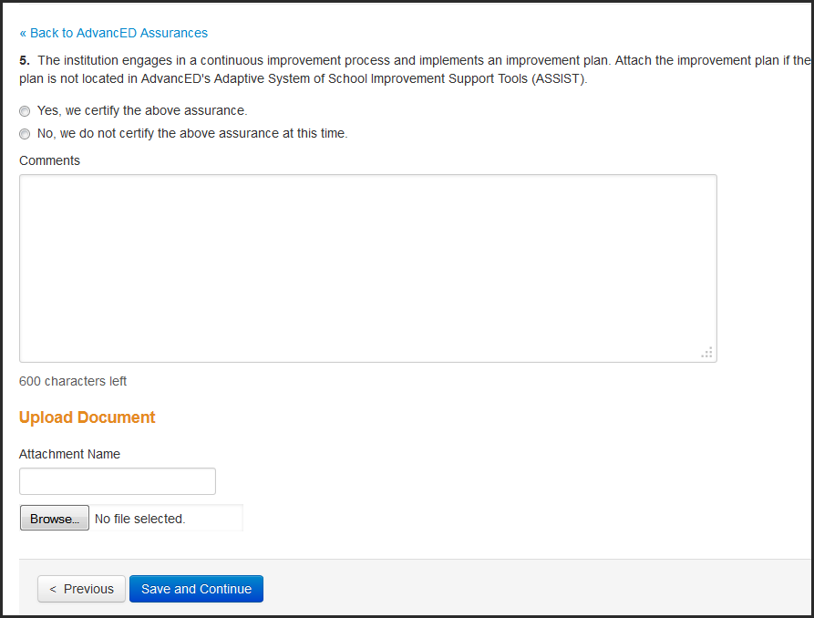

Slide 81
Stakeholder Feedback
AdvancED Improvement Plan for Continuous Improvement
IMPROVEMENT PLAN
Notes:
For this session, you will need the Learning Guide and the Abbreviated Standards.
Do introductions, audience demographics (characteristics) and some type of ice-breaker
If the audience is large, have them introduce themselves to 2-3 people in the room that they don’t know – make them walk around to do this. Provide a 3 minute time limit. If time is an issue, have them take a few minutes to introduce themselves to the rest of their table group or to the people around them (if seated theater style).
Why the changes? Just as we ask our schools to continue to improve, AdvancED continuously seeks to improve the accreditation process based on research and feedback from our schools and districts as well as to provide schools with increasingly helpful and effective resources and tools.

Slide 82
A Quality Improvement Plan
Aligns improvement goals with diagnostic results
Requires collaboration
Focuses on manageable number of priorities
Builds shared commitment to purpose and direction
Communicates purpose and direction clearly to others
Results in student achievement gains

Slide 83
Goals and Improvement Plan
Develop and implement a comprehensive plan
Document goals based on data collected from Self Assessment, Student Performance, Stakeholder Feedback surveys
Use to inform and guide continuous improvement
Monitor impact and analyze results
Use ASSISTTM or upload your own
Includes goals, objectives, strategies, and activities
The plan serves as a blueprint or road map
Technical Guide: Building & Managing Goals & Plans
www.advanc-ed.org/assistresources
Notes:
One of the most important things to understand about an improvement plan is – that it does not realize its potential benefit until it is implemented, monitored, analyzed and modified to maximize results.
The plan is not an end in itself but rather the blueprint or road map for a meaningful improvement journey. The plan should be informed by data. The AdvancED diagnostic suite provides a rich base of data/information from which to craft a relevant improvement plan.
AdvancED does not require a specific improvement plan framework. There are many out there and we do not want schools to duplicate efforts – especially if your state , district or funding sources require a designated format.
We do expect that the plan will be comprehensive – containing key elements regardless of the number of steps it contains or its format.
You may use the “Goal and Plan” tab in ASSIST (AdvancED’s electronic platform) or you may use your own design and upload your plan in the Assurances section (within ASSIST). (This will be shown to you in a section of the workshop especially designed to illustrate ASSIST.)
Either way is good as long as an improvement plan is submitted and available for review. As you will recall, the improvement plan is a requirement of accreditation.
For additional resources, see the Technical Guide: Building & Managing Goals & Plans at www.advanc-ed.org/assistresources.

Slide 84
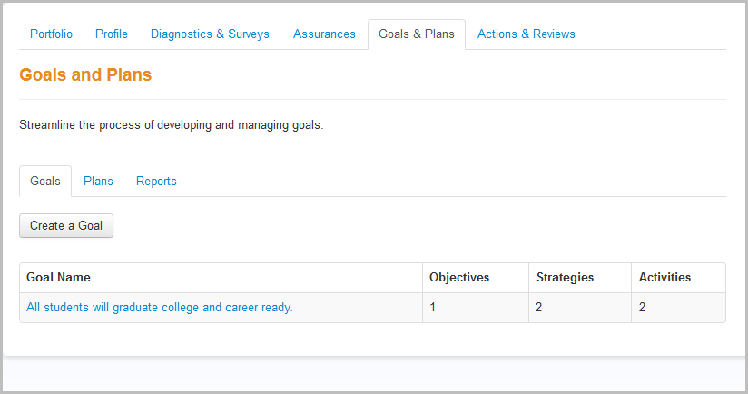
ASSIST – Goals and Plans

Slide 85
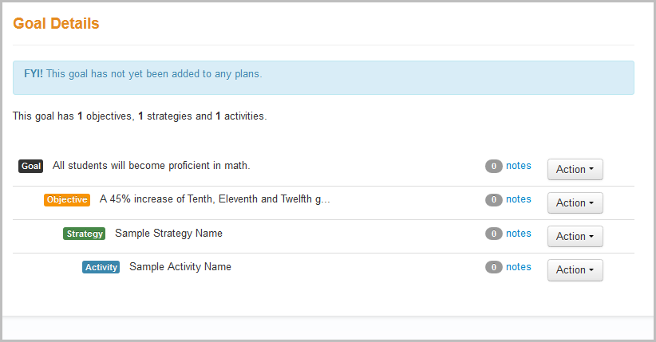
ASSIST – Goals and Plans

Slide 86
Executive Summary
AdvancED School
Executive Summary for Continuous Improvement
EXECUTIVE SUMMARY
Notes:
For this session, you will need the Learning Guide and the Abbreviated Standards.
Do introductions, audience demographics (characteristics) and some type of ice-breaker
If the audience is large, have them introduce themselves to 2-3 people in the room that they don’t know – make them walk around to do this. Provide a 3 minute time limit. If time is an issue, have them take a few minutes to introduce themselves to the rest of their table group or to the people around them (if seated theater style).
Why the changes? Just as we ask our schools to continue to improve, AdvancED continuously seeks to improve the accreditation process based on research and feedback from our schools and districts as well as to provide schools with increasingly helpful and effective resources and tools.

Slide 87
Executive Summary “Telling the Story”
Describe and celebrate who you are
Define the institution’s purpose and direction
Identify achievements, accomplishments and challenges
Incorporate additional information
*The Executive Summary is available at “Find An Accredited Institution” (www.advanc-ed.org)

Slide 88
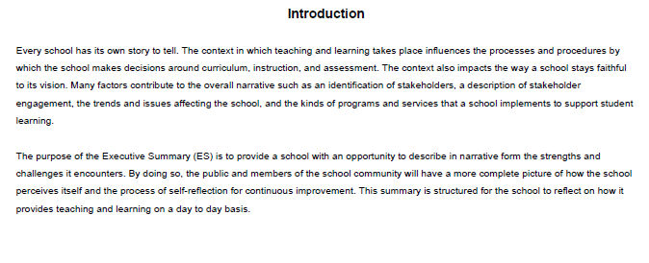
Executive Summary: High School

Slide 89



Slide 90
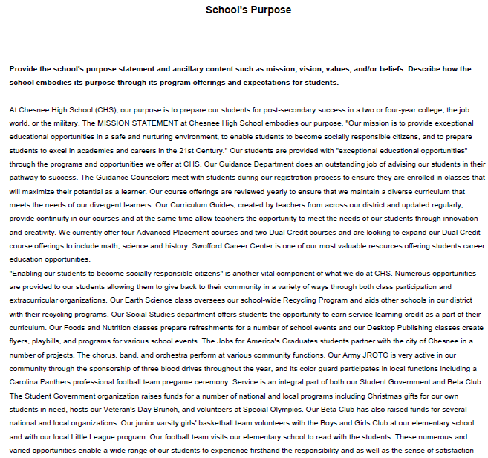

Slide 91



Slide 92
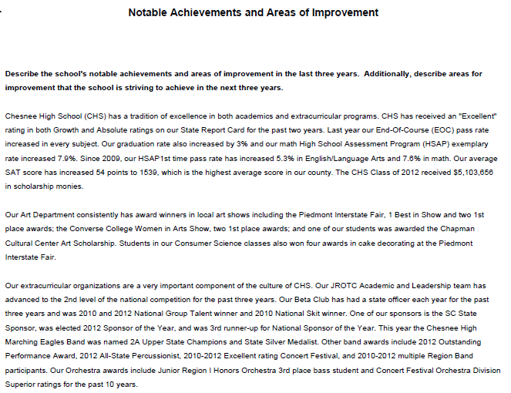

Slide 93


Slide 94


Slide 95
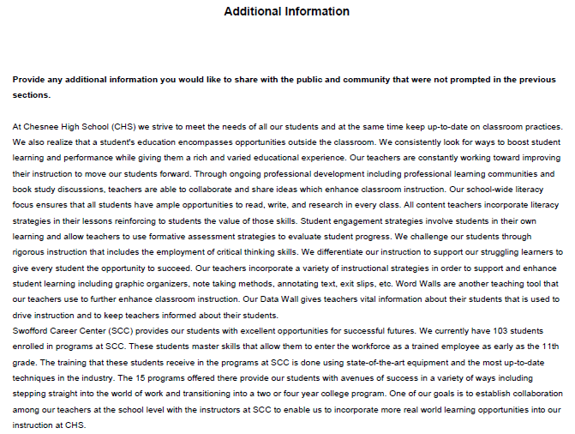

Slide 96
Applied Practice #3: Executive Summary Review
Locate a System Executive Summary at “Find Accredited Schools” at www.advanc-ed.org
Critique each section. Does the school present:
A clear picture of the system’s demographics?
A clearly stated purpose and direction?
A thorough description of achievements and challenges?
Critical information to enhance understanding?
What suggestions would you make to enhance this summary?

Slide 97
Continuous Improvement
How might the Executive Summary become part of your continuous improvement process?

Slide 98
ASSIST Overview – “Hands On”
We will now spend about 30 minutes going over how to access each of the following ASSIST components:
Profile
Demographics
Executive Summary
Self Assessment
Student Performance
Stakeholder Feedback
Improvement Plan
Assurances

Slide 99
The AdvancED External Review for Continuous Improvement
EXTERNAL REVIEW
Notes:
Learning Guide
Any additional items taken from resources and tools page (all or in part) to enrich a message or facilitate an activity.
Participant Materials:
PowerPoint slide deck (Hide activity slides . If you add any, hide them as well.)
Standards packet
Provide first two narrative pages of concept map as they provide excellent definitions and information.
Provide and use a handout with standards and indicators for the activity on themes and the standards jigsaw activity.
Provide a section of the concept map (1 standard and 2-3 indicators) to illustrate the format and use it for performance level activity – or provide the holistic rubrics with concepts synthesized. (workbook) The entire performance level presents the learner with a more challenging activity whole the concept approaches illustrates the tool and its use.
Sample Schedule – External Review
Planning Tool
Do introductions, audience demographics (characteristics) and some type of ice-breaker

Slide 100

Important Deadlines
Complete Internal Review and submit all diagnostic results with evidence in the Portfolio (ASSIST) at least 4 weeks prior to External Review.
Notes:
This is a good lead in to ASSIST. Now that the school has completed the Internal Review and diagnostics – how do they submit it so the External Review team and AdvancED have access to it. The answer is ASSIST.

Slide 101
The External Review
Provides a sustainable, stable, systemic process of continuous improvement
Provides an institution with the opportunity to identify and leverage its strengths
Provides objective, meaningful, evidence based feedback that stimulates and drives improvement
Notes:
External review is what sets accreditation apart from other improvement processes
It is important to explain that the team is comprised of professionals - people / peers who know and can relate to school /institution life – including the joys and challenges!
Be sure to stress that the Lead Evaluator has been through comprehensive training and team members are well prepared and trained prior to the review. (Feel free to elaborate on the chair and team member training.)
Make sure participants understand that the purpose of the review is multi-faceted. It is designed and intended to ……
Verify the extent to which the institution has met the requirements and fulfilled the expectations of accreditation (recognition and validation)
Honor the institution for its efforts and successes. (celebrate)
Discover and highlight what the institution does well as well as identify where it needs to/can improve.
Provide the institution with evidence based feedback …… tied to the standards and indicators.
No matter how good the system is ……The team has an obligation and responsibility to help the system improve!

Slide 102
External Review
An emphasis on
Standard indicators
Classroom observations
Focus on learner and learning environment
Evaluation of evidence
Interviews, observations, artifacts
Quality and relevance
Dialogue and deliberation
Notes:
For those familiar with the way we did things in the past – this highlights some of the improvements that will be evident throughout the review and incorporated into the findings/final report.
Systems will want to know that the focus is on individual indicators – not the standard as a whole. The team will spend more time (at schools) observing the learner and the learning environment and less time in structured interviews.
They will also devote more on-site time to dialogue and deliberation rather than narrative writing.

Slide 103
ELEOT – Effective Learning Environment Observation Tool
Focuses on observed student behaviors
Looks at patterns and trends, not individual classrooms
Used as one piece of evidence (to corroborate other evidence regarding learning)
Summary results are reported in Oral Exit Report and External Review Report
Notes:
A copy of the instrument is in your learning guide.

Slide 104
ELEOT Learning Environments
Equitable Learning Environment
High Expectations Environment
Supportive Learning Environment
Active Learning Environment
Progress Monitoring and Feedback Environment
Well-Managed Learning Environment
Digital Learning Environment

Slide 105
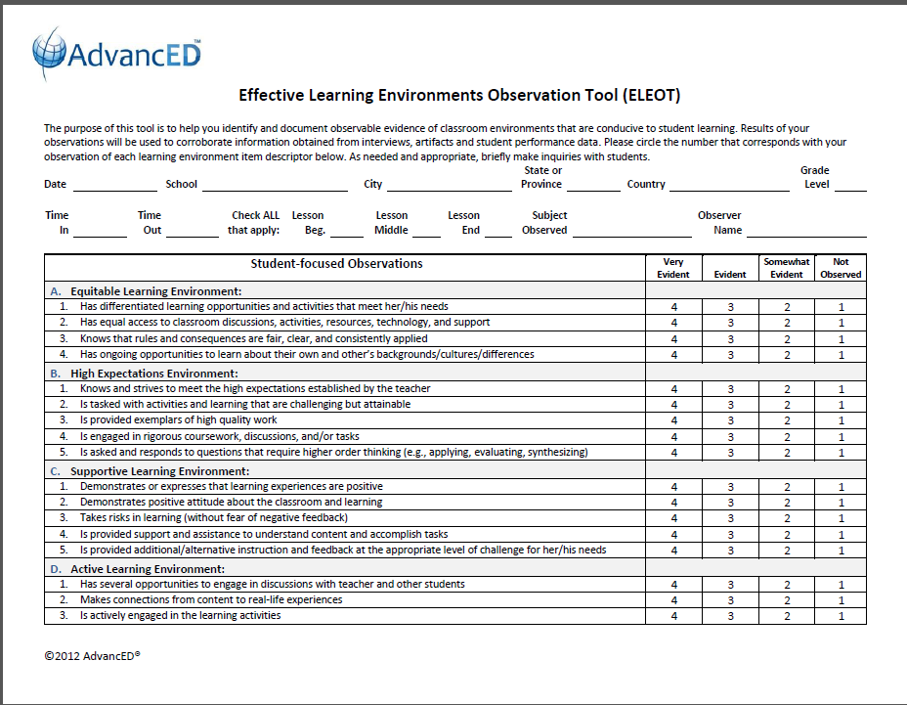
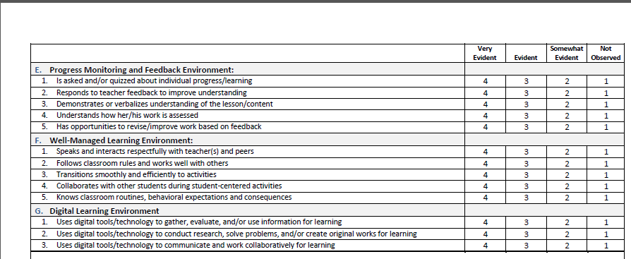

Slide 106
External Review Team Actions
Off-Site
Reviews school diagnostics, improvement plan, website, etc.
On-Site
Conducts comprehensive two-day review
Participates in school’s overview and presentations
Conducts stakeholder interviews
Collects and analyzes data
Observes learning environments
Verifies school’s evidence and diagnostics
Engages in deliberations, discussions and decisions
Communicates findings
Notes:
It will be important to share the concept of “off-site” work. Explain the team will review and think about the system’s diagnostics prior to the on-site portion of the review. This will give them a foundation of information and basic understanding (on paper) of practices. It also provides more on-site time to verify evidence and engage in deliberation. This will help them to be prepared when they arrive on site and collaborate with the entire team.
Details of the review will follow, but this slide helps to articulate a picture of the experience and give them the context they need for preparing for the visit and for hosting the team.
Systems need to understand that the review team will use diagnostic data the system has supplied (executive summary, standards assessment, stakeholder feedback, student performance). In addition they will collect data during the review by listening to presentations, interviewing stakeholders, observing the learning environment and reviewing artifacts.
The team will spend time reviewing all of the data – verifying the school’s findings, deliberating over what their data showed and making determinations as to the system’s performance and actions required for improvement.

Slide 107
External Review Team Members
Team size determined by the size of the school and the state/regional office
Lead Evaluator and team members are assigned by AdvancED state/regional office
Team members must complete Team Member Training (eLearning) and ELEOT certification

Slide 108
IEQ: The Index of Educational Quality
Represents a move away from a system of labels and statuses to a reporting process that is more descriptive of the actual quality and performance of an institution
Balances both quantitative data such as student performance data with qualitative data about the processes of schooling
Provides a more descriptive picture of the overall performance of a school in relation to standards, student performance and stakeholder perceptions
Generates an overall index score for the institution that is derived from the scores for standards, student performance and stakeholder perceptions
Notes:
Before the team leaves – they will give an oral report. You may invite whomever you want (stakeholders) to attend. After the team leaves, they will craft a comprehensive written report. It will contain their findings
Standards and Indicator Findings
Indicators evaluated individually, with a performance level and sources of evidence
Scores roll up to arrive at overall standard score
Promising Practices
Something the school does really well, supported with evidence and rationale
Link to an indicator(s)
Opportunities for Improvement
“Something” the school can improve, supported with evidence and rationale
Link to an indicator(s)
Learning Environment
(Student Performance, Observations)
Stakeholder Perceptions
Conclusion
Summary of Findings
Narrative summarizes overall organizational and instructional effectiveness
References how the school performed (standards, stakeholder perceptions, student performance
Required Actions
Something” the school really needs to work on
Supported by evidence with rationale
Must link to an indicator (Level 1 must be an RA)
No limit to the number of Required Actions
School is held accountable

Slide 109
IEQ: The Index of Educational Quality
Predicated on the use of a set of performance levels based on a scale of 1 to 4.
Includes scores from
Indicators (33)
Evaluative Criteria
Student Performance Evaluation (4)
Stakeholder Feedback Evaluation (2)
Notes:
Before the team leaves – they will give an oral report. You may invite whomever you want (stakeholders) to attend. After the team leaves, they will craft a comprehensive written report. It will contain their findings
Standards and Indicator Findings
Indicators evaluated individually, with a performance level and sources of evidence
Scores roll up to arrive at overall standard score
Promising Practices
Something the school does really well, supported with evidence and rationale
Link to an indicator(s)
Opportunities for Improvement
“Something” the school can improve, supported with evidence and rationale
Link to an indicator(s)
Learning Environment
(Student Performance, Observations)
Stakeholder Perceptions
Conclusion
Summary of Findings
Narrative summarizes overall organizational and instructional effectiveness
References how the school performed (standards, stakeholder perceptions, student performance
Required Actions
Something” the school really needs to work on
Supported by evidence with rationale
Must link to an indicator (Level 1 must be an RA)
No limit to the number of Required Actions
School is held accountable

Slide 110
IEQ: The Index of Educational Quality
The relative values of the three components (containing a total of 39 measures) form one overall “accreditation score” upon which the Commission will base its accreditation decision.
Notes:
Before the team leaves – they will give an oral report. You may invite whomever you want (stakeholders) to attend. After the team leaves, they will craft a comprehensive written report. It will contain their findings
Standards and Indicator Findings
Indicators evaluated individually, with a performance level and sources of evidence
Scores roll up to arrive at overall standard score
Promising Practices
Something the school does really well, supported with evidence and rationale
Link to an indicator(s)
Opportunities for Improvement
“Something” the school can improve, supported with evidence and rationale
Link to an indicator(s)
Learning Environment
(Student Performance, Observations)
Stakeholder Perceptions
Conclusion
Summary of Findings
Narrative summarizes overall organizational and instructional effectiveness
References how the school performed (standards, stakeholder perceptions, student performance
Required Actions
Something” the school really needs to work on
Supported by evidence with rationale
Must link to an indicator (Level 1 must be an RA)
No limit to the number of Required Actions
School is held accountable

Slide 111

IEQ: The Index of Educational Quality
Notes:
Before the team leaves – they will give an oral report. You may invite whomever you want (stakeholders) to attend. After the team leaves, they will craft a comprehensive written report. It will contain their findings
Standards and Indicator Findings
Indicators evaluated individually, with a performance level and sources of evidence
Scores roll up to arrive at overall standard score
Promising Practices
Something the school does really well, supported with evidence and rationale
Link to an indicator(s)
Opportunities for Improvement
“Something” the school can improve, supported with evidence and rationale
Link to an indicator(s)
Learning Environment
(Student Performance, Observations)
Stakeholder Perceptions
Conclusion
Summary of Findings
Narrative summarizes overall organizational and instructional effectiveness
References how the school performed (standards, stakeholder perceptions, student performance
Required Actions
Something” the school really needs to work on
Supported by evidence with rationale
Must link to an indicator (Level 1 must be an RA)
No limit to the number of Required Actions
School is held accountable

Slide 112
Index of Educational Quality
288
The Index of Educational Quality is a score between 100 and 400 that represents the overall status of the school or system as they progress through the continuous improvement cycle.
100
Index of Educational Quality
Based on all Evaluative Criteria
400

Slide 113
Index of Educational Quality
288
Every indicator from every Standard and from both the Stakeholder Feedback and the Student Performance Diagnostics are used in the computation of the Index of Educational Quality
100
Index of Educational Quality
Based on all Evaluative Criteria
400

Slide 114
Index of Educational Quality
288
100
Index of Educational Quality
Based on all Evaluative Criteria
400
321
100
Teaching and Learning Impact
Standards 3 and 5, Student Performance Evaluative Criteria
400
217
100
Leadership Capacity
Standards 1 and 2, Stakeholder Feedback Evaluative Criteria
400
300
100
Resource Utilization
Standard 4
400
Notes:
The Evaluative Criteria (Standards Indicators, Stakeholder Feedback and Student Performance ratings) are divided into three domains, Teaching and Learning Impact, Leadership Capacity, and Resource Utilization.
The Index of Educational Quality and it’s three domains provide the institution with a clear picture of their current reality and a roadmap toward excellence.
Teaching and Learning Impact consists of all Indicators in Standards 3 and 5, and the Student Performance Evaluative Criteria.
Leadership Capacity consists of all Indicators in Standards 1 and 2, and the Stakeholder Feedback Evaluative Criteria.
Resource Utilization consists of all Indicators in Standard 4.
You can see that there are 39 total criteria included in the IEQ (41 for systems), 21 of which are related to Teaching and Learning Impact, 11 related to Leadership Capacity (12 for systems), and 7 related to Resource Utilization (8 for systems).

Slide 115
Index of Educational Quality
288
100
Index of Educational Quality
Based on all Evaluative Criteria
400
321
100
Teaching and Learning Impact
Standards 3 and 5, Student Performance Evaluative Criteria
400
217
100
Leadership Capacity
Standards 1 and 2, Stakeholder Feedback Evaluative Criteria
400
300
100
Resource Utilization
Standard 4
400
Notes:
In the overall Index of Educational Quality, each indicator and evaluative criteria are worth equal points – none are weighted.
By design, the three domains are weighted. Teaching and Learning Impact consists of 21 indicators, which is almost ½ of the 39 (or 41) points, emphasizing the importance of this domain.
Reporting progress in this manner should help schools and systems focus on the area of most need.

Slide 116

Calculating the Index of Educational Quality
Notes:
This is a screen shot of the worksheet that will be used to calculate the Index of Educational Quality and each of the domains. As you enter the score for each indicator and evaluative criteria, the Index of Educational Quality and the score for each of the domains will automatically populate at the top of the page. You will use these numbers to report the IEQ.
The worksheets can be found on the Lead Evaluator Resource pages for the type of institution that is being reviewed.

Slide 117
Reporting the IEQ
The IEQ and the scores for each of the Domains will be reported in the Exit Report.
You may reference all of the scores in the narrative portion of your External Review Report.

Slide 118
Communicating Findings
Oral Exit Report
External Review Report
Standards
Learning Environment
Stakeholder Feedback
Student Performance
Conclusion
Summary of Findings
Required Actions
Addenda
Notes:
Before the team leaves – they will give an oral report. You may invite whomever you want (stakeholders) to attend. After the team leaves, they will craft a comprehensive written report. It will contain their findings
Standards and Indicator Findings
Indicators evaluated individually, with a performance level and sources of evidence
Scores roll up to arrive at overall standard score
Promising Practices
Something the school does really well, supported with evidence and rationale
Link to an indicator(s)
Opportunities for Improvement
“Something” the school can improve, supported with evidence and rationale
Link to an indicator(s)
Learning Environment
(Student Performance, Observations)
Stakeholder Perceptions
Conclusion
Summary of Findings
Narrative summarizes overall organizational and instructional effectiveness
References how the school performed (standards, stakeholder perceptions, student performance
Required Actions
Something” the school really needs to work on
Supported by evidence with rationale
Must link to an indicator (Level 1 must be an RA)
No limit to the number of Required Actions
School is held accountable

Slide 119
Decision on Accreditation
External Review Team reports results, not decisions
AdvancED state/regional office reviews and approves the External Review report
State/regional councils review and make a recommendation to the Commission
AdvancED Accreditation Commission grants accreditation
Notes:
Note: The Accreditation Leadership Team recommended that the Review Team can tell the school that they are “accredited pending review” by the State Council and Accreditation Commission.
Highlight that the team is not empowered to make accreditation status decisions . Commission grants status (January and June)
The ER Lead Evaluator may make a statement to the effect that “the institution is recommended to pursue accreditation for the next five year time period.”

Slide 120
Maintaining the Momentum for CONTINUOUS IMPROVEMENT
Notes:
For this session, you will need the Learning Guide and the Abbreviated Standards.
Do introductions, audience demographics (characteristics) and some type of ice-breaker
If the audience is large, have them introduce themselves to 2-3 people in the room that they don’t know – make them walk around to do this. Provide a 3 minute time limit. If time is an issue, have them take a few minutes to introduce themselves to the rest of their table group or to the people around them (if seated theater style).
Why the changes? Just as we ask our schools to continue to improve, AdvancED continuously seeks to improve the accreditation process based on research and feedback from our schools and districts as well as to provide schools with increasingly helpful and effective resources and tools.

Slide 121
Continuous Improvement
Maintaining a culture that supports continuous improvement requires
Engaging in self-reflection and internal review
Keeping stakeholders motivated and engaged
Monitoring and adjusting instructional and organizational practices
Responding to Required Actions and planning for ongoing improvement
Notes:
Review each of these important “After the Visit” initiatives.
While the first is required – the others are also essential for building commitment and legitimizing the process.
The essence of continuous improvement is that it is an ongoing, un-interrupted cycle of analysis and purposeful growth.
We want stakeholders to engage because they understand the value and not because they want to be compliant.
Responding to Required Actions ensures both accountability and thoughtful/meaningful improvement.

Slide 122

Paradigm Shift
In the past the External Review was viewed as a culminating event.
Now, the External Review is the foundation for continuous improvement.

Slide 123
The Future
Education occurs any time, any where
Learners of all ages continually increase their knowledge, skills, and dispositions for success
State and national performance standards are superseded by global performance expectations
Schools and districts participate in a global education arena with many education providers
The quest for improvement never ends
Notes:
From AdvancED Strategic Plan…..

Slide 124
Values Inherent in AdvancED Protocol
Effective processes are transparent, inclusive, honest, reflective and continual
Striving for improvement is an ongoing collective responsibility
Improvement efforts utilize best practice, research-based approaches, and reflective planning
Student achievement is enhanced and lives can be positively impacted

Slide 125
Questions?
Notes:
There’s not telling what questions you might get. If you don’t know the answer, get their name and email and we’ll send them a response (forward your questions along with the person’s name and email to David Hurst: dhurst@advanc-ed.org).

Slide 126


The power of education can change the world.

